Slide 1
Snow River Bridge: ARRC Superstructure Raise
CE A438 CED 2024.01
Presented by: UAAR Consultants
UAAR Consultants Inc.
April 26th, 2024
Notes:
Good morning everyone our project is the Snow river bridge, Alaska railroad Superstructure raise. Today Colby and I will be presenting the background and methodology of our project.

Slide 2
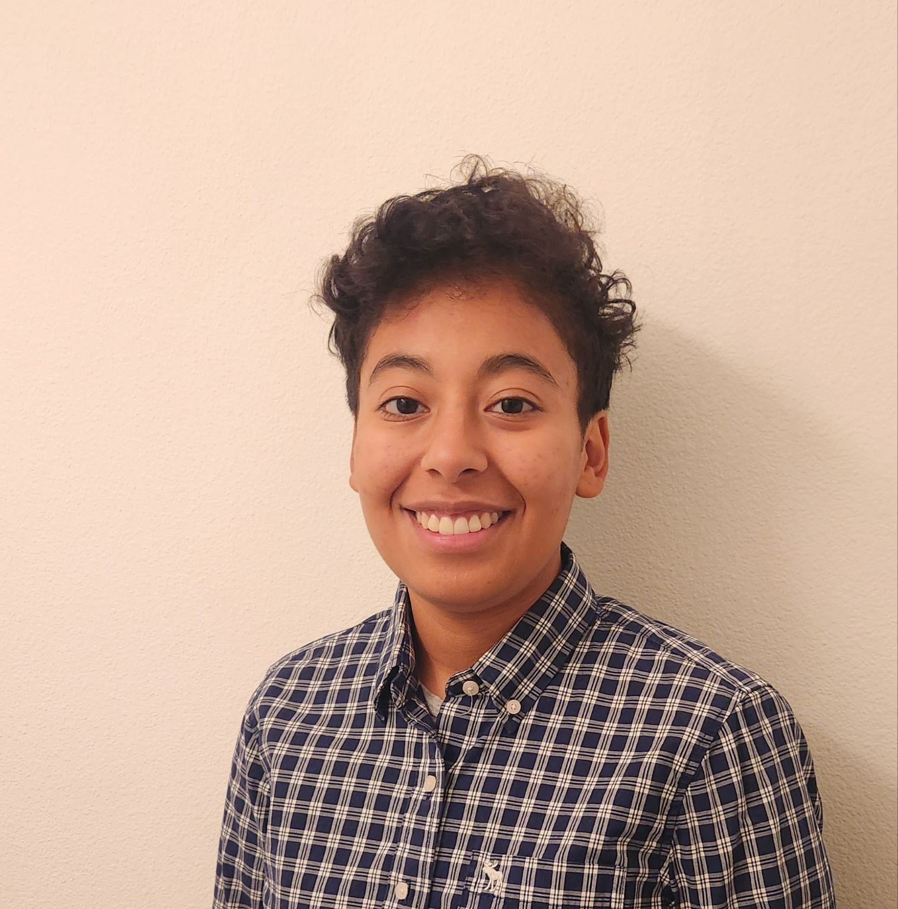
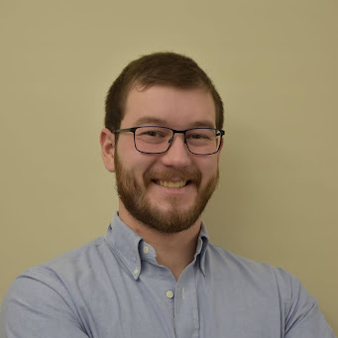
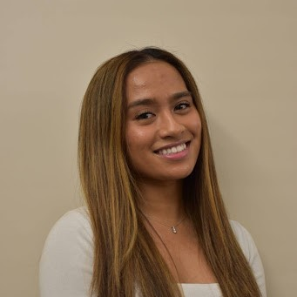
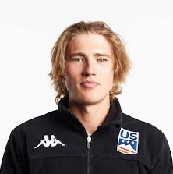
UAAR Team
Dianny Melgar, Project Manager
Colby Fletcher, Transportation Engineer
Nikka Macaraeg, Structural Engineer
Gus Schumacher, Hydrology & Geotech Engineer
Notes:
Here is our UAAR Team, (Do we need to read off everything?) ask Hamel

Slide 3
Client & Mentors
Client and Mentor: Brian O’Dowd, P.E., Director - Engineering Services
Professional Mentor: Anthony (Tony) Hafner, P.E.
Faculty Advisor: Scott Hamel, P.E., PhD
Notes:
These are our Client and Mentors that are guiding us through this project, Brian is with our Client which is the Alaska Railroad.
Our Professional Mentor, Tony, is with HDR, and our Project Advisor here at UAA is Dr. Scott Hamel.

Slide 4
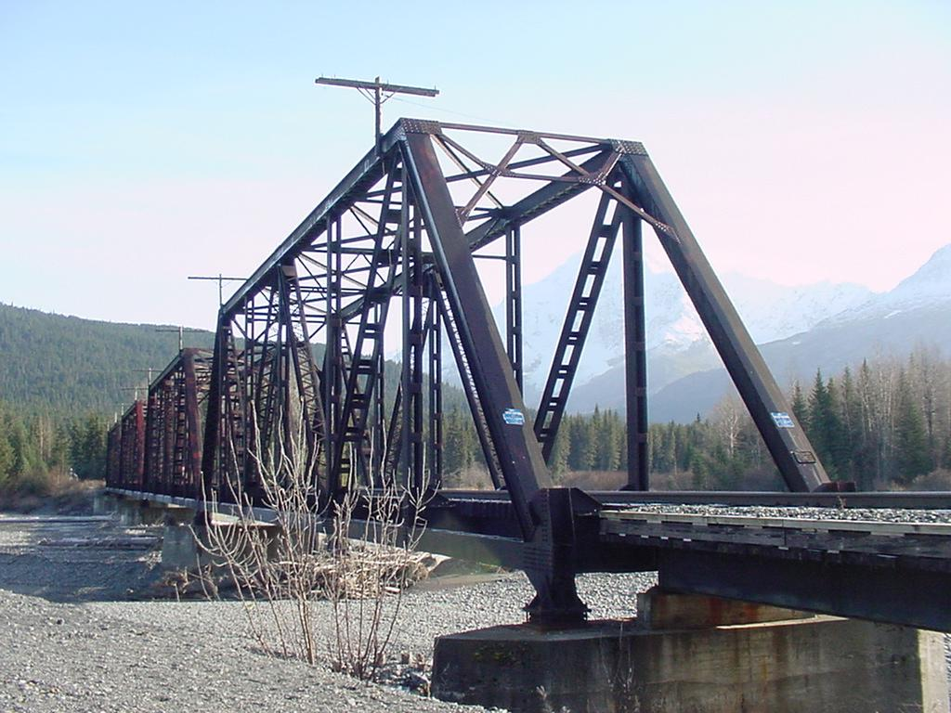
Overview
Background
Design Criteria
Alternative Designs
Preferred Alternative
Cost Estimate
c
14.5 bridge seen at a typical water level
Notes:
We are going to go into detail about the project background, scope, methodology, deliverables, schedule, and budget

Slide 5
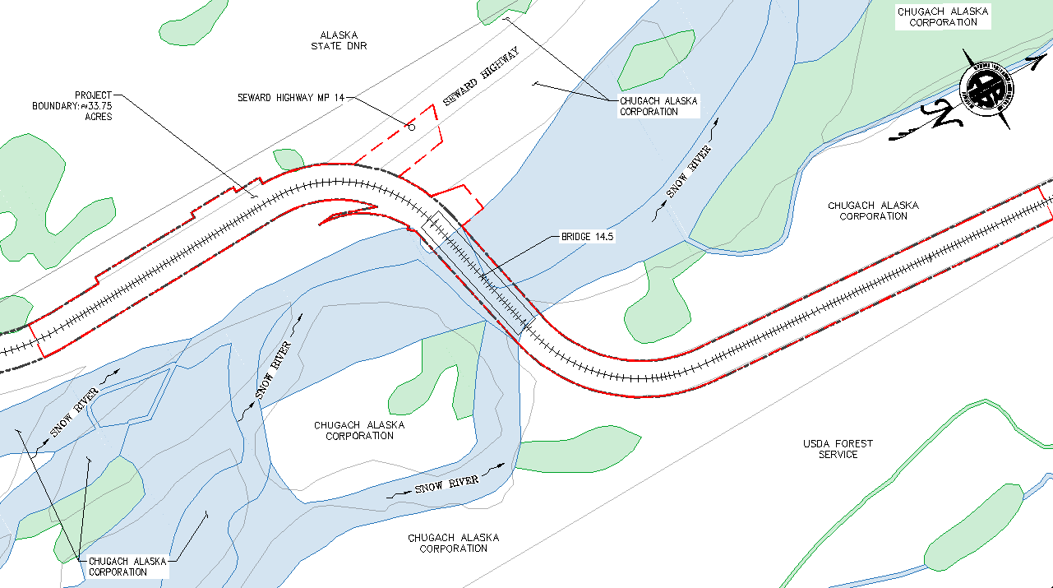
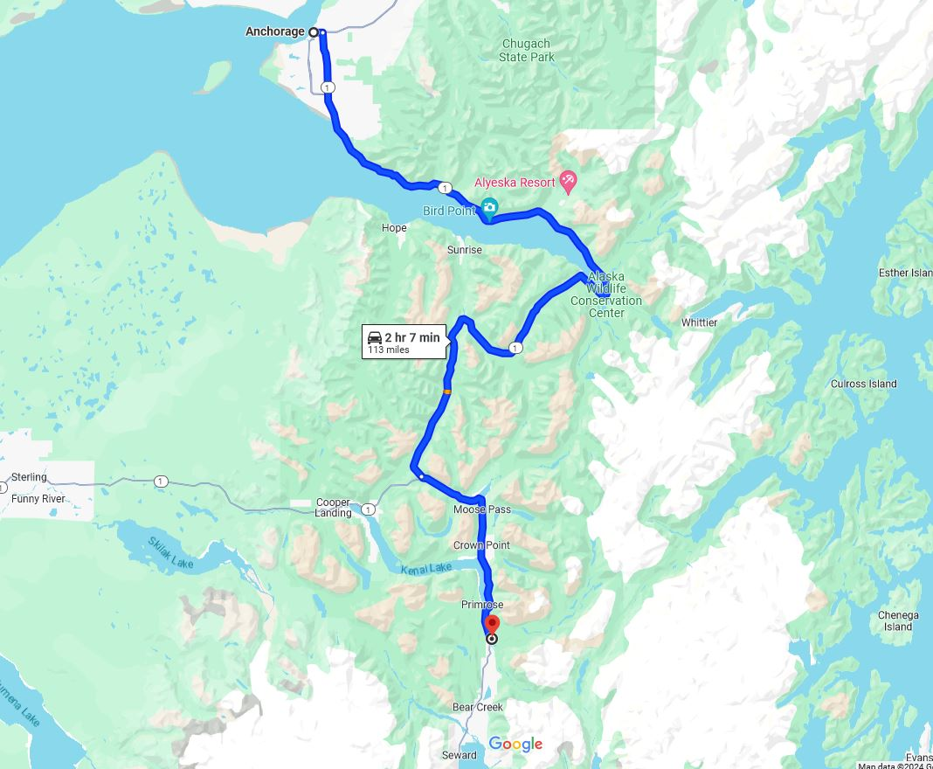
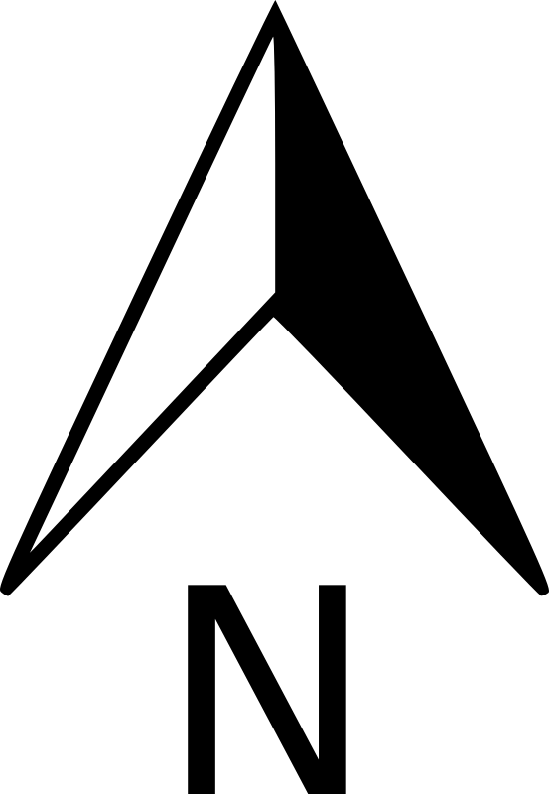
Location
Anchorage
2 hour 7 minute drive time along Seward Highway
ARRC Milepost 14.5
Provided by ARRC
Snow River Bridge
Seward
Notes:
So where are we? The Snow River bridge is located at the milepost 14.5 which is about a 2 hour drive from anchorage taking the Seward Highway

Slide 6
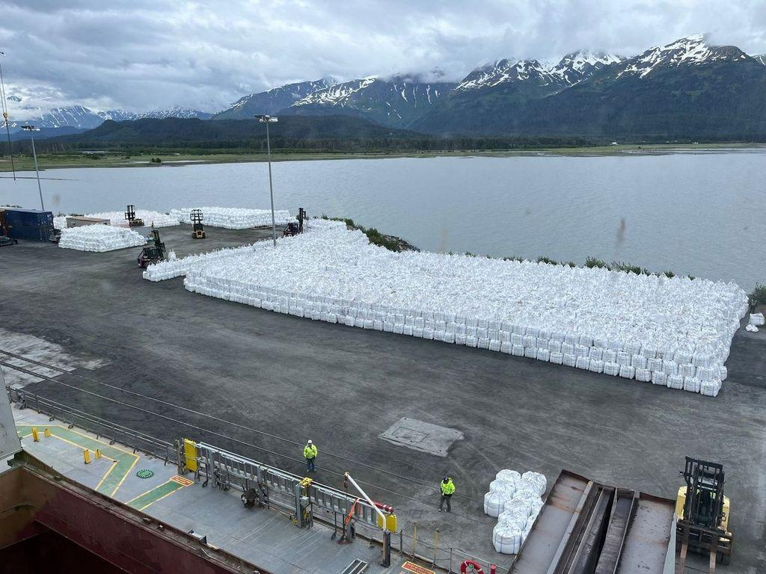
What is at Stake?
Freight
Economy
Transportation
Seward freight yard holding 1,000,000 pounds of frac sand
Notes:
The importance of the Alaska railroad can be seen through all the freight that it carries. It transportssupplies to rural areas, if the railroad is no longer able to get to these areas people and families will be affected and it will be that much harder for people to receive some of their basic necessities. It will also affect the economy since the railroad also takes passengers and tourists to their destinations. Anchorage port doesnt have the capacity to handle the quantity of supplies for the willow project. These materials cant be trucked either as it would be an insane amount of trucks causing wear and traffic on the roadway. WHittier cant receive the materials either as they dont have cranes. This is also a popular tourism route

Slide 7
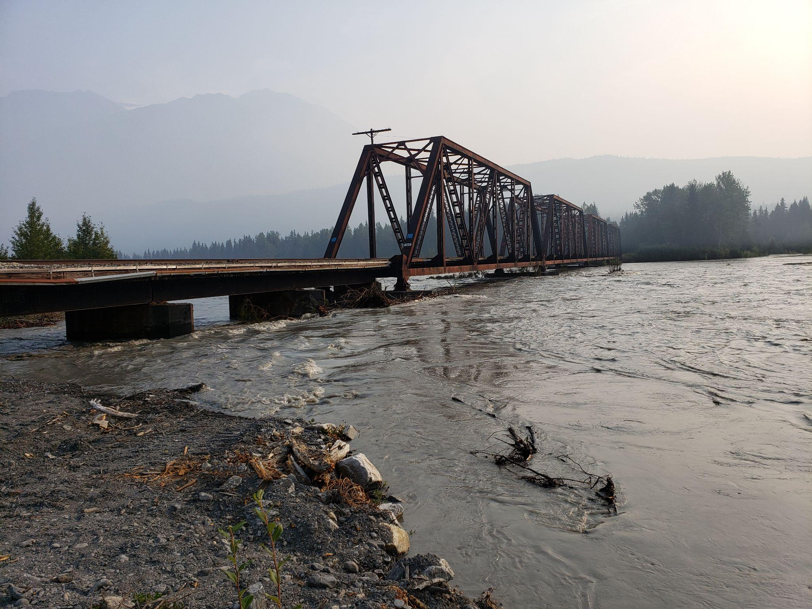
Project Problem
Jökulhlaups (Glacial lake outburst flood)
Structure at risk of overtopping
Low chord elevation is too low
Multiplate structure restricts clearance
Low chord
Bridge during 2019 flood
Notes:
The reason that this specific bridge needs to be addressed is due to the flooding that occurs in Snow River. Snow river is a glacial fed river that runs beneath the bridge in question and it is one of the first structures that the river encounters. You can see in this photo that the river is relatively close to the actual superstructure of the bridge.

Slide 9
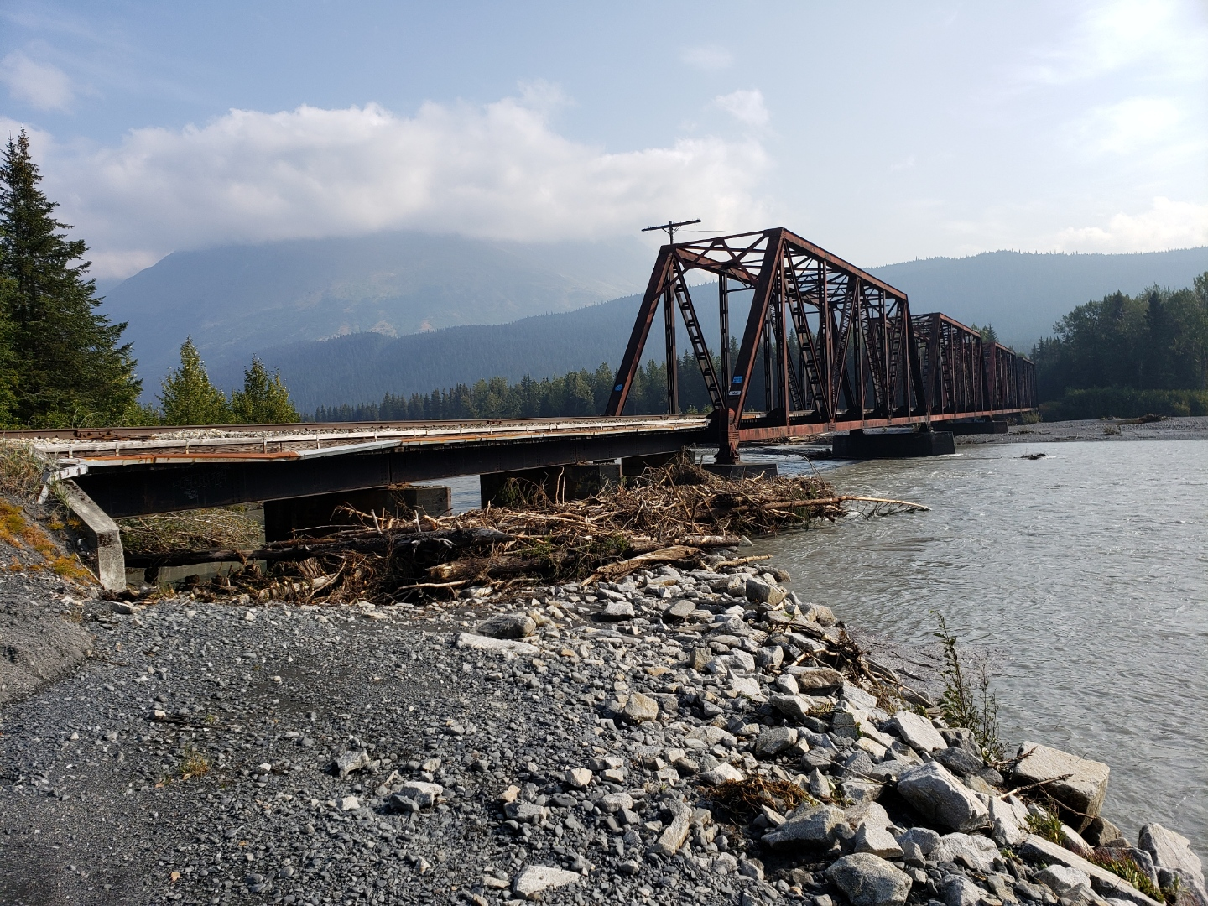
Bridge after the flood
Notes:
Here is a picture of the bridge from 2019 from the southern end. As you can see after peak flow there is debri built up against the bridge

Slide 10
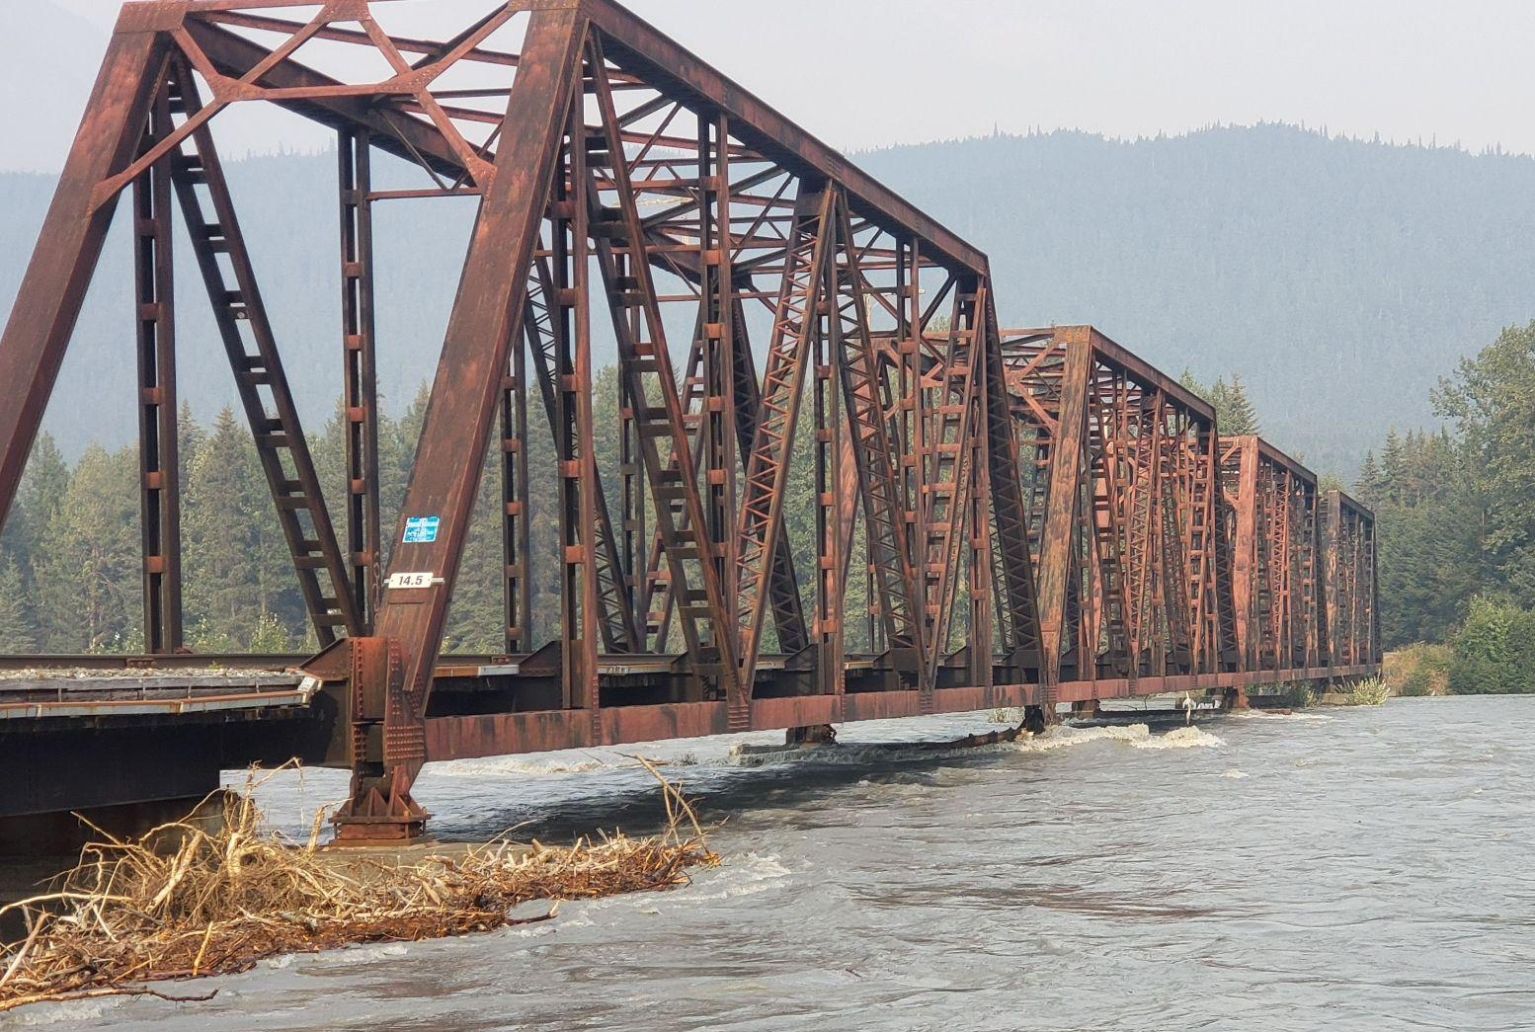
Objectives
Raise existing 4 thru-trusses a minimum of 4 feet
Determine vertical and horizontal clearance requirements for future highway overpass
Bridge during 2019 flood (ARRC)
Notes:
The reason that this specific bridge needs to be addressed is due to the flooding that occurs in Snow River. Snow river is a glacial fed river that runs beneath the bridge in question and it is one of the first structures that the river encounters. You can see in this photo that the river is relatively close to the actual superstructure of the bridge.

Slide 11
Design Constraints
Limited changes to the active floodplain
Rockface
The AKDOT&PF multiplate
Track Outage Allowances
Seasonal Construction Limitations
Rockface south of BR 14.5
Notes:
The other constraint in the design is the construction method. The construction must be done in th winter as this provides the largest window for construction. No matter the alternative the maximum amountof time the railway can be down for is 36 hours.

Slide 12
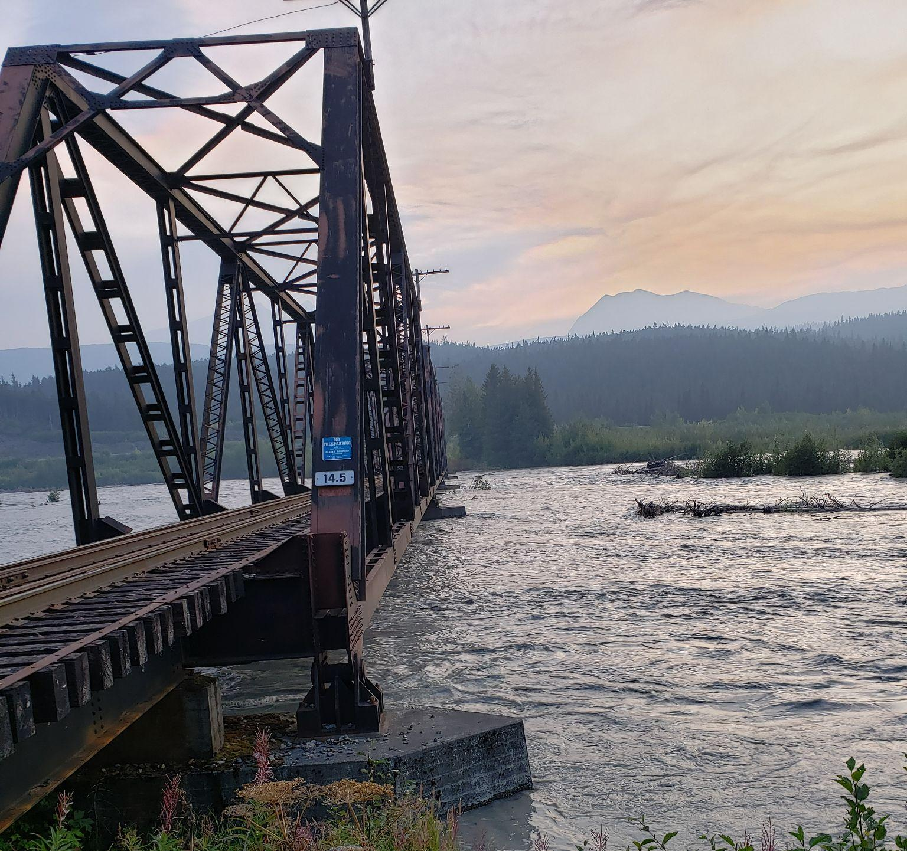
Alternatives
No-Build
Superstructure Replacement
Substructure Replacement
Bridge Superstructure Raise
Track Realignment
Bridge 14.5 during the 2019 flood. View from southern approach (ARRC)

Slide 13
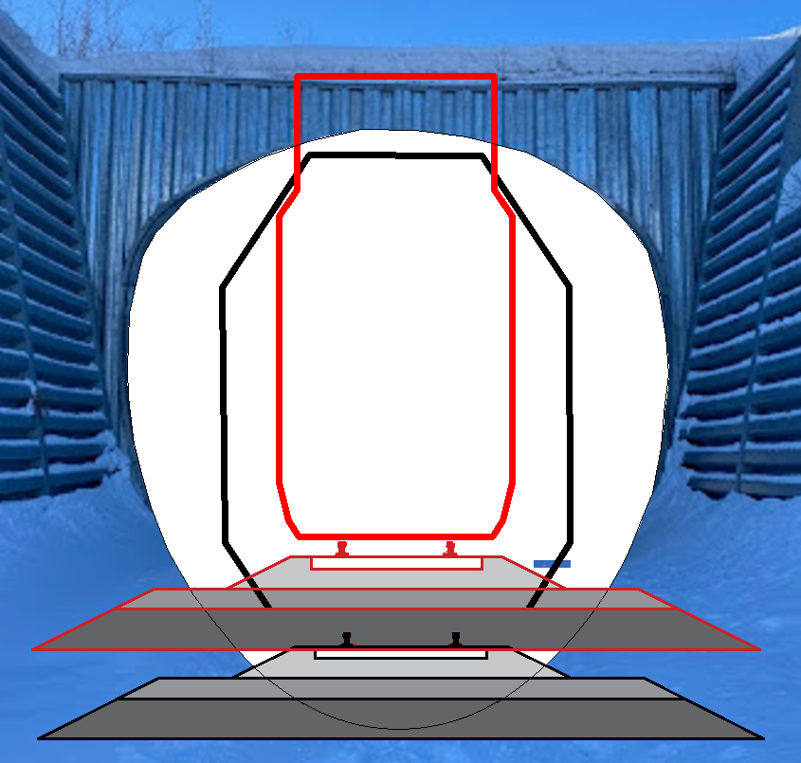
Shared Elements
New
Existing
Raise tracks and ballast to bridge level until profile ties into existing track on both sides
Place and key-in rip-rap along bridge substructures
Removal of AKDOT&PF multiplate structure
New rail elevation through AKDOT&PF multiplate
Notes:
Things necessary for all discussed alternatives, describe how profile ties in in detail

Slide 14
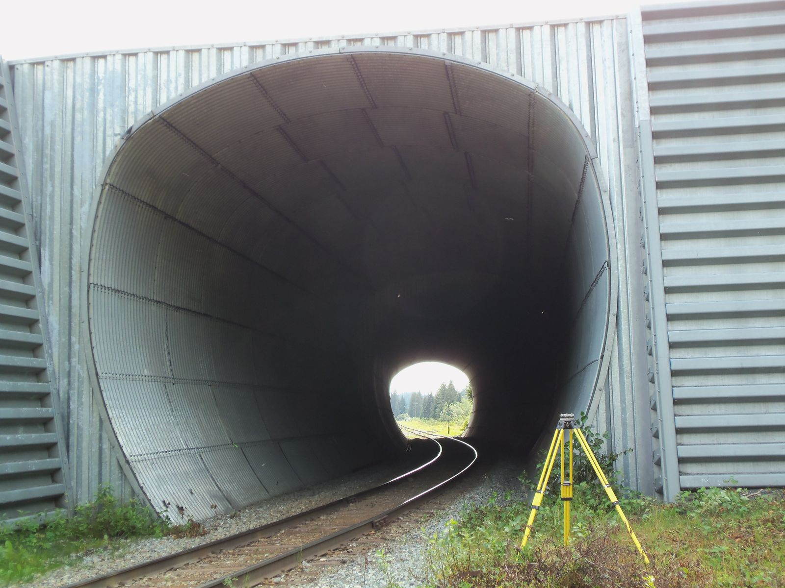
AKDOT&PF Multiplate Structure
To be addressed in a related AKDOT&PF project. Likely alternative is a highway overpass.
Clearances:
Min. horizontal = 15 feet (9.B.2)
Min. vertical = 20’-11” from top of rail
Front view of AKDOT&PF Multiplate Tunnel

Slide 15
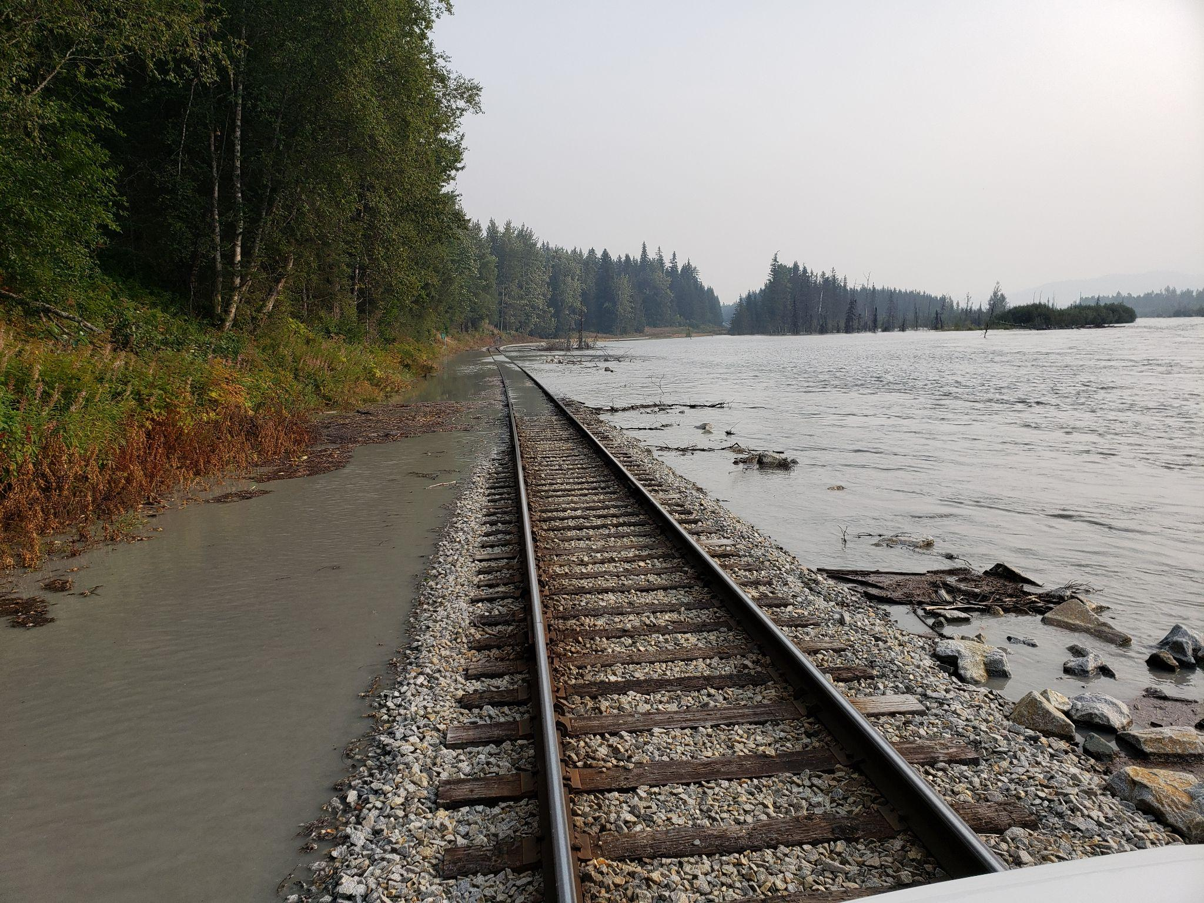
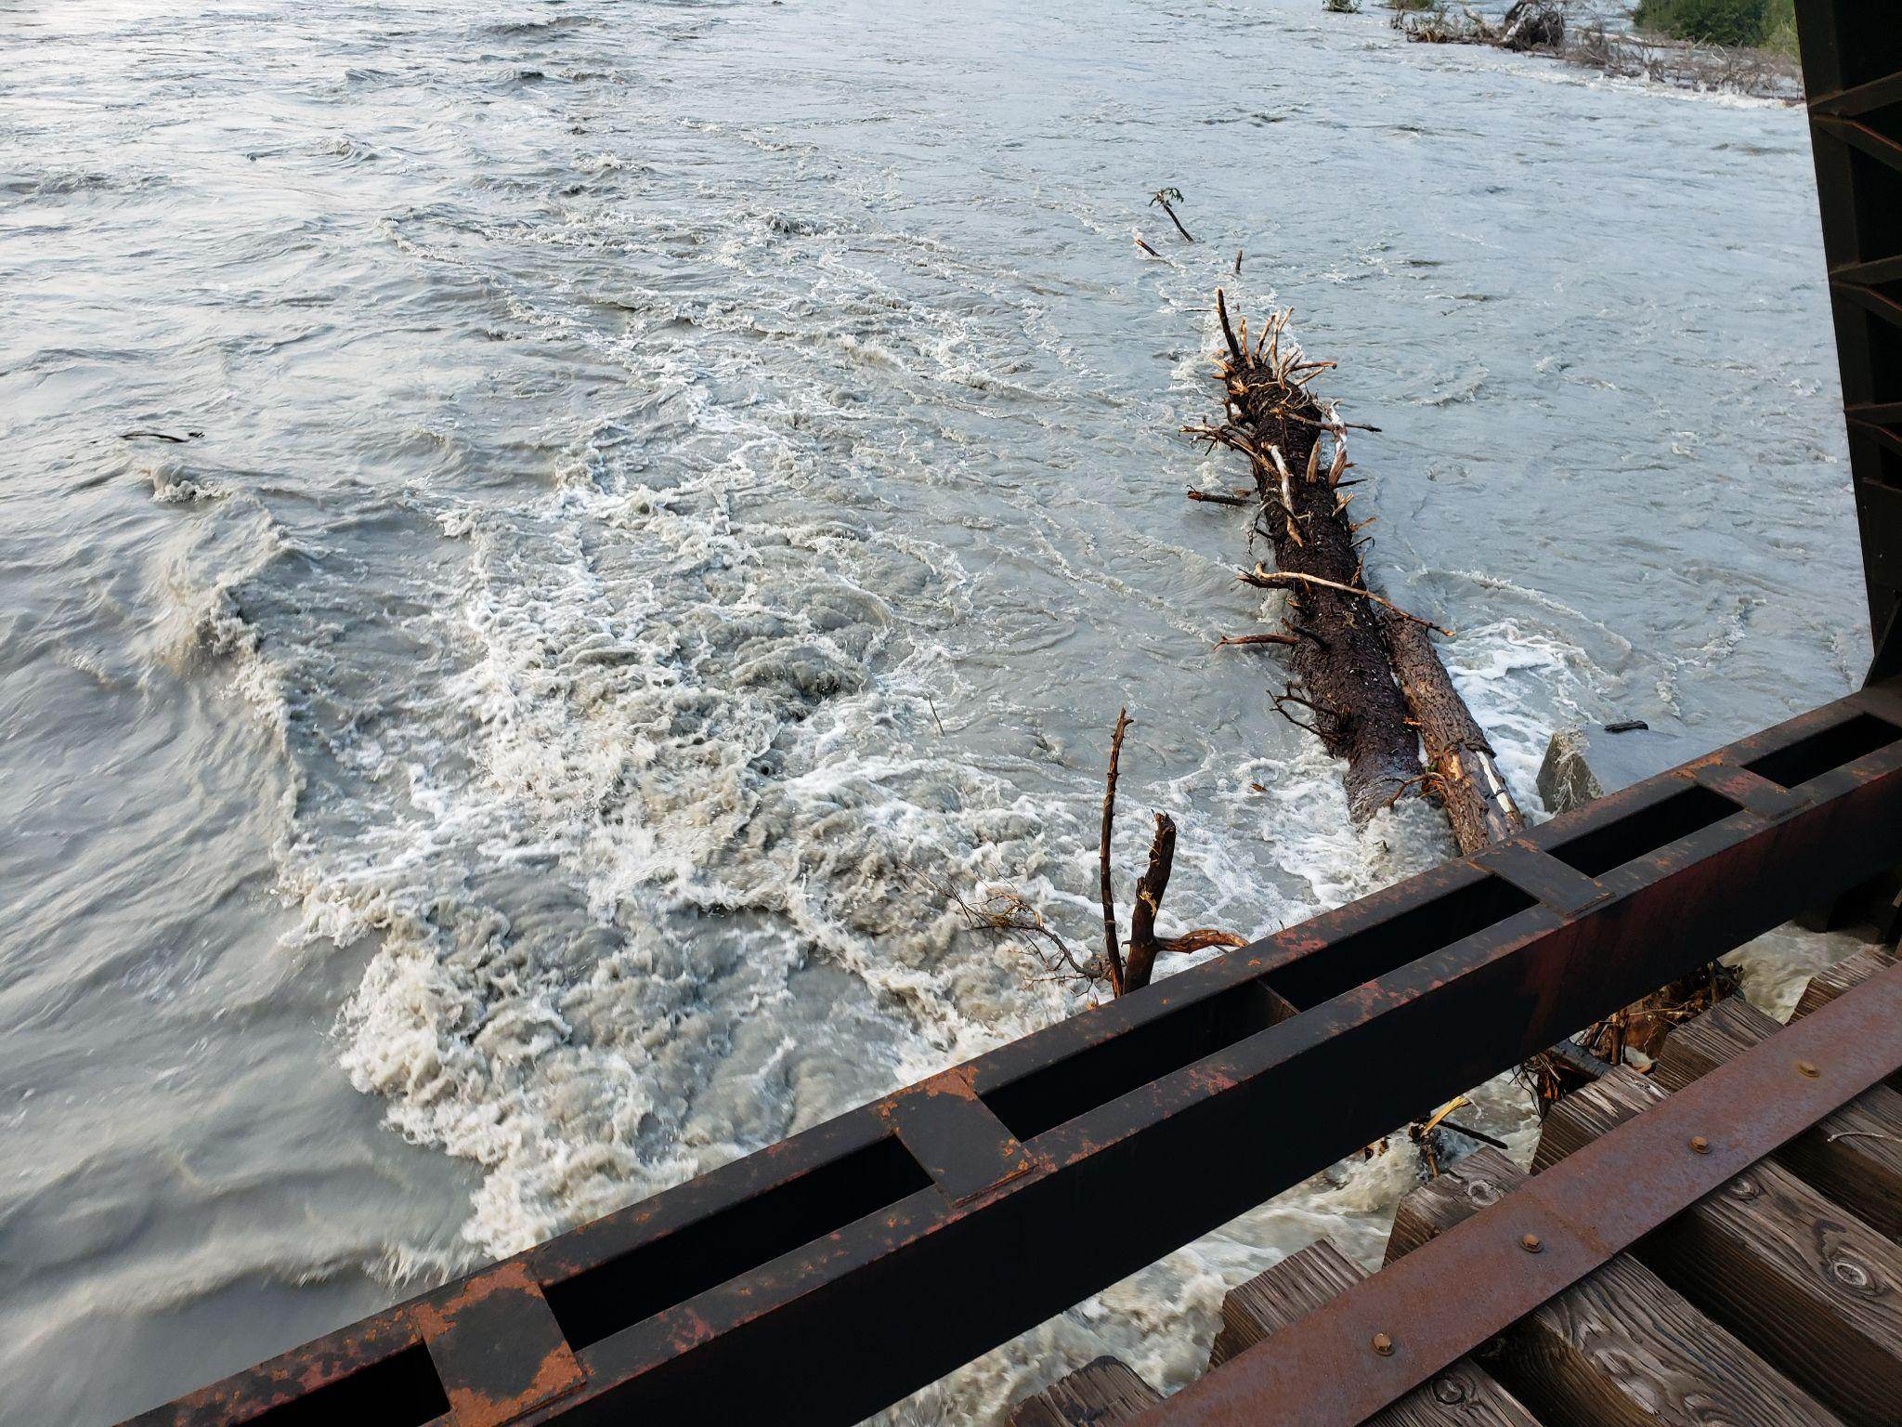
1. No Build
All existing track and bridge structures remain
ARRC photo showing rail damage due to 2019 flood
Debris caught on 14.5 low chord in 2019 flood

Slide 16
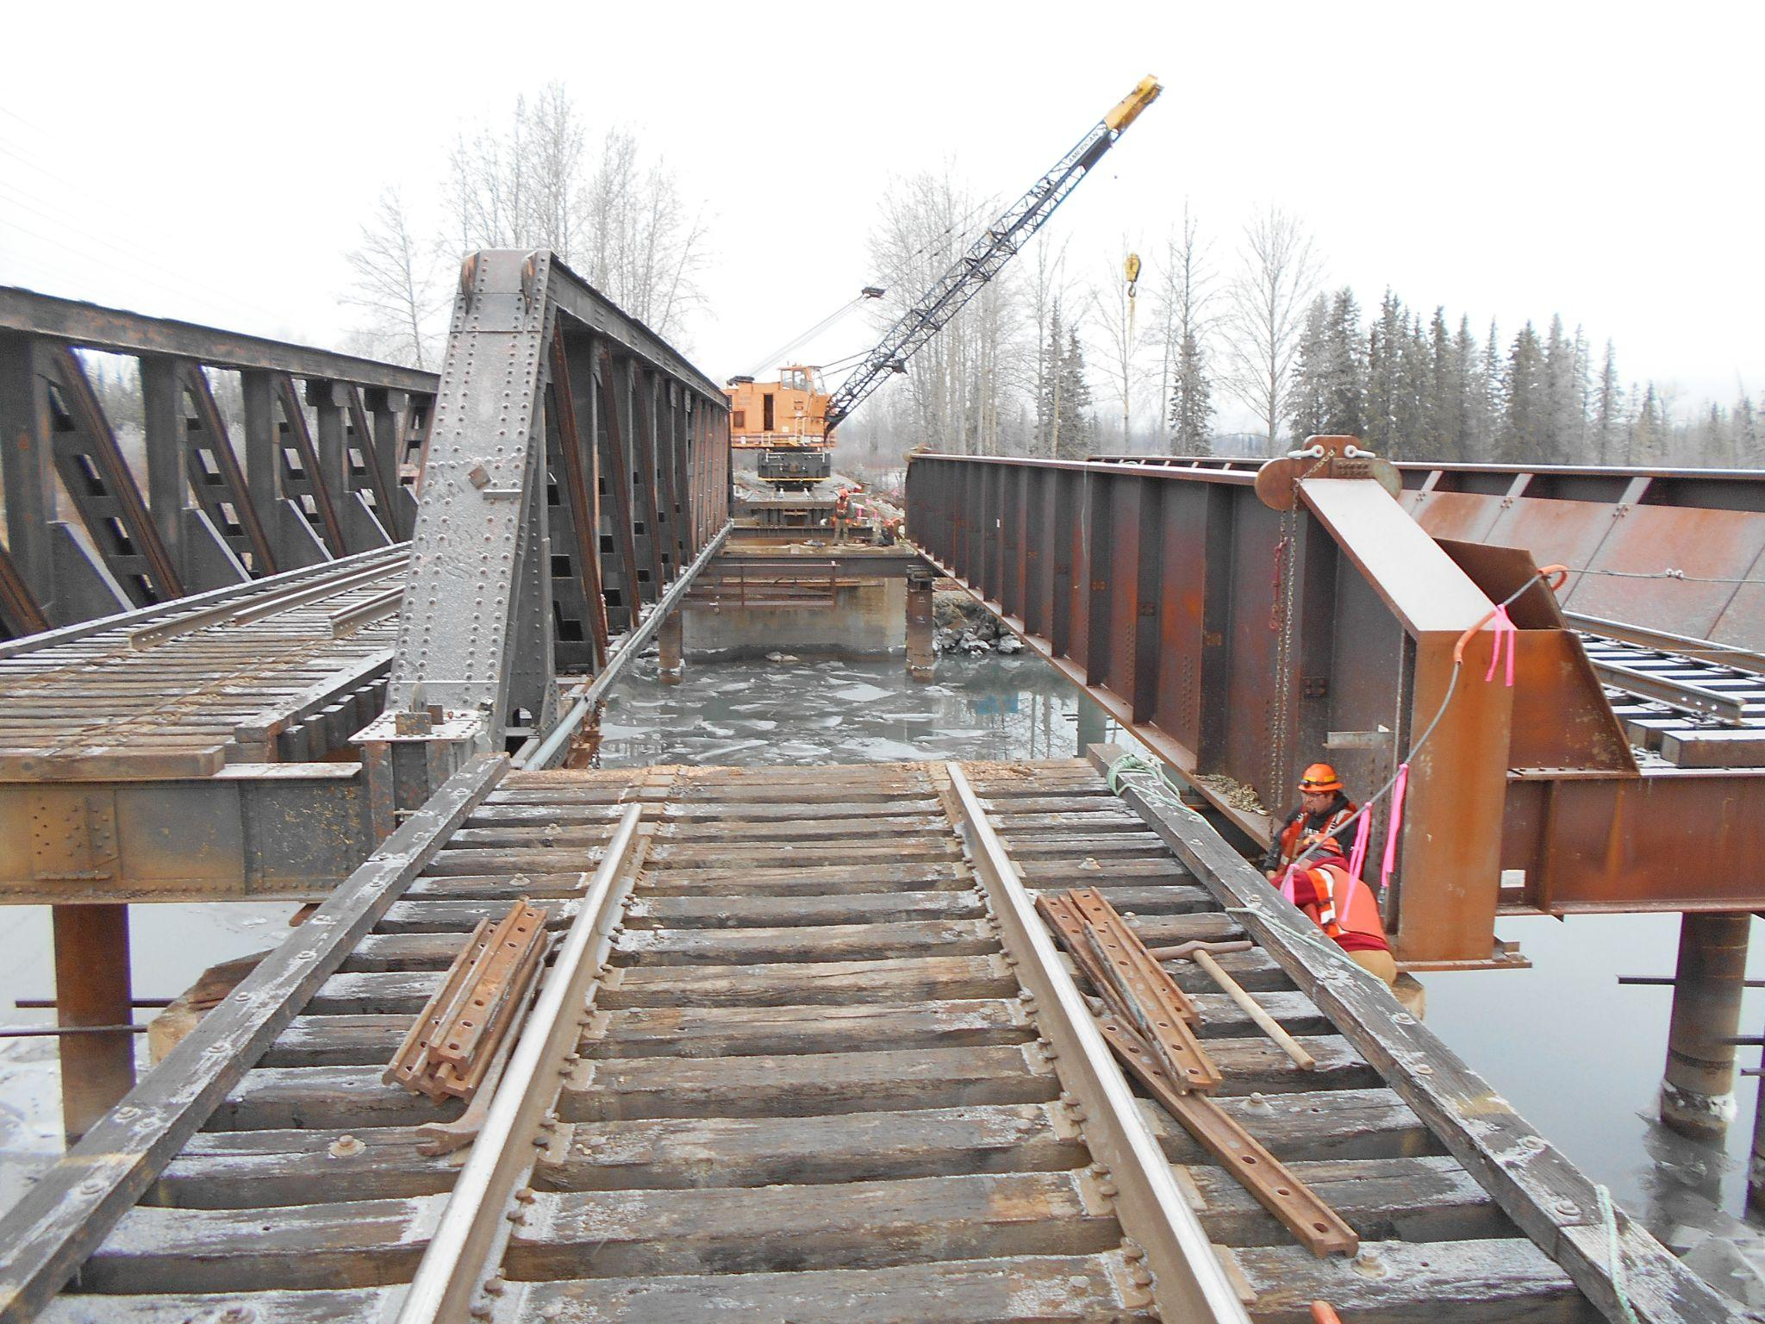
2. Superstructure Replacement
Removal and replacement of existing superstructure
Approach span replacement
Construction and installation of new superstructures at higher elevation
Old Bridge
New Bridge
Construction on ARRC bridge 147.4
Notes:
Approach spans replaced in south approach with precast concrete (shallow bedrock, geotech report), and in north approach with sheet pile bulkhead (cheaper). Low chord raise needs to consider the WSE raise as a result of approach span replacement, likely need >4ft raise.
Very expensive and time consuming. Long track closure.

Slide 17
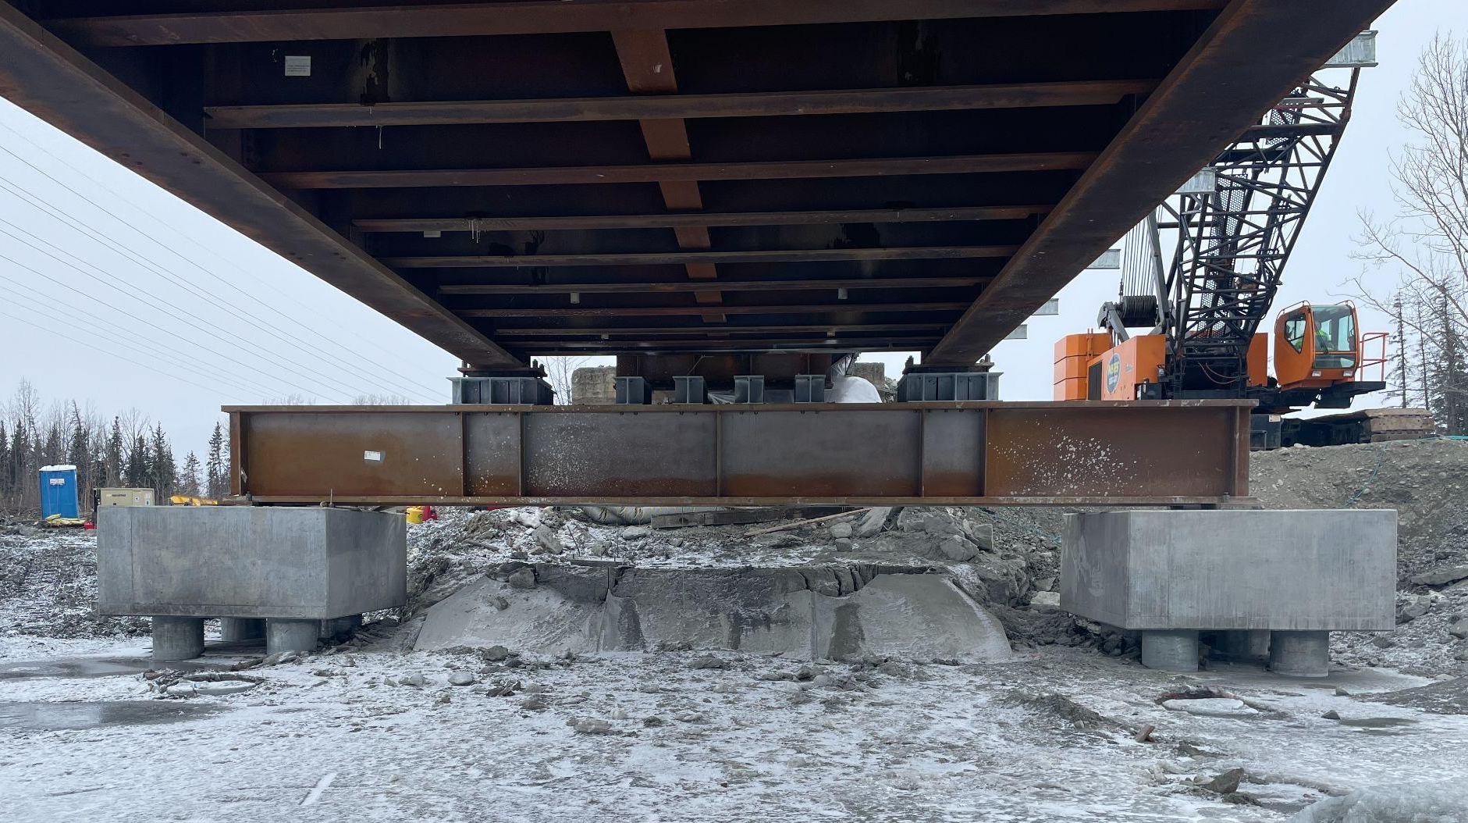
3. Substructure Replacement
Install temporary supports and jack bridge
Construct new piers
Remove existing piers
Install straddle cap
Straddle Cap
New Pier
New Pier
Existing Pier
BR 147.4 pier replacement using straddle cap (ARRC)
Notes:
Existing piers would need to be removed and new, 4ft taller piers would be installed while bridge it out of construction zone.

Slide 18
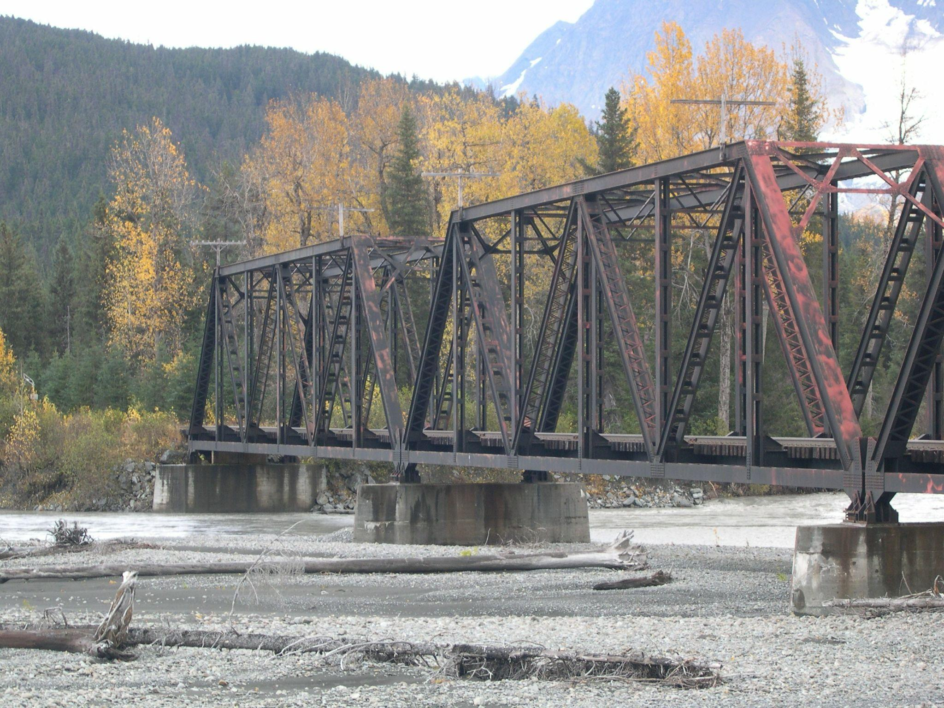
4. Bridge Superstructure Raise
Raise executed in 4”-6” increments
Allows for track openings between each small raise
Raise and replace approach spans with new girders
View towards south approach
Notes:
Incremental raise to accommodate shift from open to ballast deck. Further details considered for this alternative because it is the least costly

Slide 19
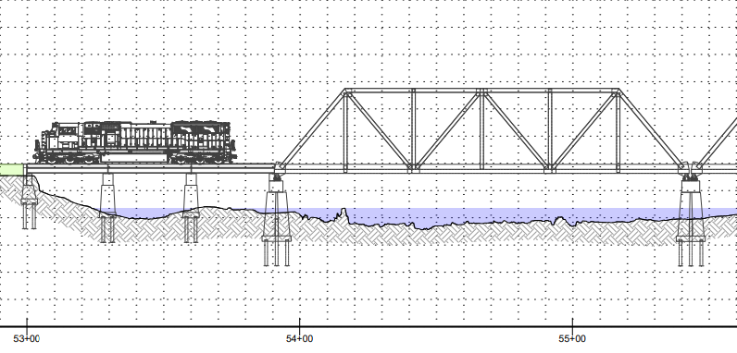
4. Bridge Superstructure Raise
Bridge After Raise
New Fill
Riverbed
Approach Spans
Current Bridge Elevation

Slide 20
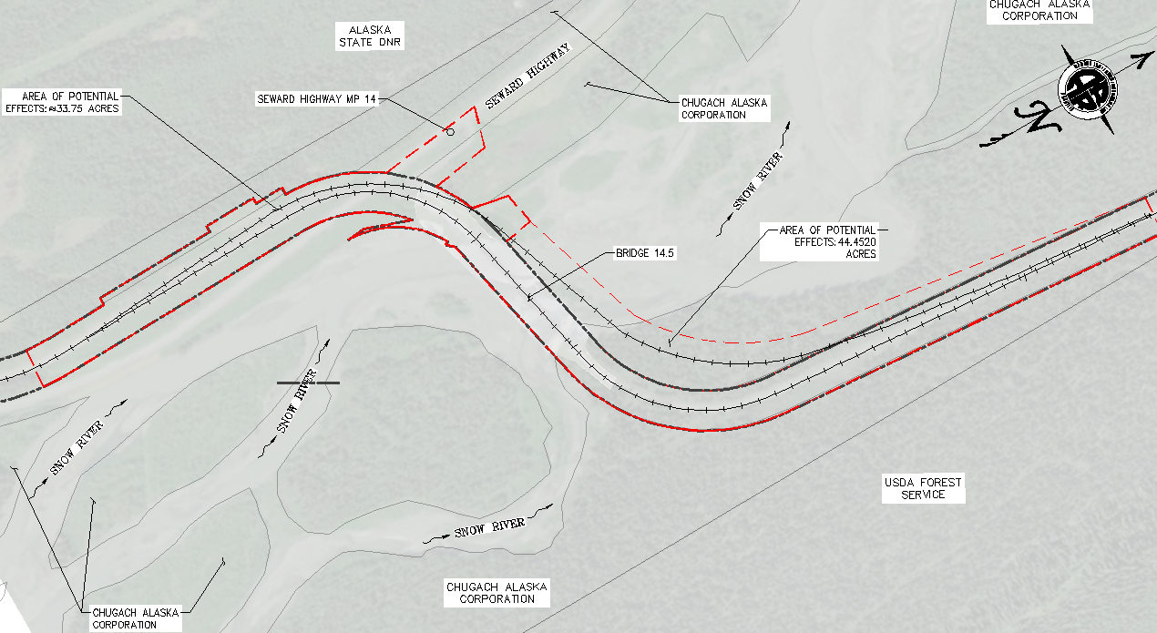
5. Track Realignment
Blast rock face on southern approach
New bridge
Existing structure services rail during new construction
Potential Realignment Strategy
Notes:
Rock face blasting for realignment curve needs. New structure needed, old structure can be used during the construction period. AKDOT needs to address our height requirements for new overpass.
Permitting nightmare

Slide 21
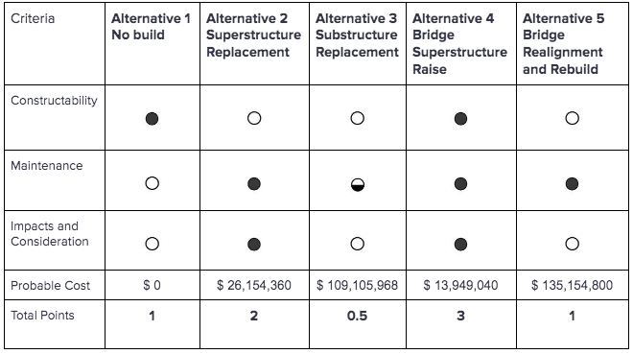
Alternative Evaluation
= 0 points
= 0.5 points
= 1 points

Slide 22
Cost Estimate
$0
Alternative 1
$26,154,360
Alternative 2
$109,105,968
Alternative 3
$13,949,040
Alternative 4
$135,154,800
Alternative 5

Slide 23
Alternative Evaluation
= 0 points
= 0.5 points
= 1 points

Slide 24
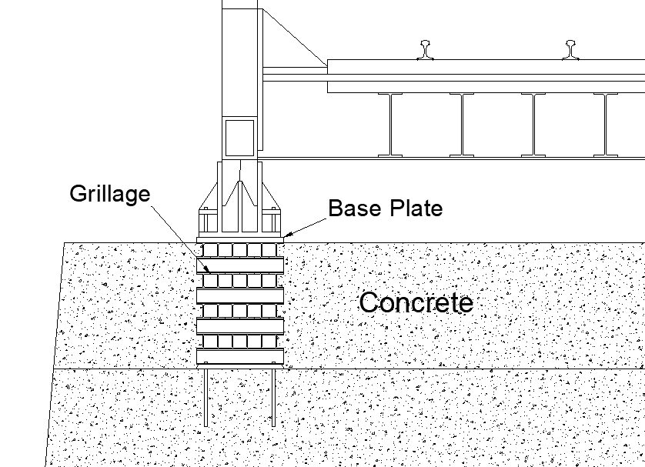
Construction Methods
Insert shims on existing piers as space opens
Interconnection using structural fasteners or welding
Concrete connection done using anchors
Set a concrete form around grillage
Place concrete
Concrete-encased steel grillage
Notes:
Same quick process to get bridge to final elevation, then molds set for the cast-in-place concrete encasement. Use finishing detail to seal steel from weathering. THis will provide protection and increased lateral support to the substructure.

Slide 25
Summary
Snow River Bridge raise aims to prevent damage from flooding to the railroad route
UAAR Consultants followed the Design Criteria to evaluate different alternatives
Our firm recommends Alternative 4 as the preferred alternative

Slide 26
What we learned
Time Management
Civil 3D Design and Plan sets
Presentation creation and skills
Communication with a Team
Budget and Report Creation

Slide 27
References
HDR, T. H. (2021). Bridge 86.6 over Bird Creek, 15% Bridge Design –Alternatives Memo. Anchorage.
Michael Baker International. (2020). Snow River Initial 2D Modeling Report. Anchorage.
Michael Baker International. (2023). 2023 Snow River Modeling Project Memo. Anchorage.
Northern Geotechnical Engineering, Inc. d.b.a.Terra Firma Testing. (2023). GEOTECHNICAL FINDINGS FOR THE SITE OF THE ALASKA RAILROAD CORPORATION RAILBRIDGE BR14.5–SNOW RIVER, ALASKA. Anchorage.

Slide 28
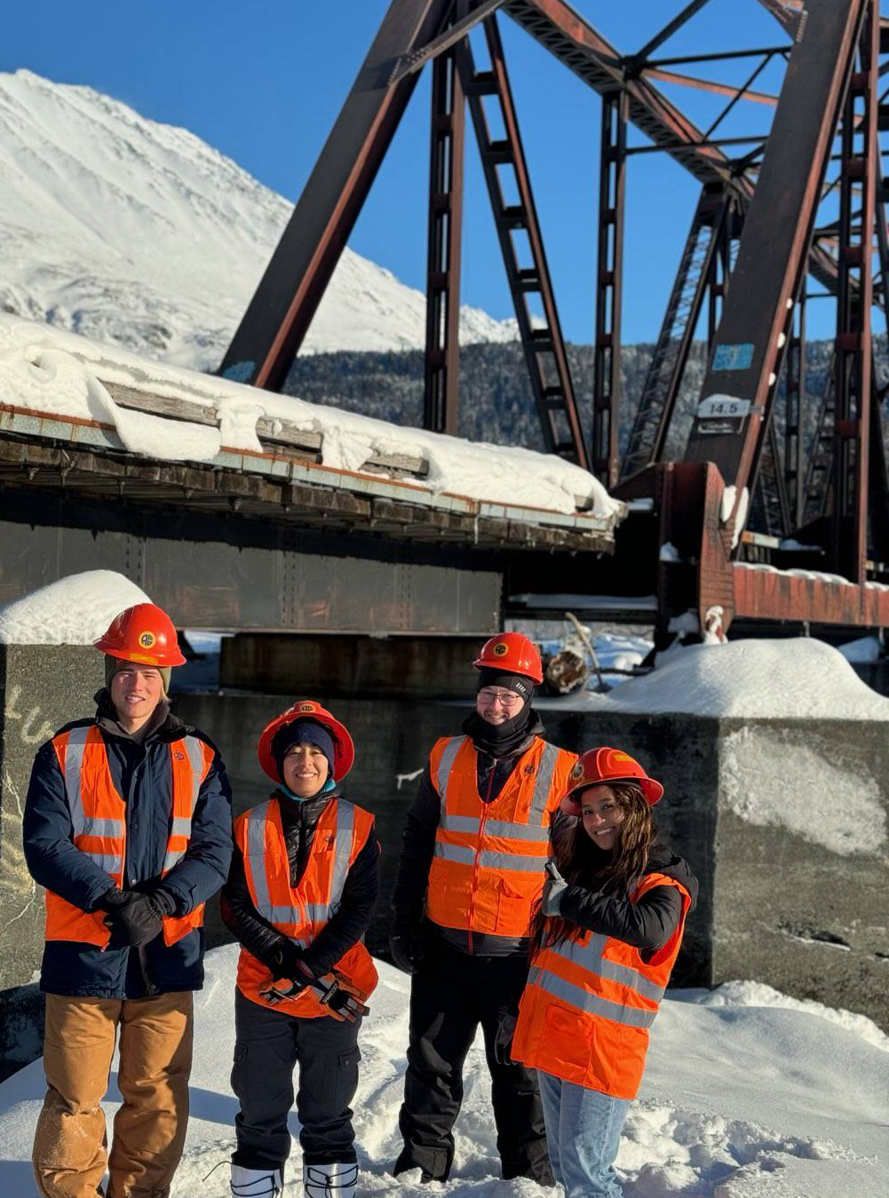
Questions?
Please Contact: damelgar@alaska.edu
Notes:
Ask Brian for Team photo

