Slide 1
Summer Engineering Academies Registration System Client Side Development
Summer Engineering Academies Registration System
Christopher Brooks

Slide 2
Overview
Introduction
Development
User Interface
Technologies Used
Research Conducted
Questions

Slide 3
Summery
UAA Summer Engineering Academies is a summer camp that teaches Science and Engineering concepts to middle school to high school aged students.
Hundreds of students apply every year
Current method is time consuming and repetitive
Replace the existing system with a web based registration portal and database management system

Slide 4
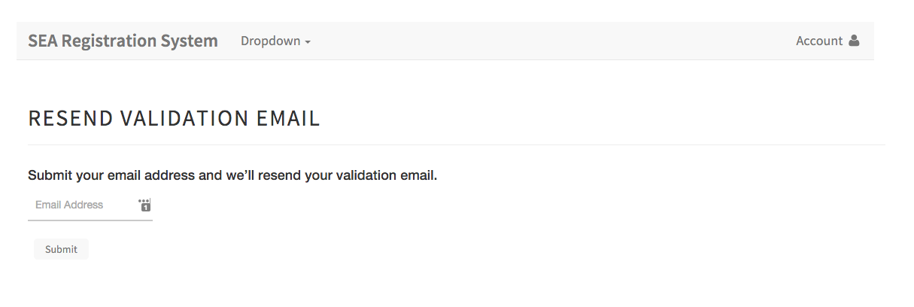
Development
Objectives
Web based system
Allow parents to register their children online
Allow administrators to maintain a database of student preferences and personal information

Slide 5
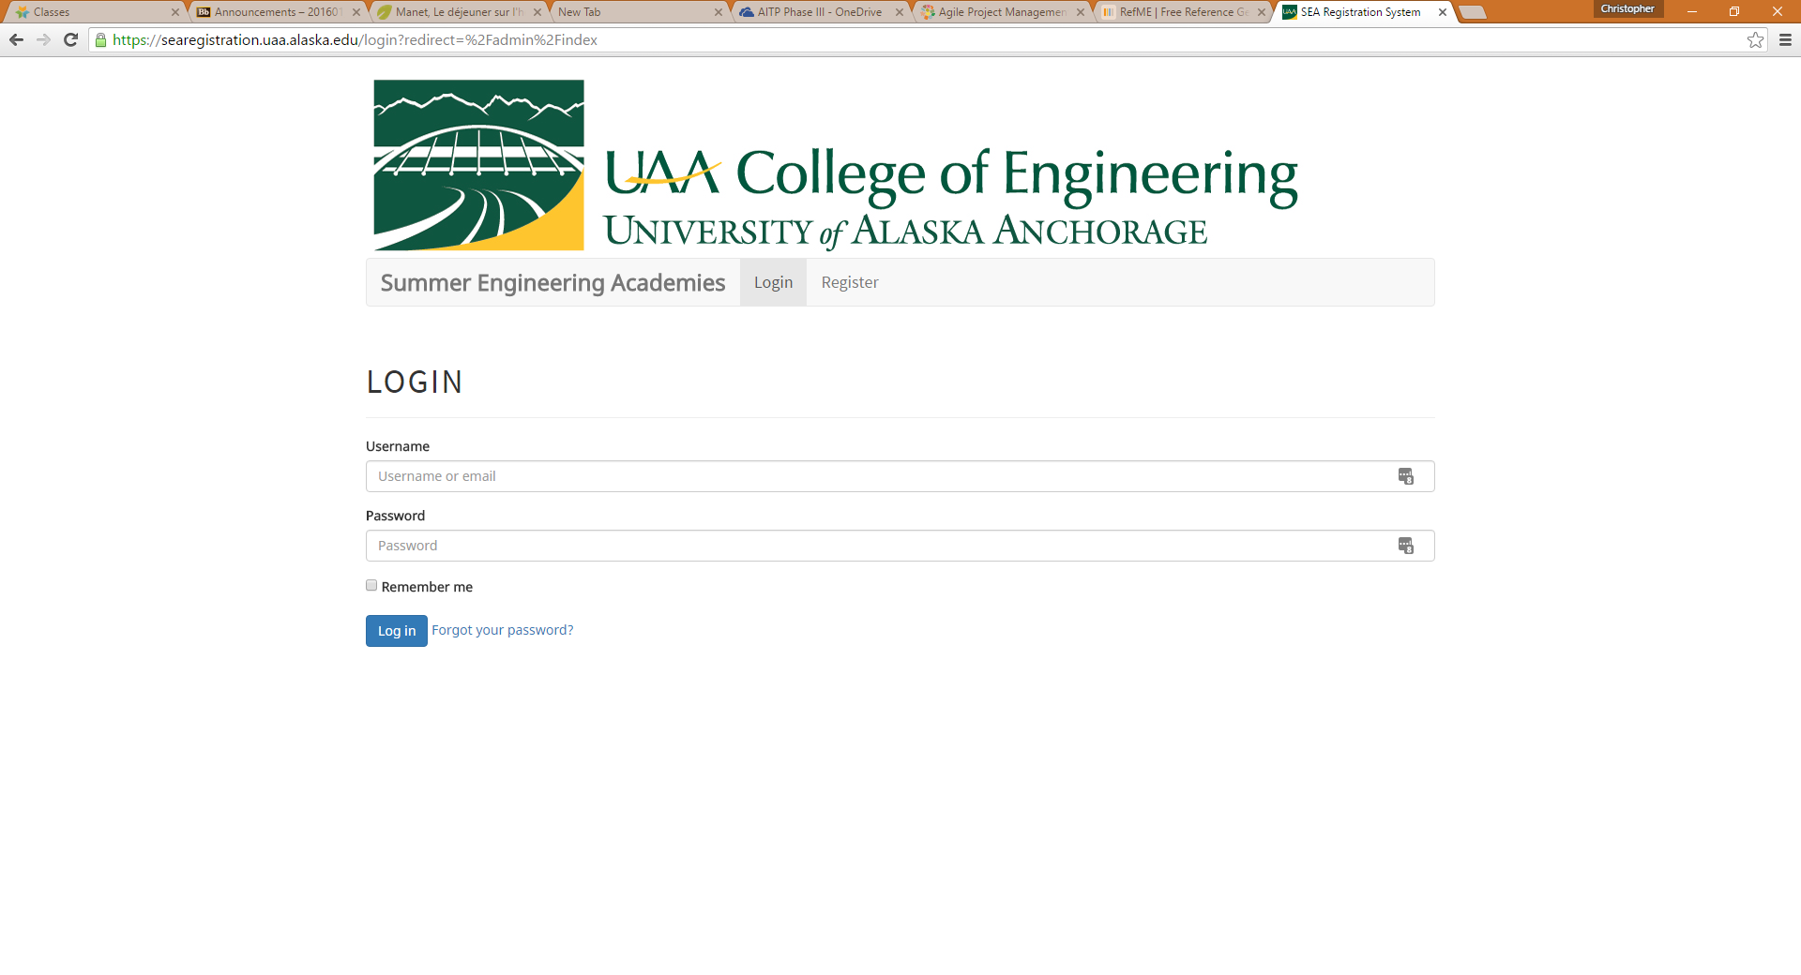
User Interface
The web interface was developed to be easy to understand
Uses common design techniques
Accessable from a browser
Allow for more complex user actions for administrators

Slide 6
Technologies Used
The following technologies were used for the user interface and client side development of the project
HTML5
CSS3
JavaScript ES6
Bootstrap 3
AngularJS 1.6

Slide 7
Research Conducted
AngularJS framework
Power set a JavaScript methods and functions
Used to create Model-View-Controller web applications
AngularJS was also used to filter and sort data in real-time to the client side of the application.

Slide 8
Questions

