Slide 1
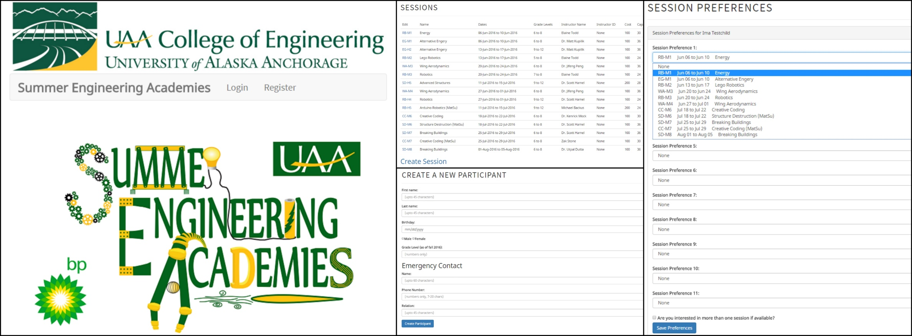
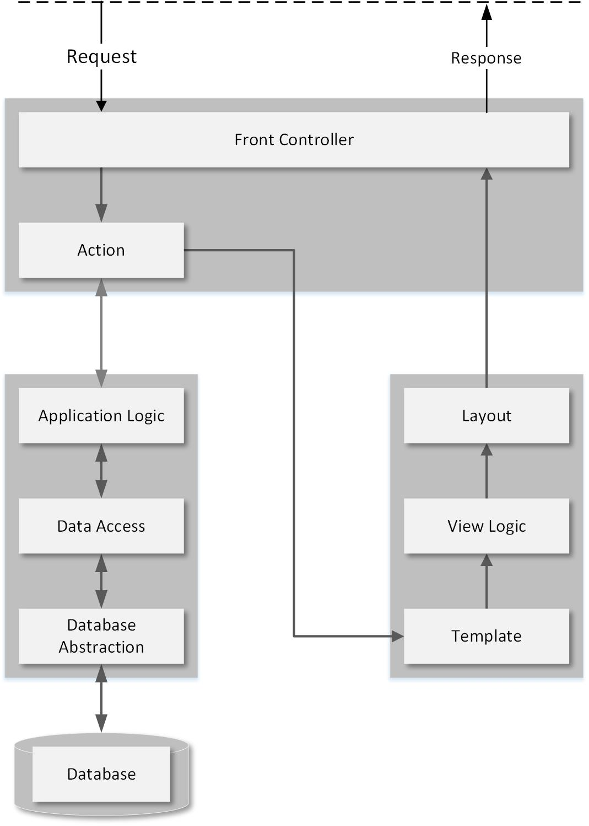
Summer Engineering Academies Registration System
Zachary Stone, Christopher Brooks, Johannes Meyer
University of Alaska Anchorage College of Engineering
Supervisor: Dr. Scott Hamel
REPLACE THIS BOX WITH YOUR ORGANIZATION’S
HIGH RESOLUTION LOGO
Introduction
Model View Controller
The SEA Registration System is comprised of a web application front end and a database back end. Technologies used included PHP, Huge by Panique, Bootstrap, and AngularJS. Parents create accounts, register participants, and update their data as needed. Administrators can then edit the data, view contact information, and otherwise manipulate user accounts and participant data as needed. The SEA Registration System represents a unified information management system that replaces the existing system involving several different third party applications.
Model–view–controller (MVC) is a software architectural pattern for implementing user interfaces on computers. It breaks a software application into three separate but interconnected parts.
MVC is divided in to three main components:
The model which retrieves and stores data based on a set of programmed commands
View: Generates output based on the model and updates that data by triggering controller actions.
Controller: Is used to relay commands to the model based on inputs received from the view.
Results
The SEA Registration System streamlines the registration process for parents by enabling them to make changes and view status updates. It also reduces the admin workload by consolidating administrative functions into a unified system. The entire process is much more efficient for both parents and administrators, and ultimately makes it easier for students to attend the Summer Engineering Academies.
The skills learned in the beginning of the project, while slow to come, have paid off now that the main structure of the application is complete. As we continue to add features, the time and research required has been become less and less. The MVC pattern makes for logical development in a way that requires less planning than was needed in the past. The
separation of concerns has enabled us to break features down into individual tasks, and quickly release new versions of the application.
Technology
The system uses an open source PHP framework, HUGE (panique), MySQL database, Twitter BootStrap for a responsive web interface, AngularJS for dynamic filtering of displayed data, and git version control hosted on BitBucket.
Contact
Johannes Meyer
Project Manager
UAA College of Business & Public Policy
Email: jcmeyer2@alaska.edu
Phone: 907-268-0143
Zakary Stone
Backend Developer
UAA College of Engineering
Email: zrstone@alaska.edu
Phone: 907-317-8216
Christopher Brooks
Frontend Developer
UAA College of Engineering
Email: cmbrooks2@alaska.edu
Phone: 907-854-6717
Dr. Scott Hamel
Project Sponsor
UAA College of Engineering
Email: sehamel@uaa.alaska.edu
Phone: 907-786-1070
Dr. Adriano Cavalcanti
CSCE Faculty Reviewer
UAA College of Engineering
Email: acavalcanti@uaa.alaska.edu
Phone: 907-786-6756
Dr. Dennis Drinka
MIS Faculty Reviewer
UAA College of Business & Public Policy
Email: dedrinka@uaa.alaska.edu
Phone: 907-786-4120

