Slide 1
Operation Christmas Child Data Management System (OCCDMS)
The database for
OCCDMS
David Bretz
Supervisor: Dr. Kenrick Mock
April 13, 2016
Notes:
Slide time: 2 minutes
ASK: How did you hear about OCC and learn how to get involved?
Allow attendees to answer this question. Chances are, many of them were first contacted by a volunteer or learned about OCC from someone other than a staff person.
SAY: Volunteers are the heart of Operation Christmas Child, involved in every part of the process, from beginning to end. Without volunteers there would be no OCC.
VOLUNTEER HIGHLIGHT – Project Leaders
SAY Project Leaders at a church or community group are the volunteers who have the important role of organizing and promoting Operation Christmas within their own organization.
SAY Project Leaders ensure that those participating understand the significance the single gift they are packing.
SAY There are also more than 7400 volunteers who serve year-round to promote the project – speaking in churches, to schools, businesses, etc. to spread the word about OCC.

Slide 2
Background and Inspiration
Volunteered with Operation Christmas Child since 2006
Became a Year Round Volunteer in 2010
Want to improve donor information gathering process

Slide 3
Goals and Technology
Goals
Simplify collection process for donor information using location based forms
Increase data integrity
Track Short-Term Volunteer hours
Technology
PHP
MySQL
Platforms
Desktop
Mobile

Slide 4
Number of Donations
In 2014
The Northwest Region collected over 260,000shoebox gifts.
Alaska collected over 18,300 shoebox gifts.
South Central Alaska collected over 12,025 shoebox gifts.
Over 500 individual Drop-Off Logs processed in South Central Alaska
Notes:
Slide time: 2 minutes
Note to presenter: Insert regional, state and Area Team collection numbers.
SAY What an incredible year and an incredible God! These numbers not only represent shoe boxes collected, but each of them is a child who will have the opportunity to hear the Gospel!
Highlight/review the information on the screen

Slide 5
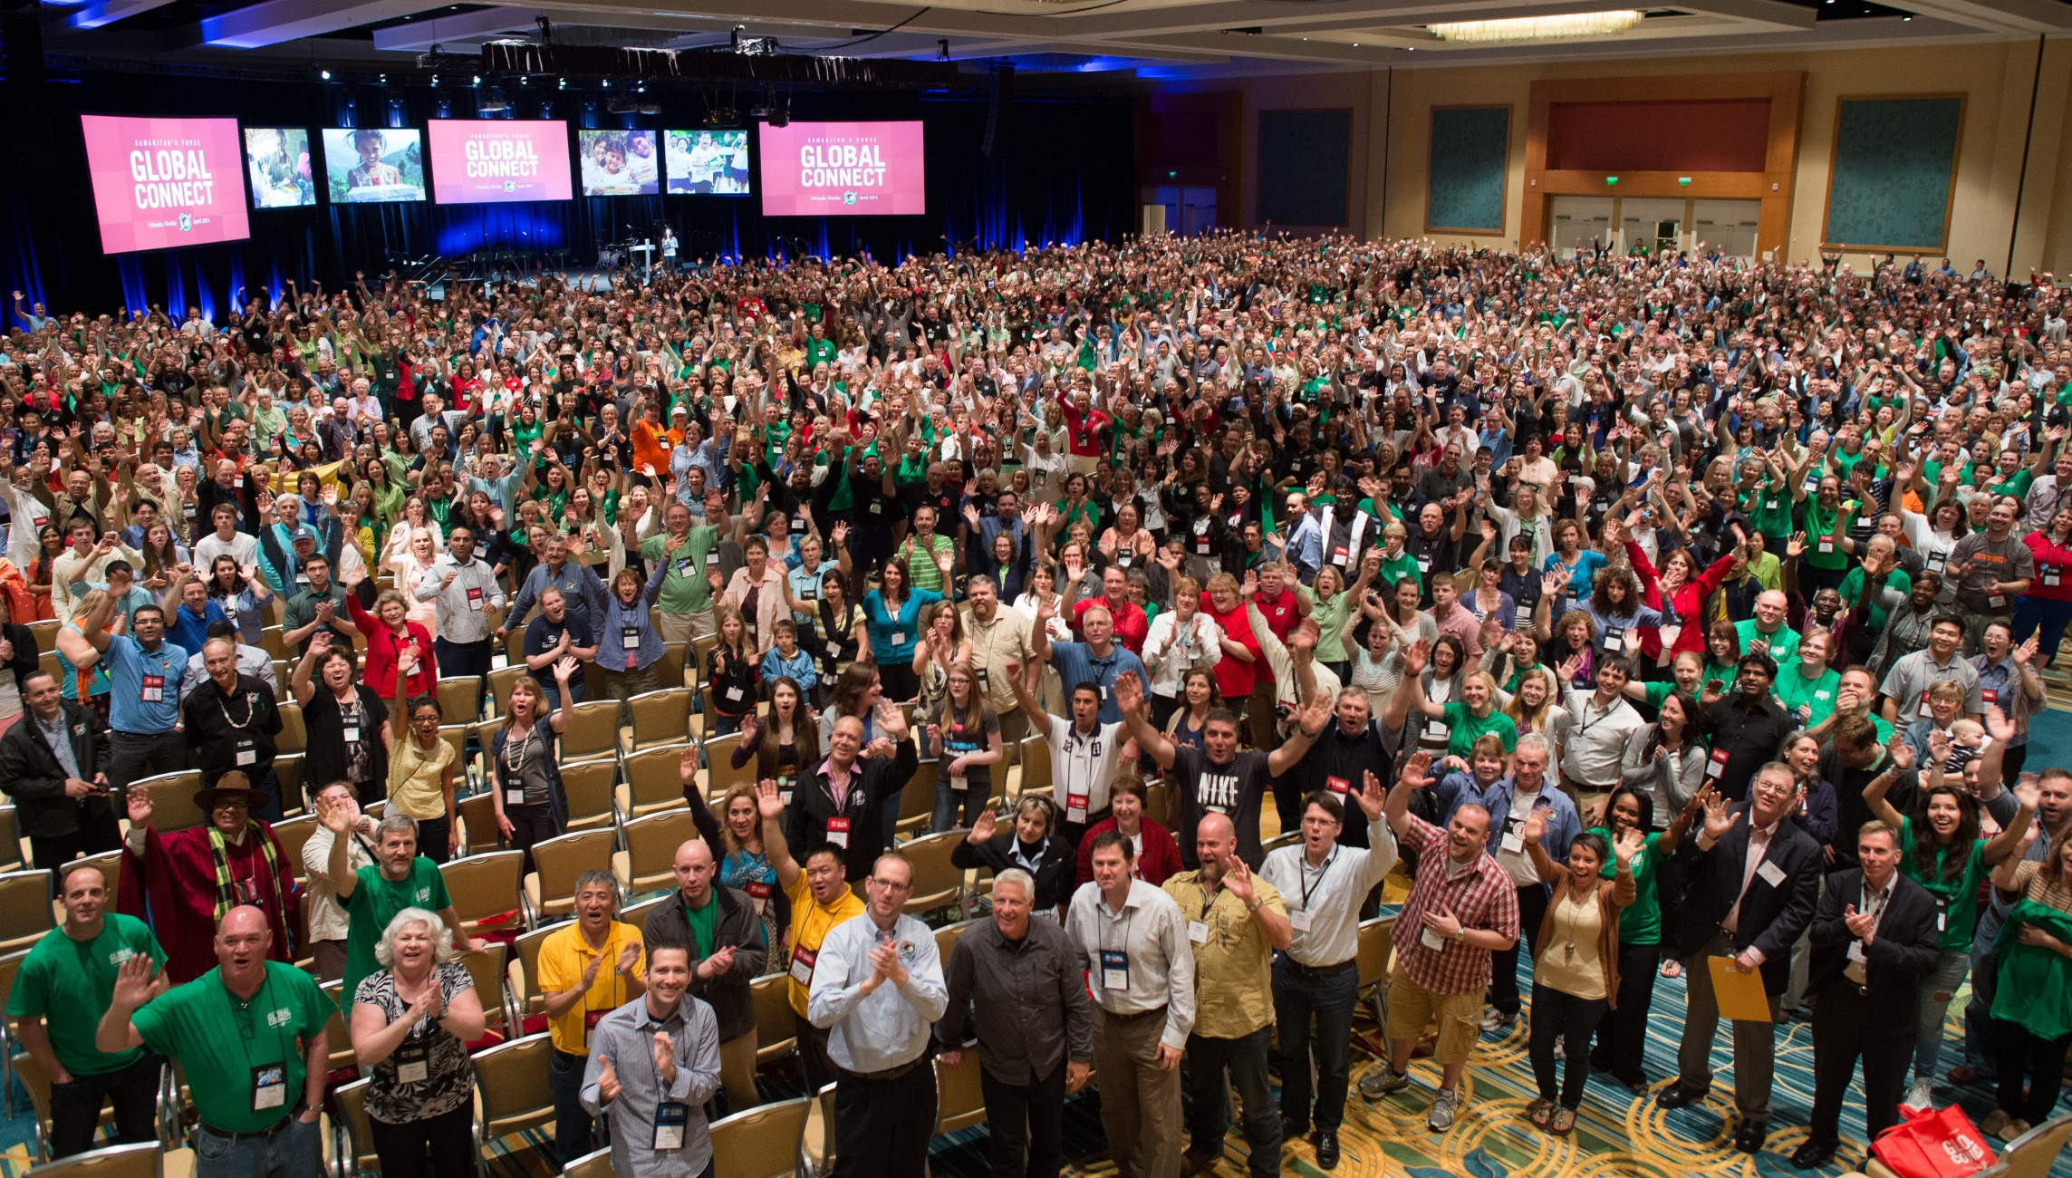
Connect Volunteers
Notes:
Slide time: 2-3 minutes
This picture was taken at the Global Connect Conference in April 2013 in Orlando. Over 2500 people attended representing OCC volunteers in over 100 sending and receiving countries.
Substitute a story of how God has used your area team & picture from your Area Team or Region

Slide 6
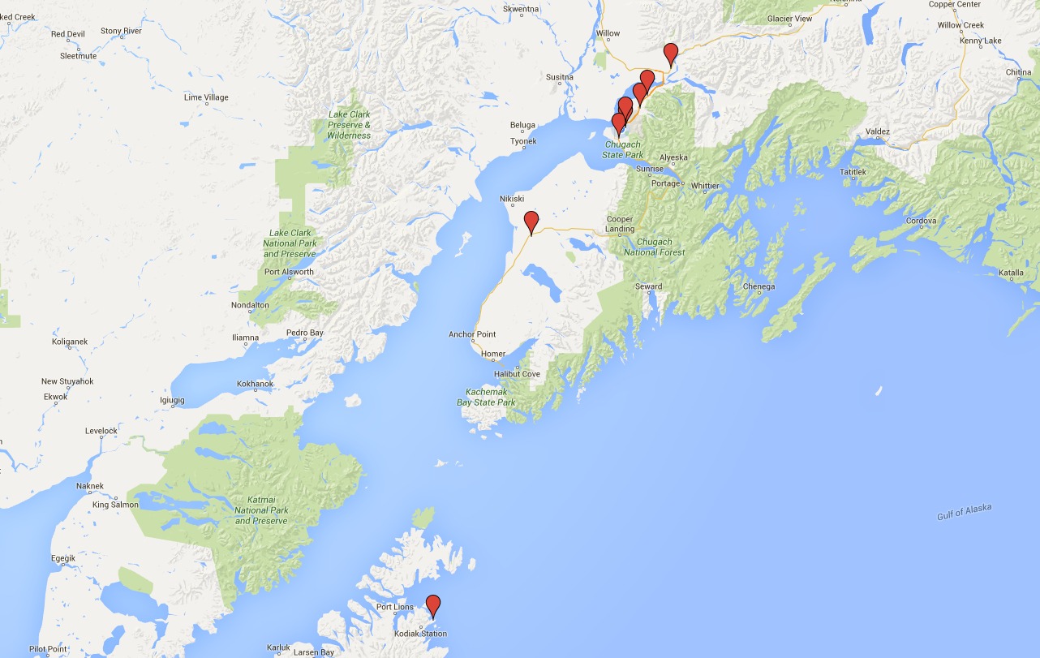
South Central Official Relay Centers

Slide 7
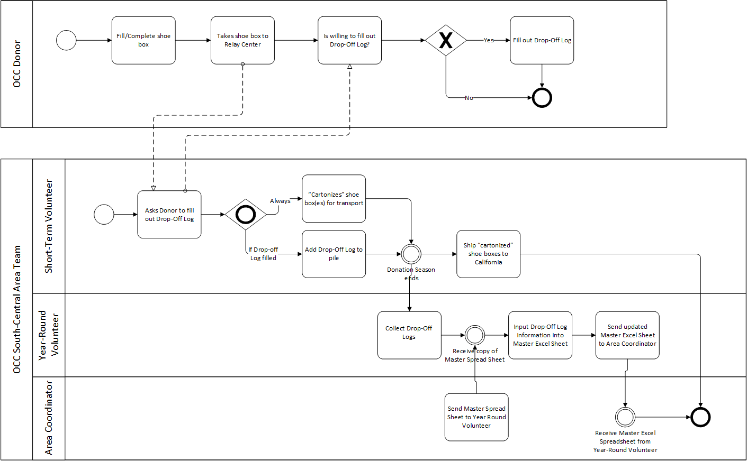
Current Data Entry Flow
Notes:
Slide time: 2-3 minutes
This picture was taken at the Global Connect Conference in April 2013 in Orlando. Over 2500 people attended representing OCC volunteers in over 100 sending and receiving countries.
Substitute a story of how God has used your area team & picture from your Area Team or Region

Slide 8
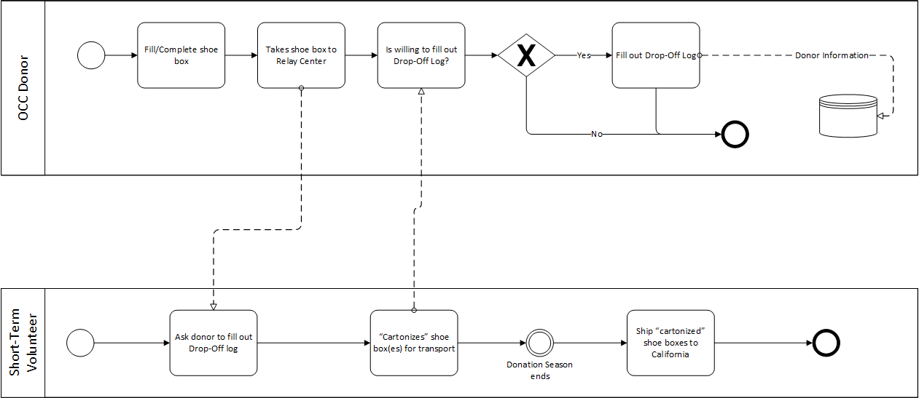
New Data Entry Flow
Notes:
Slide time: 2-3 minutes
This picture was taken at the Global Connect Conference in April 2013 in Orlando. Over 2500 people attended representing OCC volunteers in over 100 sending and receiving countries.
Substitute a story of how God has used your area team & picture from your Area Team or Region

Slide 9
Database Layout

Slide 10
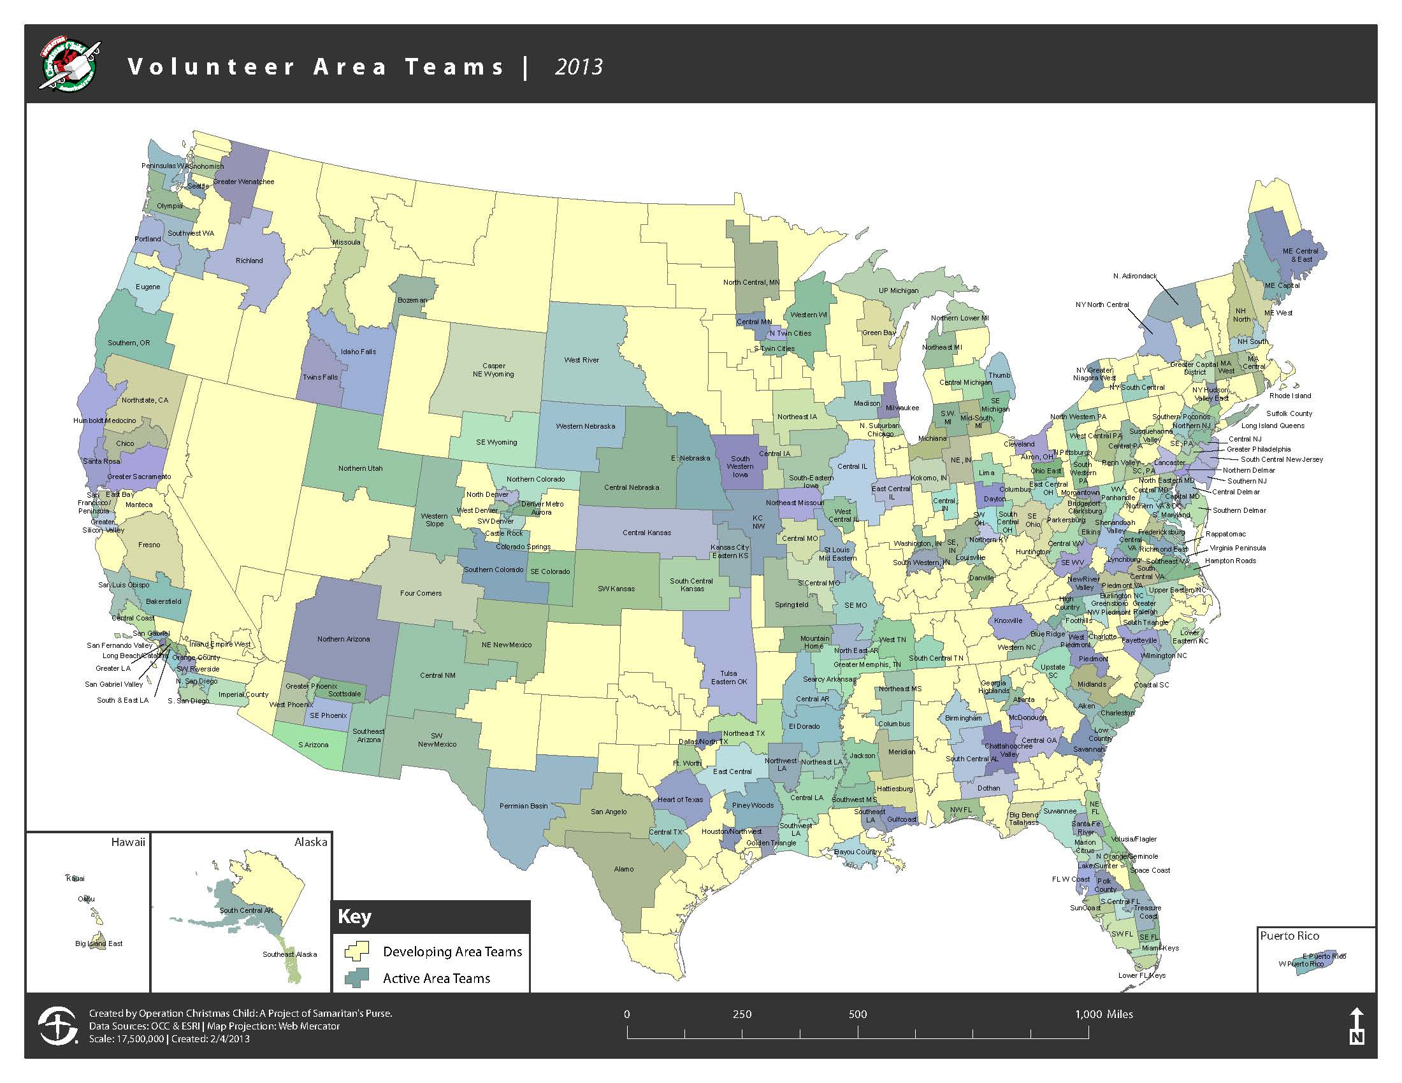
Project Expandability
Notes:
Slide time: 3 minutes
The red arrow and text box are timed to come in with the click of a mouse after the Area Team map appears.
Place the arrow and text box over your Area Team’s geographical area.
Type in the text box by double clicking in the white space. Edit your Area Team name and collection numbers.
Feel free to add any additional statistics that may be useful to point out about your local Area Team (example: number of volunteers on the team, number of years the team has been active, number of counties in the geographical area, etc.)
SAY Who are the people that follow through on the Commission that Christ set forth through the mission of Operation Christmas Child?
SAY Very dedicated volunteers. Operation Christmas Child is able to make the impact that we do because of both the domestic and international volunteers that partner with us.
SAY Volunteers have been working with OCC since the project’s beginning.
SAY Since 2003, the OCC domestic volunteers have been working together and forming Area Teams across the country. To date, there are approximately 300 Area Teams.
Click here to bring up the information box about your area team. Then, share a Spiritual Impact Story from your team.

Slide 11
Possibilities for the Future
Originally planned to rent space on a server
Samaritan’s Purse might incorporate into their OCC-Connect Service
Additional tables to incorporate Samaritan’s Purse Drop-Off Location data

Slide 12
Questions, Comments, Concerns

