Slide 1
Audio programming for obstacle detection system
Evan Riley

Slide 2
Motivation & Project goals
In 246 million individuals afflicted with "low vision". [World Health Organization]
The aim of this capstone project was to develop an affordable sensor system to aid individuals in navigation.
System should be capable of detecting and discerning between different obstacle types and relaying information to the user.

Slide 3
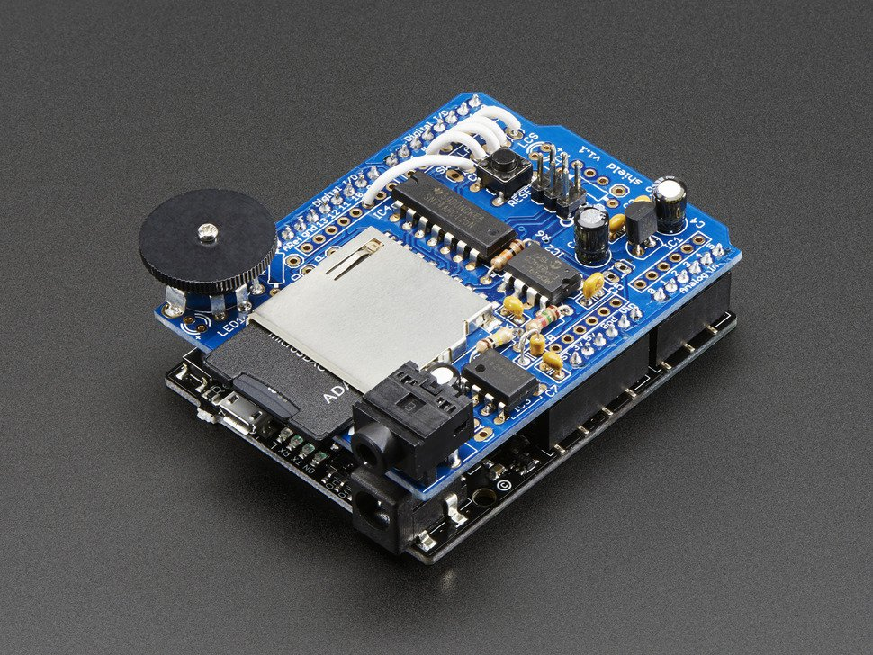
User Interface
After reviewing different options (tactile, audio, etc.), it was decided audio would be the best format for information to be relied to the user.
Using an Adafruit Wave Shield, .wav files are stringed together to create comprehensive cues.

Slide 4
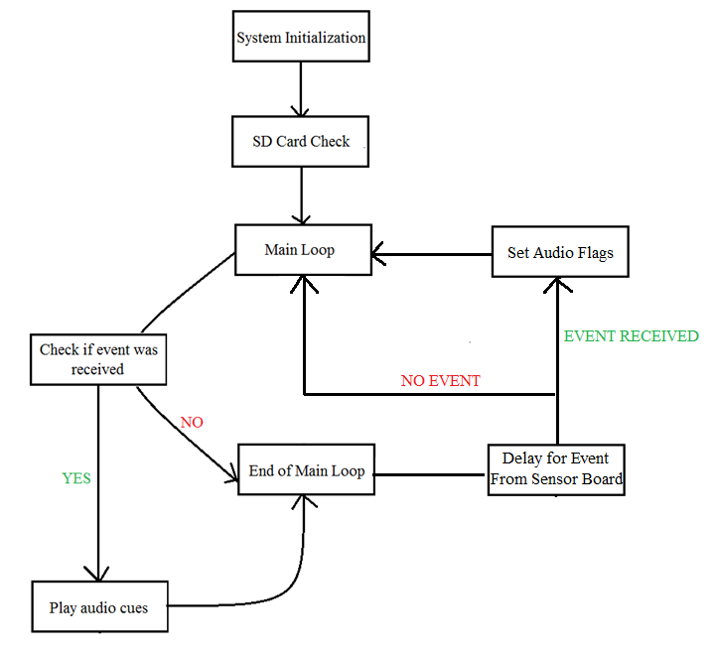

Slide 5
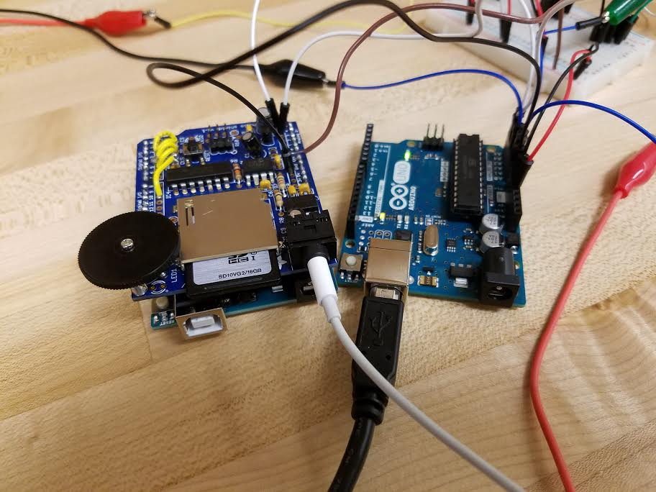

Slide 6
Audio Cues
20 different sound files.
2 – startup
4 – Obstacle type
11 – Distance
3 – Directions
Each cue approximately half a second long.

Slide 7
Results
If constant warnings are being given, every other event from the sensor board will be relayed to the user.
Some static interference with the audio cues. Cause has been tracked to a possibly faulty chip.
Possible future work user interface may include adding different forms (tactile or visual).

Slide 8
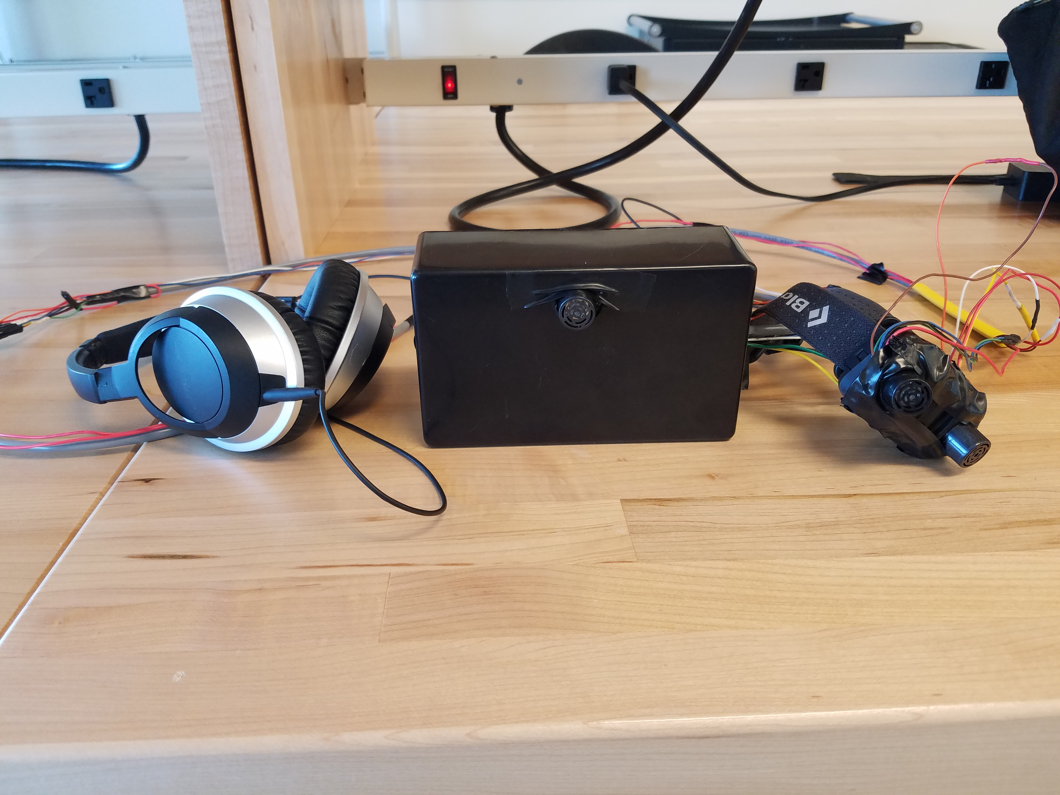
Questions?

