Slide 1
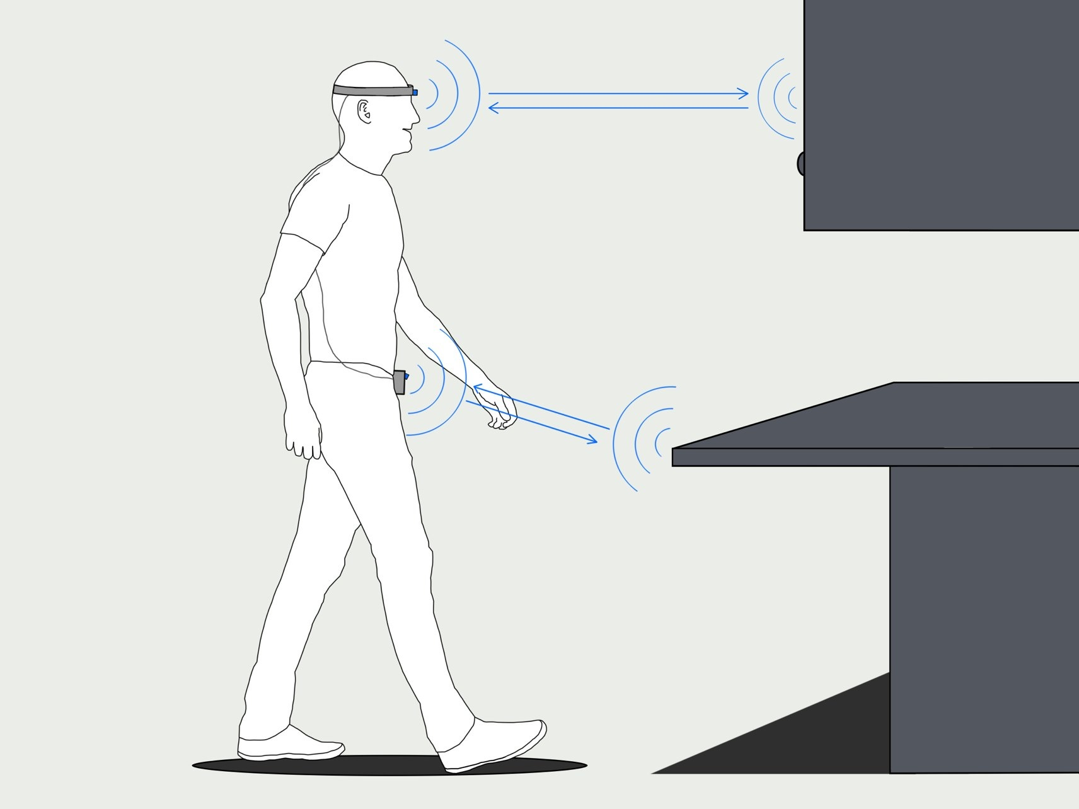
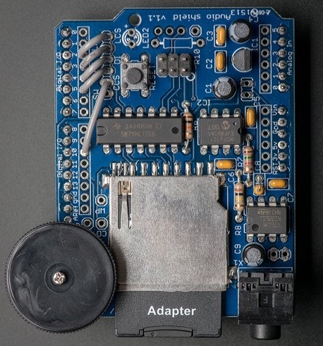
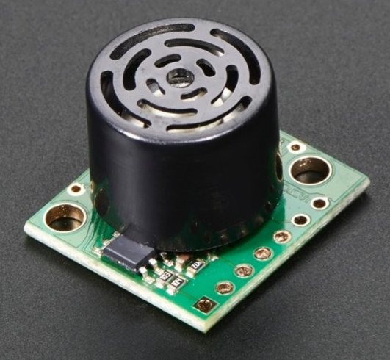
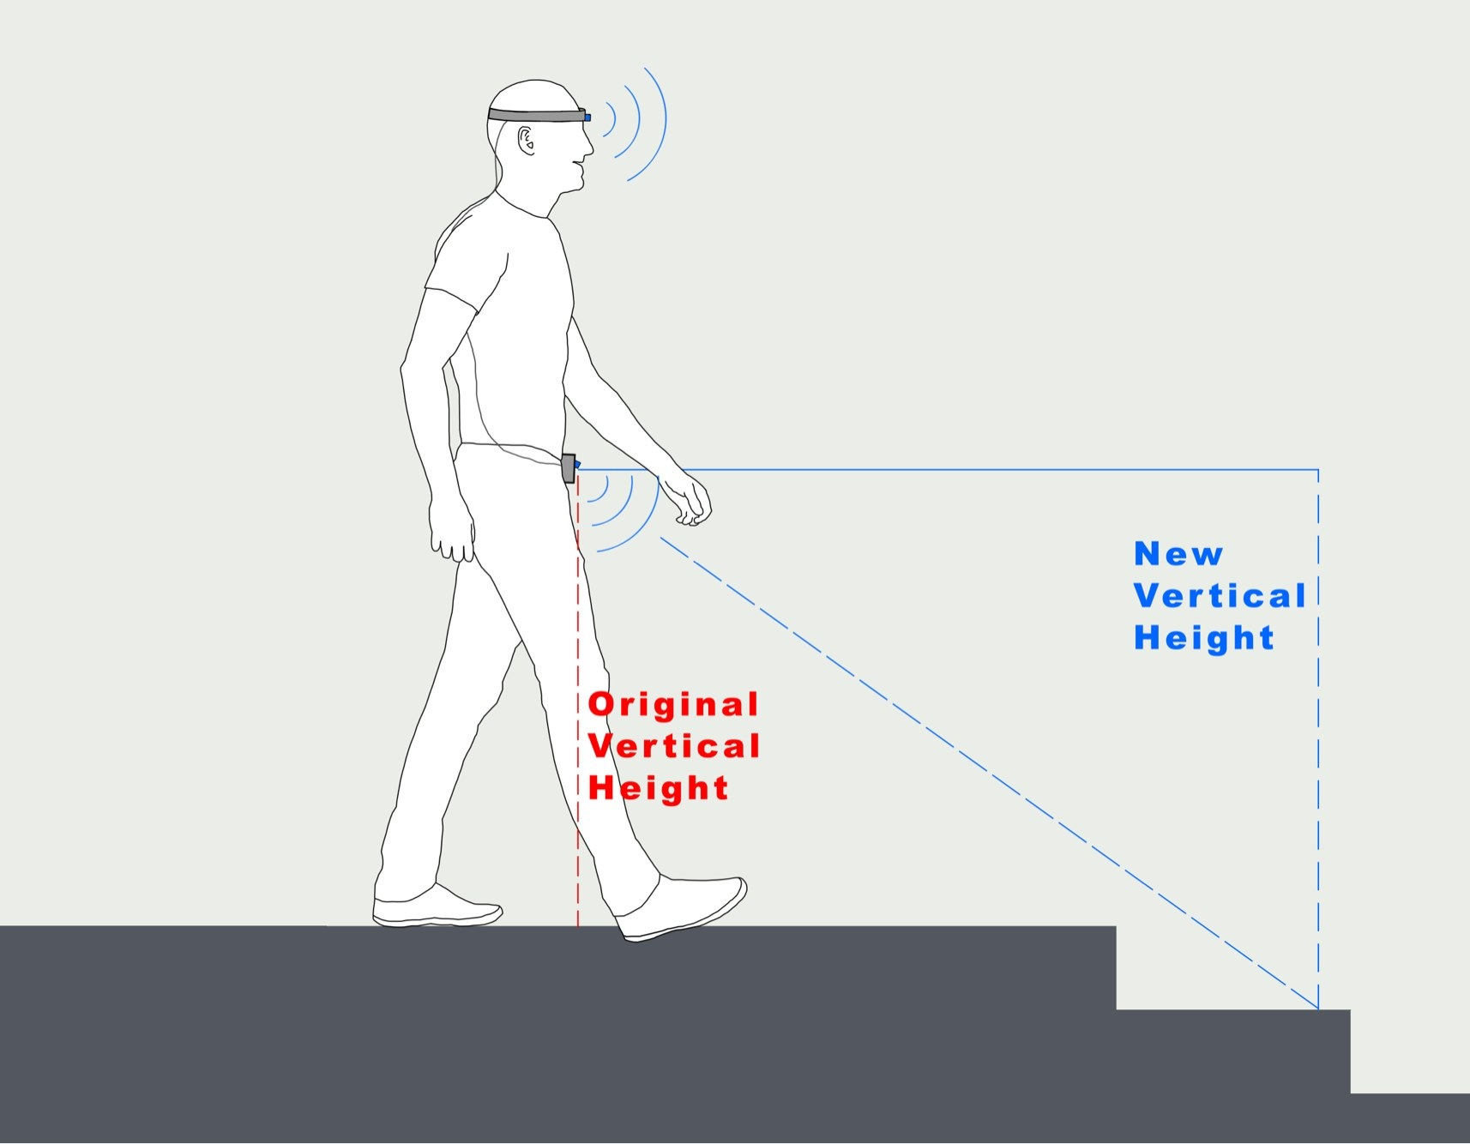
Obstacle Detection System with Audio Feedback
T. Reid
E. Riley
B. Williams-Stewart
Supervisor: Dr. Randy Moulic
Project Overview
Warning Types and Alerts
The goal of this project was to create an obstacle detection system combining ultrasonic sensors with a microcontroller to create a system that could be utilized by the visually impaired to help reduce or prevent accidents from collisions or trips that can result while navigating their environments, even while using typical mobility tools such as the white cane.
The system takes sensor measurements ~6 times a second, keeping track of the past several readings to make decisions on what warnings to issue to the user. The three elements comprising an audio output are given below.
Direction: Left, right, or both for head level obstacles, forward for waist level obstacles
High, low and drop-off are an indicator of where the obstacle is located based on which sensor unit is detecting the object
An estimate of the relative distance away from the obstacle the user is, given in foot measurement
Current Status
The system uses ultrasonic sensors to determine the distance to the nearest objects in the user’s path. If the user walks too close to an obstacle or if a surface level drop is detected ahead, a warning message will be played to the user through a pair of headphones. The system is battery powered, currently using a 9V battery. To use the system, the user dons the head piece and straps the hip sensor system around their waist. The battery is connected externally via a snap interface, which can then be stowed in a pocket.
When initially started, a series of sensor readings are taken from the waist sensor which will calculate the average floor height. This value will later be used to determine if there are low objects or a drop in the user's path. Once the initial readings are completed, the system will tell the user that they are free to move.
System Components
2 x Arduino Uno Microcontrollers
2 x Maxbotix EZ0 sensors
1 x Maxbotix EZ1 sensor
1 x Adafruit Wave Shield
1 x SD card with audio recordings
1 x Housing unit including a mini breadboard
6 x 100 ohm Resistors
1 x 1k ohm Resistor
1 x 9V Battery
Assorted wiring
T. Reid
re.tmreid@gmail.com
E. Riley
evantriley@gmail.com
B. Williams-Stewart
b.j.williamsstewart@gmail.com
Notes:
Current Status Bullet Points
Device uses ultrasonic sensors to detect distance of nearest obstacles
User can walk towards an obstacle and a warning message is delivered via an audio system
Initial readings are taken from the hip sensor and calculates each users average floor height. This value is used to detect low obstacles and drop offs.
If drop offs are detected in the path of the user again a warning message is played through the audio system
To use system, place head unit across the forehead and strap hip system around the waist. Followed by connecting a 9V battery to the system
After connection of battery, allow the system to take those initial readings.
Once this is complete the system will inform you that you may proceed with moving in your environment.

