Slide 1
Sensor Controller
for Obstacle Detection System
Trail Reid
Team Members: Briana Williams-Stewart & Evan Riley
Supervisor: Prof. Moulic, PhD
Instructor: Prof. Cavalcanti, PhD

Slide 2
Overview
Original requirements
Sensor difficulties
Sensor Input
Current System Results / Using the System
Warnings / Determining Alerts
Programming Environment
Testing
Future Possibilities

Slide 3
Main Original System Requirements
Take multiple sensor readings each second
Ignore/compensate for noisy readings
Detect when the user approaches a drop-off
Output an audio warning if the user gets within certain range of an obstruction
Easy to use

Slide 4
Sensor Difficulties
Ultrasonic sensors measure distance to closest object
Wave reflection/distortion
Waves are conical
Sensor resolution is one inch, leads to variability in readings
Noise vs. dead sensor

Slide 5
Sensor Input
Sensors read over analog
On-board analog to digital converter
Signal converted to 10 bit digit
Received value is twice the distance to the closest object
When the sensors worked, the readings were accurate to within an inch (ignoring noisy readings)

Slide 6
Current System Results
Sensor readings ~6 times a second
A warning must be updated a minimum number of times to cut down on false warnings due to noisy readings
Audio warnings are generated and played for the user when obstacles encountered
Walking speed ~1 m/s
No user input necessary for use, simplifying the setup process

Slide 7
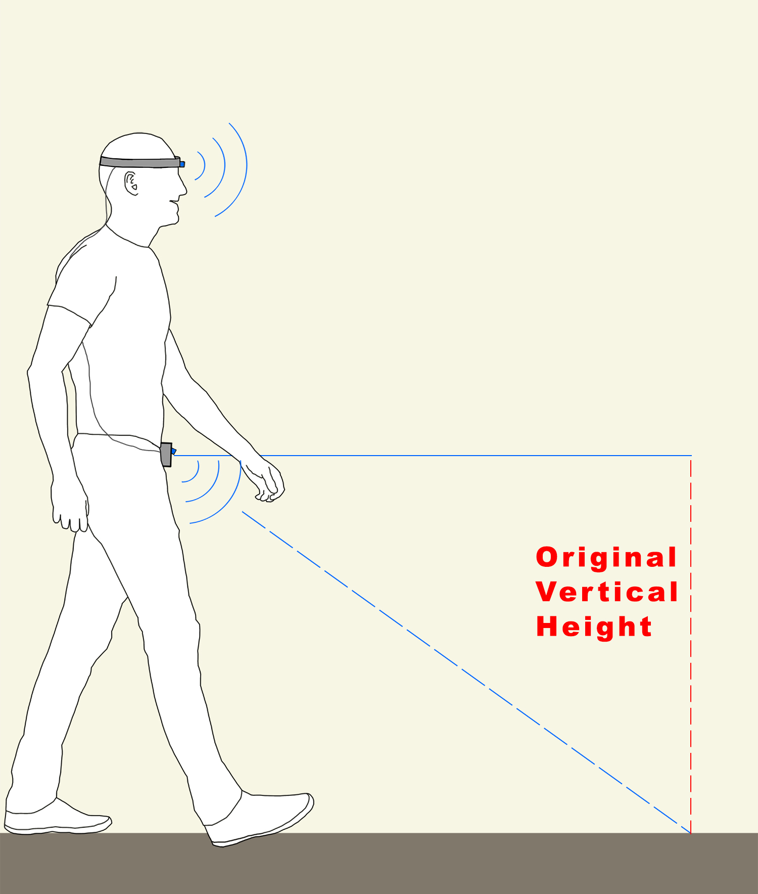
System Use
System is powered
System takes initial floor readings for baseline
Audio message indicating system launch is played to the user
System starts detection mode and will output warnings when obstacle encountered

Slide 8
Warnings
A warning object is a saved state of the sensors for comparison with the next readings
A warning is generated if:
Either head sensor reading is below head threshold
The waist sensor reading is below waist threshold
Both 1 and 2
The waist sensor reading is more than a threshold value larger than the initial average floor height

Slide 9
Warnings (cont.)
When a warning is going to be generated, the system will check if an existing warning can be updated
If a warning with the same triggered sensors is found, the sensor readings in the old warning will be updated
Otherwise a new warning is created

Slide 10
Determining Alert
When a warning is created or updated, the warning properties are set
These include: critical level, object region, and distance to closest object
Decisions made by comparing the different sensor readings to each other and defined thresholds

Slide 11
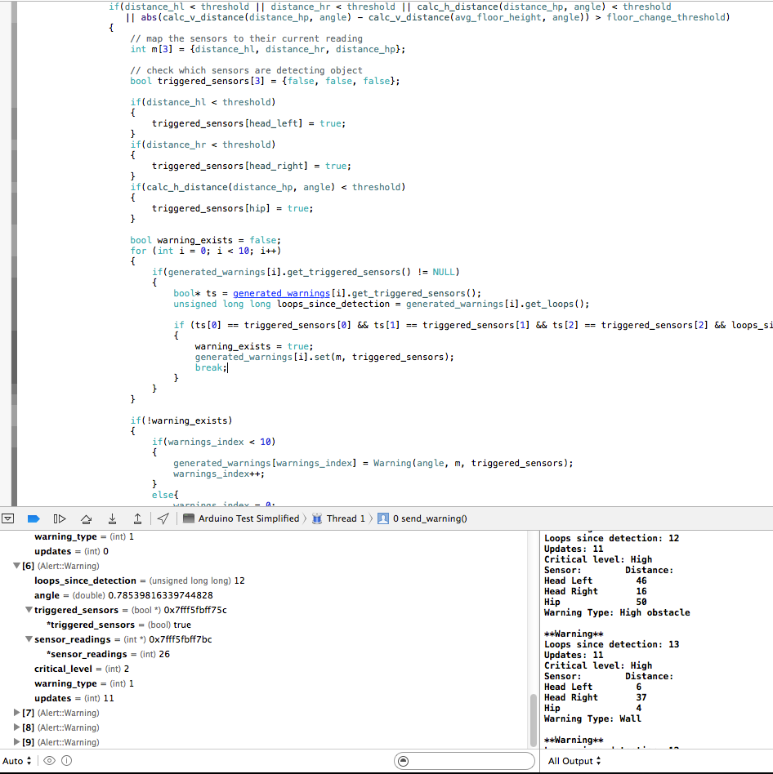
Programming Environment
All programming done in C/C++ with use of built-in Arduino libraries
Mainly used the default Arduino IDE
Used Xcode for testing and editing of library files

Slide 12
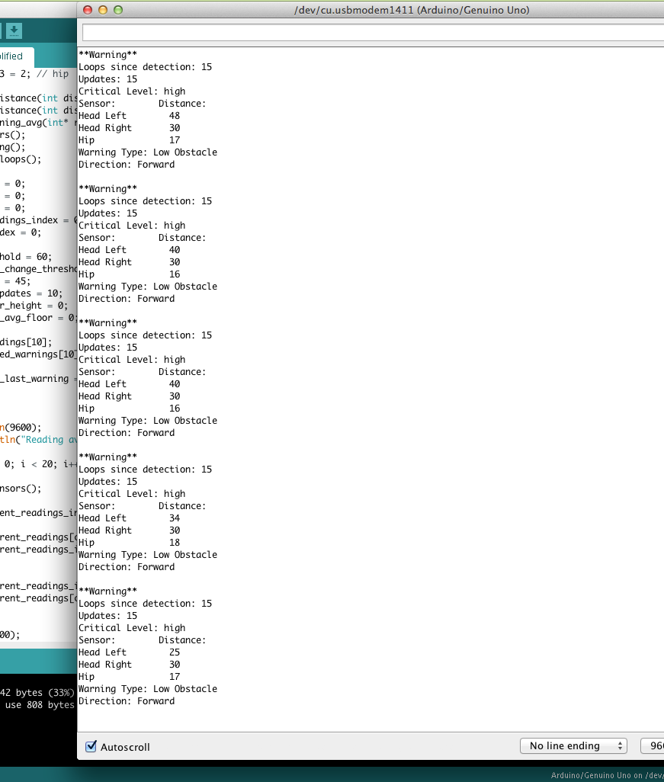
Testing
Majority of testing accomplished by running code on the Arduinos
Initial testing used a simple program to output sensor readings
Next program iteration only output values within a certain distance from sensor
Tested by moving objects in and out of threshold
Later versions of the sensor controller were tested for correct assignment of warning types
Also used Xcode debugger for stepping through program to check correct functionality of methods

Slide 13
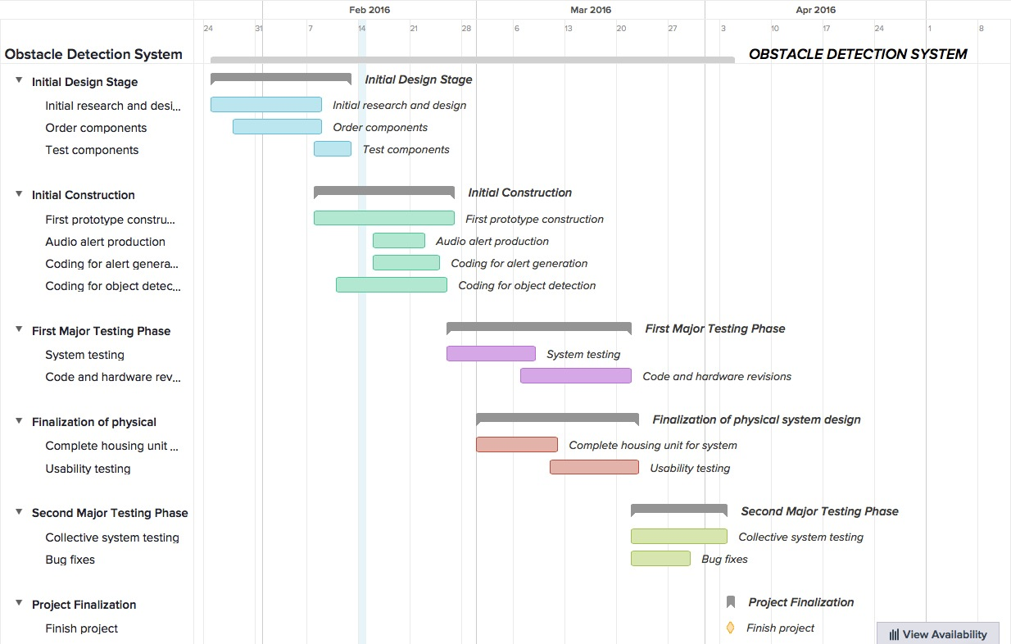
Original Planned Timeline

Slide 14
Improvements and Future Work
Dynamic sensor angle updates
Faster output to user to allow for faster walking speeds
Optimized sensor reading filtering
More sensors with narrower beams to give a more accurate picture of the environment around the user
Extra functionality built in through hand gestures

Slide 15
Questions?

