Slide 1
Back End for Ocean Data Analysis Program
Name:Tuan Huynh
Supervisor: Dr. Jifeng Peng

Slide 2
What it is
A program that automatically gets ocean data from an eight day period of time and computes LCS from it on a daily basis. You can then plot the data to get a visual of what the LCS looks like from the data

Slide 3
Motivation
This program provides graphs that show LCS in the ocean.
LCS are structures in fluids that effect the area around them and guide where fluid around then flows
With this it can be used to find the path things will float in the water
This could be used for things like finding where oil from an oil spill will flow, where plankton will go
The program currently works for ocean data but the formulas used to calculate can be used for wind

Slide 4
The requirements from the program
Automatically download ocean data
Automatically run the data through a LCS calculation program
Plot that data onto a graph

Slide 5
Requirements broken down
Downloading the data automatically
Write a program to download the data
Make a GUI to change the type of data to download
Automatically run the data through a LCS calculation program
Break down the GUI
Write a program to pipe the data into the modified LCS calculation program
Check that data is correct

Slide 6
Design
The backend was mostly used for data processing
We decided to take a modular approach to design as it fit the project
The program is made of functions that are all called by a main function
All functions can work independently

Slide 7
Problems that happened
The website, data was pulled from sometimes doesn’t work.
The original LCS calculation problem was a lot more complicated than expected
It is hard to know if the data is valid

Slide 8
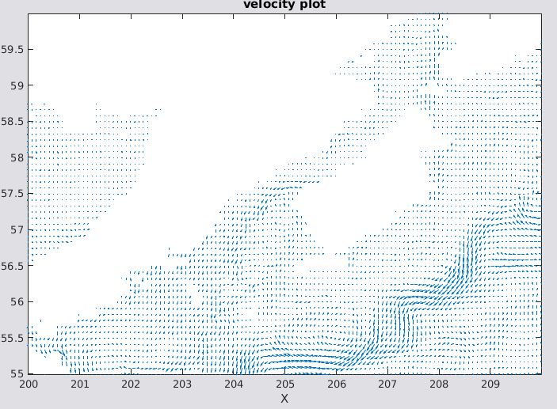
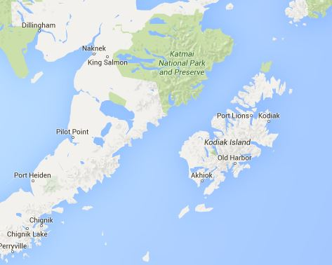

Slide 9
Program as of now
Downloading works fine
Piping the files into LCS calculation program works
The data after going through the LCS program may not be correct

Slide 10
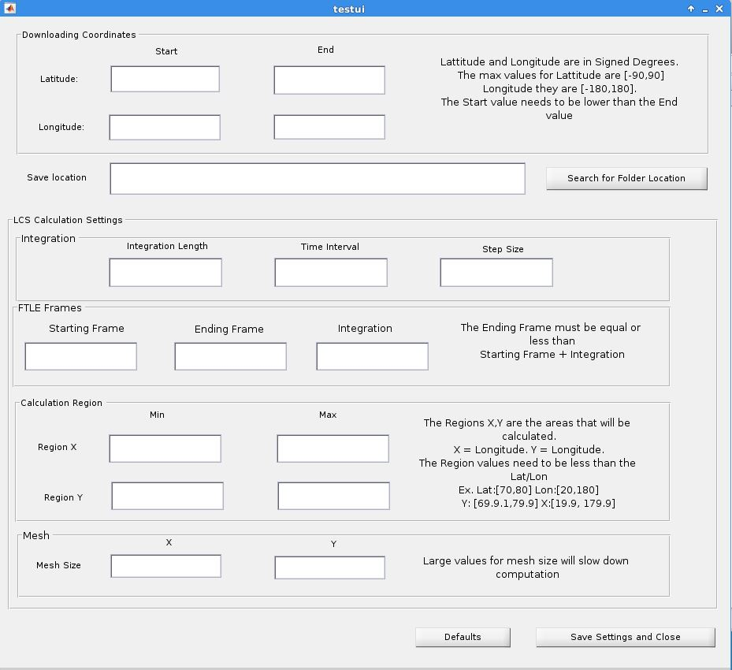

Slide 11
Future work
Program would benefit from being written in a different language
The units need to be found for the variables in the LCS calculation script
Publish the graph plot data onto a website

