Slide 1
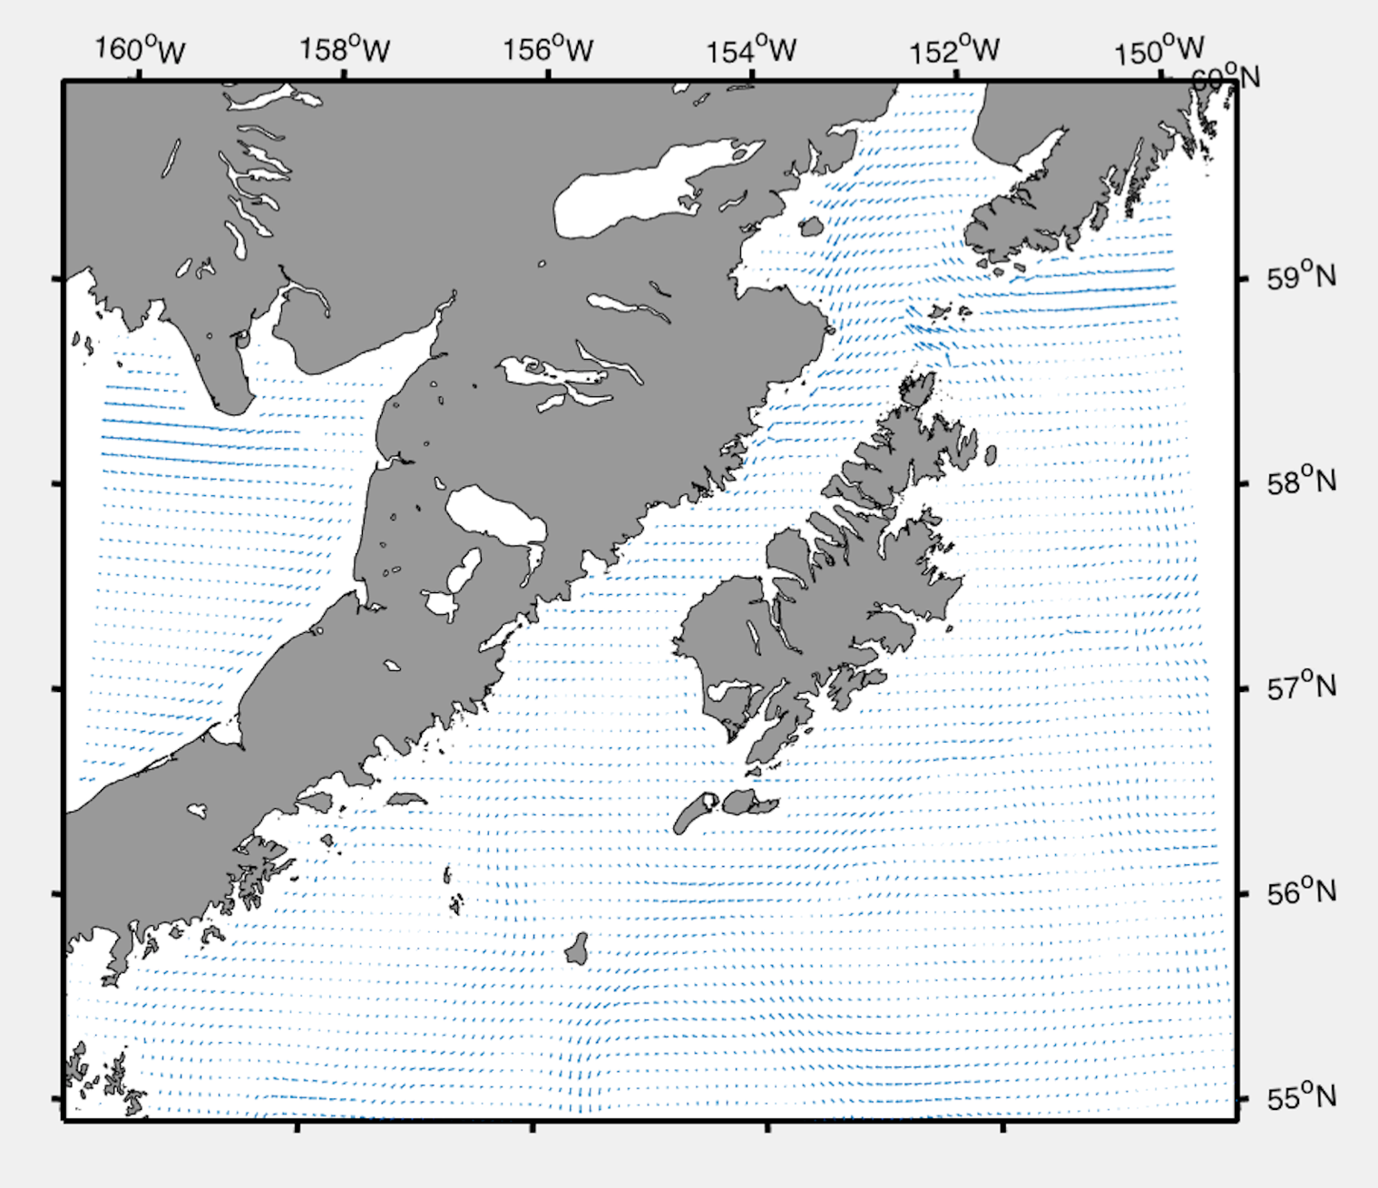
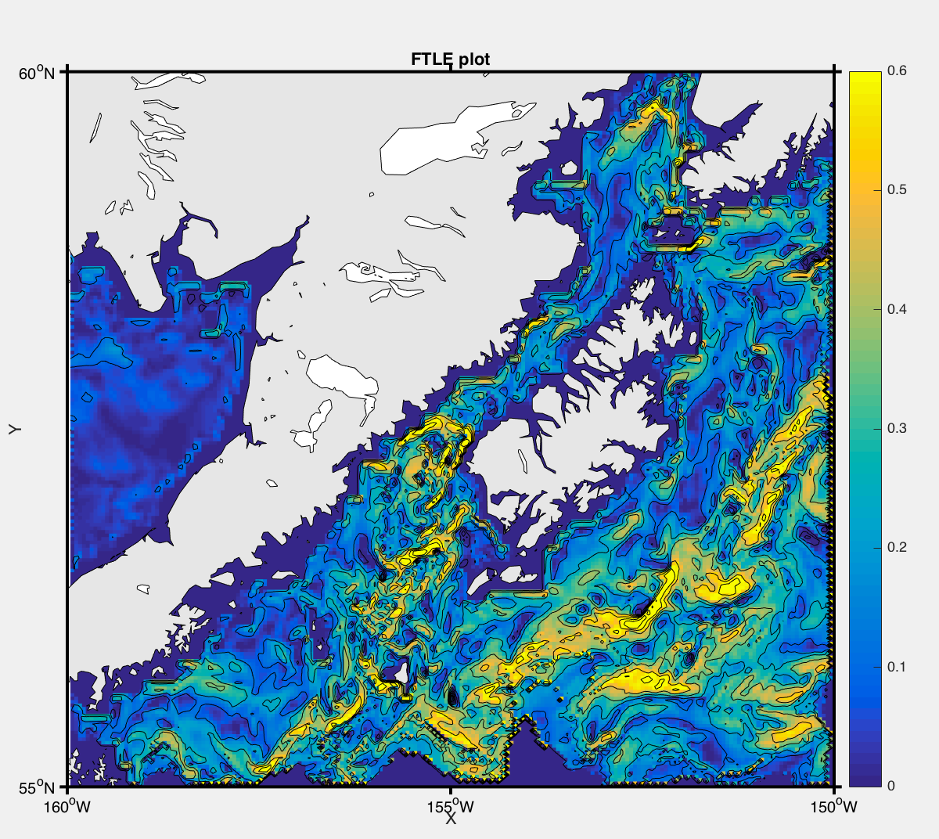
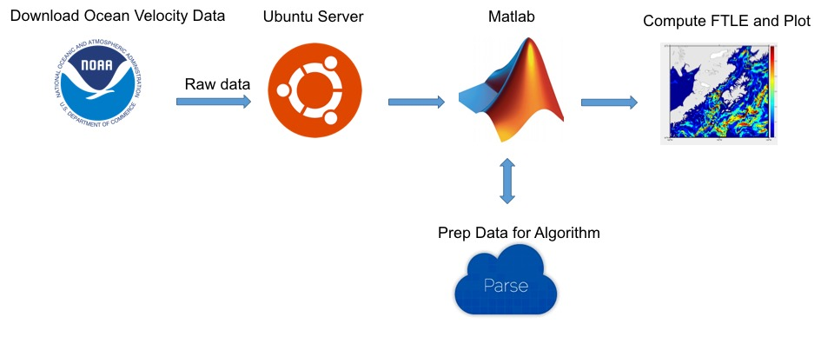
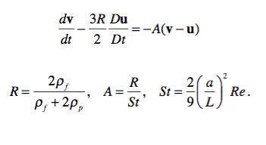
Automated Analysis of Ocean Current Flows using a Dynamic Systems Approach
Computing finite-time Lyapunov exponent (FTLE) fields, from which Lagrangian Coherent Structures can be identified.
Prepared by: Jon Rendulic and Tuan Thuynh, Supervisor: Prof. Jifeng Peng, PhD
Department of Computer Science and Engineering
Abstract
Introduction
Visualizing the Attracting Structures
Atmospheric and oceanic flows play an important role in the transport of any pollutant in the atmosphere or in the ocean. The flows are usually chaotic with some large-scale dominant patterns and small-scale turbulence. Therefore, it is difficult to accurately forecast pollutant transport. Over the past 15 years scientists have made enormous strides in their ability to identify and visually represent the underlying mechanics of flowing air and water, and to predict how objects move through these flows.
Recently, a new analyzing tool was developed in which a dynamic systems approach is used to identify attracting structures in the flow field. The attracting structures dictate the pollutant transport and mixing, therefore providing information on potential hazard zones. The hazard zones are less prone to inaccuracy of the flow field and the pollutant source data than pollutant trajectories, especially in long-term prediction.
This tool uses a dynamic systems approach to identify attracting structures in the flow field. It was written with the MATLAB software package and was developed by the Biological Propulsion Laboratory at California Institute of Technology. It enables users to input a time-series of 2-D velocity field data and compute the corresponding finite-time Lyapunov exponent (FTLE) fields, from which Lagrangian Coherent Structures (LCS) such as vortices and fluid transport barriers can be identified.
This project’s main objective is to create a server for computing and analyzing oceanic flows and automate that process by reducing the amount of user input required to acquire the raw data, analyze it and then visualize the attracting structures.
Oceanic flows play an important role in the transport of pollutants in the ocean. The flows are usually chaotic with some large-scale dominant patterns and small-scale turbulence. Therefore, it is difficult to accurately forecast pollutant transport.
The tasks for the server include:
Download ocean currents data - NOAA regularly publish ocean currents forecast data and the server is to download this data for analysis.
Compute the attracting structures using an existing algorithm - Set up the algorithm on the server to automatically analyze the currents data and determine the attracting structures.
Visualize the attracting structures - The attracting structures are displayed and visualized on the map showing the area of interests.
Visualizing the attracting structures is one of most important components of this application. Figure 4.1 shows an example plot of the raw ocean current velocity forecast data. We were then able to take this data run our modified algorithm and plot the attracting structures as seen in Figure 4.2.
Backend
Figure 4.1. Example of a Velocity Plot
Figure 4.2. Example of a Velocity Plot
The user interacts with the backend from the settings GUI. Here they will set the parameters for the program’s calculations. The backend is comprised of 6 functions that work as follows, a settings menu, a main function that runs program, downloading, data parsing, data calculations, data plotting. The program downloads data from NOAA and breaks the file down and extracts the variables it needs to calculate LCS. This data is then pushed into the plot function which saves a png and pdf file of the plot.
Server
The server has Ubuntu Server 14.04 with Xfce as the desktop environment. We have Crontab running in order to schedule scripts to run automatically at scheduled intervals. MATLAB is installed and was the main programming language used to computer the attracting structures. The algorithm we modified is the LCS MATLAB Kit V2 developed in the Biological Propulsion Laboratory at California Institute of Technology.
Figure 3. Simple System Diagram
Results and Conclusions
The Theory
We were able to meet all the major objectives of this project and have a solid foundation in place for future development. We were able to modify an existing version of the Algorithm in such a way to remove the GUI and the need for the input of user defined parameters each instance the application is run, hence automating the process.
We were able to reduce the code 68% by modifying the existing 1840 lines of code into 590, removing 1250 unnecessary lines, making it more efficient and automating it to suit our needs. This eliminated several unnecessary functions, UI for parameter input, and UI to establish directories and find files.
We were also able to improved the code to visualize the attracting structures and plot over high resolution maps of the area of interest automatically.
The FTLE calculation described in the abstract consider dynamical systems of ideal fluid tracers, which has the same velocity as local flow velocity. A similar approach can be used to study dynamical systems of finite-size inertial particles. This code can also calculate particle FTLE in dynamical systems of small, rigid, spherical particles, whose dynamics are described by the linearized Maxey-Riley equation as seen in Figure 3.
Figure 3. Maxey-Riley Equation
Contact Information:
Future Work
Jon Rendulic Tuan Huynh
Email: jmrendulic@alaska.edu Email: thuynh3@alaska.edu
One of the future goals is to plot the data over a google map.
Create a webserver to access and visualize the data.
Some modifications to the code are still required to increase the number of frames in which the data is integrating over.
Some bugs also need to be worked out on the conversion of lat/lon to UTM and back so that the time interval can be updated to integrate an increased number of frames.
Figure 1. Settings GUI

