Slide 1
Automated Analysis of Oceanic Current Flows using LCS Algorithm
Name: Jon Rendulic - Computer Systems Engineer Major
Supervisor: Prof. Peng - Mechanical Engineering Department
University of Alaska Anchorage
CSCE A470 Capstone Project - April 11, 2016
Project Objective: Create a web-server for computing and analyzing atmospheric and
oceanic flows
Contact info:
Name: Jon Rendulic
Email: jmrendulic@alaska.edu
Phone: 907-306-5027
Compilation and Parallel Start

Slide 2
CSCE A470 Capstone Project
Project Objective: Create a web-server for computing and analyzing atmospheric and oceanic flows
Atmospheric and oceanic flows play an important role in the transport of any pollutant in the atmosphere or in the ocean.
The flows are usually chaotic with some large-scale dominant patterns and small-scale turbulence. Therefore, it is difficult to accurately forecast pollutant transport.
In 2006, a new analyzing tool was developed in which a dynamic systems approach is used to identify attracting structures in the flow field.
This MATLAB software package was developed in the Biological Propulsion Laboratory at California Institute of Technology. It enables users to input a time-series of 2-D velocity field data and compute the corresponding finite-time Lyapunov exponent (FTLE) fields, from which Lagrangian Coherent Structures (LCS) such as vortices and fluid transport barriers can be identified.
.
Compilation and Parallel Start

Slide 3
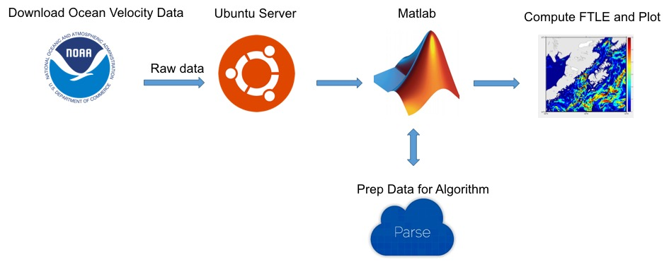
Project Tasks:
Students in this project would establish a computer server that automatically computes and analyzes real-time atmospheric and oceanic flows. The tasks for the server include:
Download wind/ocean currents data
NOAA regularly publish wind/ocean currents forecast data and the server would download these data for analysis.
Compute the attracting structures using an existing algorithm
Set up the algorithm on the server for it to automatically analyze the wind/currents data and determine the attracting structures.
Visualize the attracting structures
The attracting structures are displayed and visualized on the map showing the area of interests.

Slide 4
Project Theory
The concept of the structures grew out of dynamical systems theory, a branch of mathematics used to understand complicated phenomena that change over time.
The discovery of the structures in a wide range of real-world cases has shown that they play a key role in complex and chaotic fluid flows in the atmosphere and ocean.
The structures are invisible because they often exist only as dividing lines between parts of a flow that are moving at different speeds and in different directions.
In the ocean, the path of a drop of water on one side of such a structure might diverge from the path of a drop of water on the other side; they will drift farther apart as time passes.
Compilation and Parallel Start

Slide 5
Example LCS Plot
Suppose a blob of oil is spilled into the Gulf of Alaska. It might quickly disperse to the Pacific Ocean.
But hours later, a spill of the same size at the same spot could circle near the coastline, posing a greater danger to marine life.
The Ocean is so chaotic that a slight shift in the place or time of an oil spill, a buoy or even a person who falls in - can dictate whether it is swept out to the open ocean or swirls near the shore.
Compilation and Parallel Start

Slide 6
Project Theory Cont.
This Algorithm is a MATLAB software package was developed in the Biological Propulsion Laboratory at California Institute of Technology.
It enables users to input a time-series of 2-D velocity field data and compute the corresponding finite-time Lyapunov exponent (FTLE) fields, from which Lagrangian Coherent Structures (LCS)
Compilation and Parallel Start

Slide 7
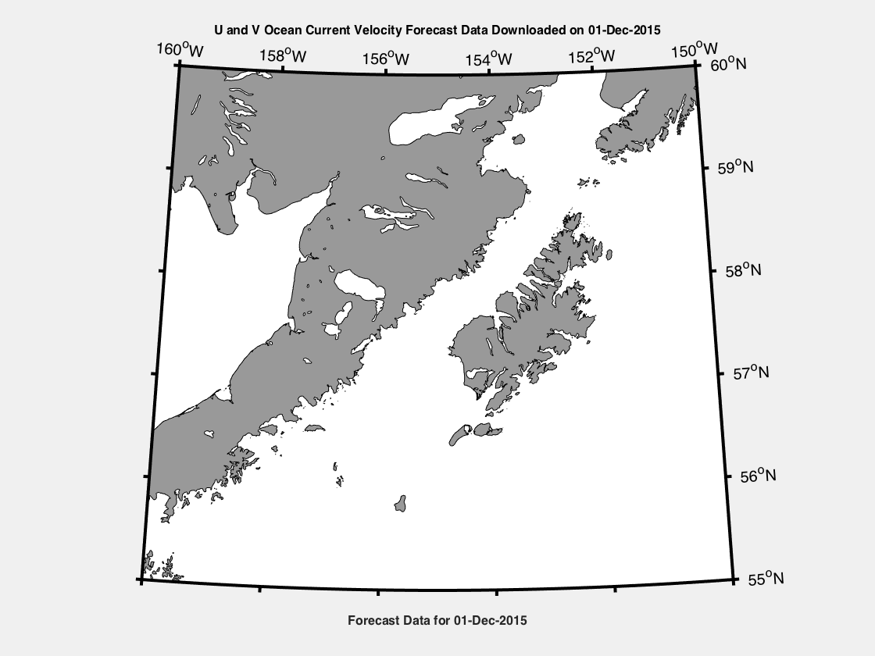
How this works:
1. It enables users to input a time-series of 2-D velocity data and outputs a velocity vector field. This is a plot of the velocity data we regularly download via a matlab script using an automated process via a task scheduling program in linux called cron.

Slide 8
2. Next we were able to modify an existing version of the Algorithm in such a way to remove the GUI and the required user defined parameters and steps to automate the process.

Slide 9
3. Next we were able to modify an existing version of the Algorithm and modify it in such a way to remove the GUI and the required user defined parameters to automate the process.
What I did is reduce the code by 68% or modified the 1840 lines of code into 590, therefore reducing it by 1250 lines, making it more efficient and automated to suit our needs.
This eliminated several unnecessary functions, UI for parameter input, UI to establish directories and find files.
Improved the code to visualize the attracting structures and plot over high resolution maps of the area of interest.

Slide 10
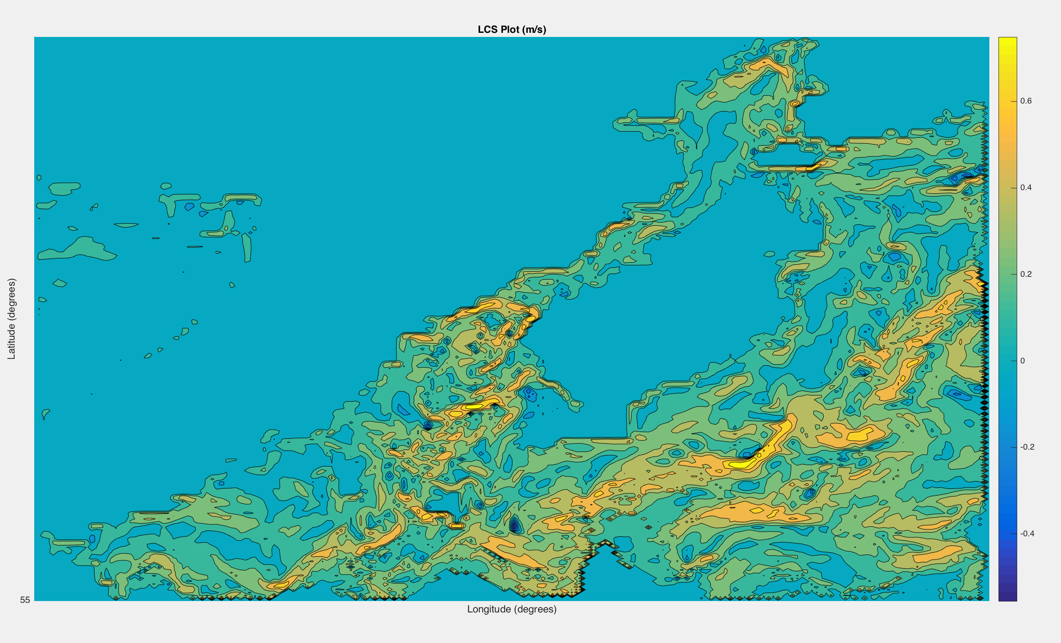
4. The Algorithm then allows us to compute the corresponding finite-time Lyapunov exponent (FTLE) fields, from which Lagrangian Coherent Structures (LCS) such as vortices and fluid transport barriers can be identified. See example of below:

Slide 11
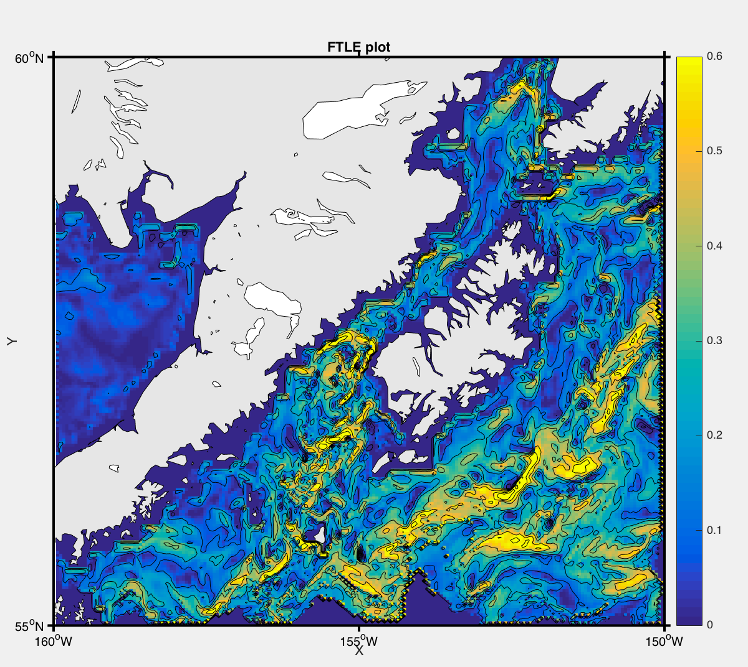
5. We then take that data which was computed and shown in the previous slide and plot it over a high resolution coastline map. See example below:

Slide 12
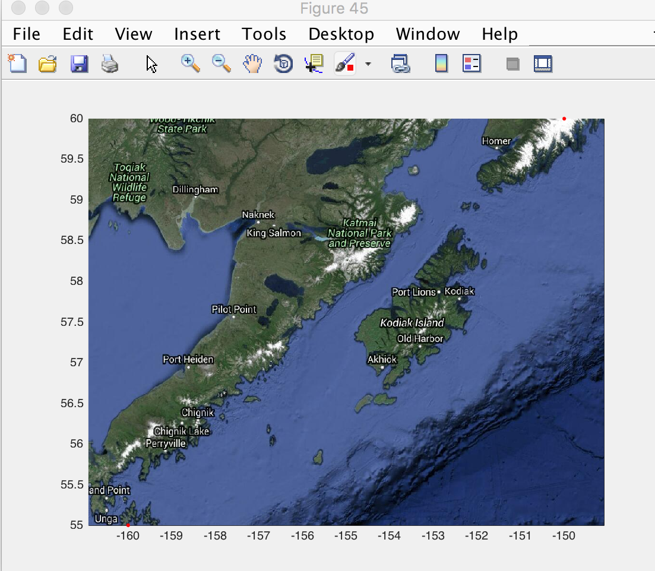
Future Work
One of the future goals is to plot the data over a google map.
Create a webserver to access and visualize the data.
Some modifications to the code are still required to increase the number of frames in which the data is integrating over.
Some bugs also need to be worked out on the conversion of lat/lon to UTM and back so that the time interval can be updated to integrate an increased number of frames.

Slide 13
Conclusion
Learned a lot of new skills, and sharpened some existing skills.
Got to put some of the project management experience from a previous internship into practice.
This project is still a work in progress, and I have a strong desire to complete the future works described on the previous slide.

Slide 14
Questions?

