Slide 1
Arduino GPS Logging Program
By: Kenneth Mendenhall
Supervisor: Prof. Adrianno Cavalcanti, PhD

Slide 2
Overview
How it works
Software / Hardware Components
Project Goals / Objectives
Lessons Learned
Conclusion / Questions

Slide 3
How it Works
PC side program connects to Intel Edison
Initialize communication channel
GPS warms up, replies back with data
Data gets stored for future use
KML data viewable in Google Earth

Slide 4
Components
NMEA Library (ATiny, v0.5.3)
RXTXComm-2-2.jar / rxtxSerial.dll
Jsoup-1.8.1.jar
Xbjlib-1.1.0.jar
FlashEdison JSON Image
Intel® Phone Flash Tool Lite

Slide 5
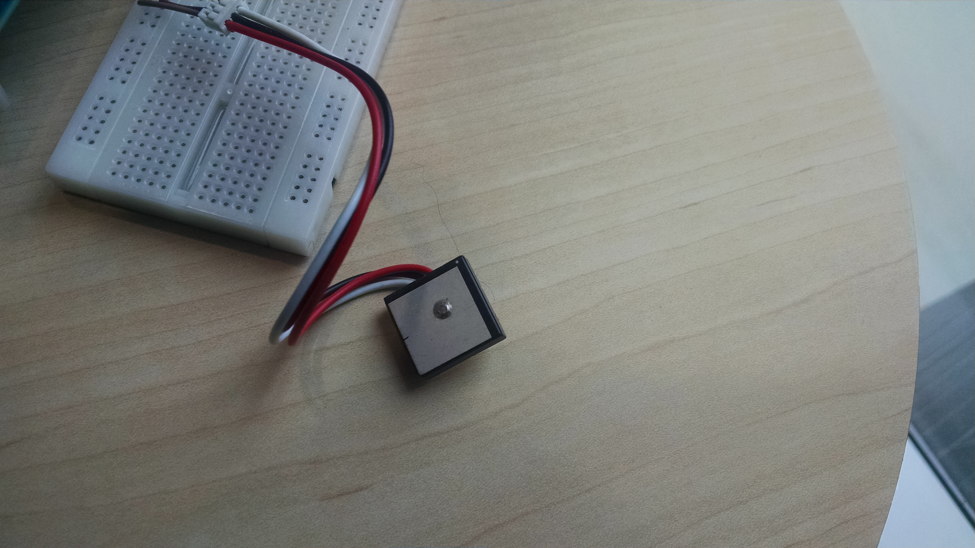
GP-17340 Receiver
Notes:
Sparkfun factsheet

Slide 6
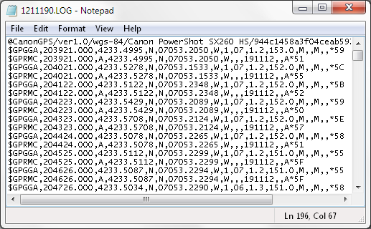
Example GPS Data Streams
Notes:
$GPRMC is the header for the type of data to follow
GPS Recomended Minimum for Transit Data
Time of the GPS fix (UTC)
Reciever error byte in the form of the characters A (Success) or V (Reciever Failure)
Latitude (N/S) and Longitude (E/W) data, in degree decimal format
Computed speed over the ground in various units (for this project m/s will be used)
Degrees will be the computed coure relative to True North. Following the course data will be the
Date of the fix
Magnetic variation data (E/W).
Mandatory checksim bit ensures data integrity

Slide 7
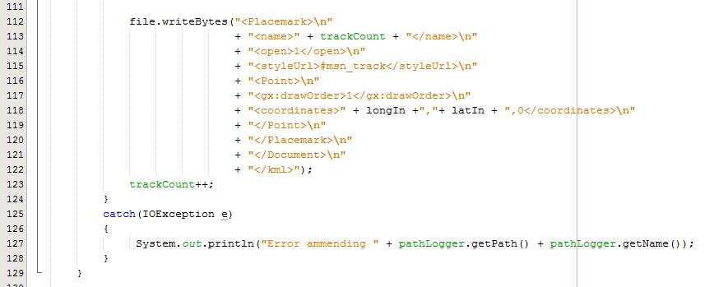
Example 2: Keyhole Markup Language

Slide 8
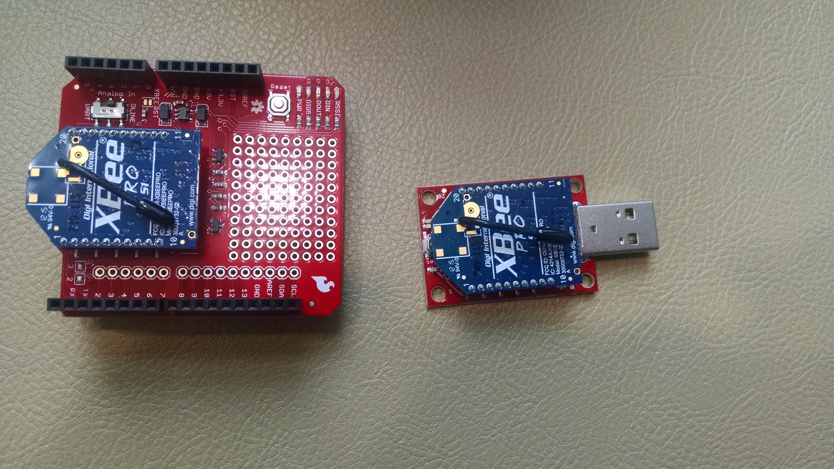
Xbee Pro Radios
Notes:
Problems integrating Xbee and GPS
Both devices use Rx Pin 0 on board
Potentially could use SoftwareSerial Library Provided by Arduino

Slide 9
More Detail
Program to log GPS data
  Latitude
  Longitude
  Course / Heading
  Speed
  Altitude
  $GPRMC Sentence Structure
  Inject data to .kml file for Google Earth to display

Slide 11
This is NOT an app
No
No
NO
Still more NO
… …
Yep… here too, still no

Slide 12
Benefits:
Expandable
Able to integrate into other projects
Possibilities are endless

Slide 13
What is Arduino?
  Driver
  C Based Coding Methodology
  Expandable DIY Prototype Environments
  Support community with great resources
Notes:
Refers to UNO or the 2560 Chip
Refers to company based out of Italy
Great community for DIY hobbyists and resources
Question and help forums

Slide 14
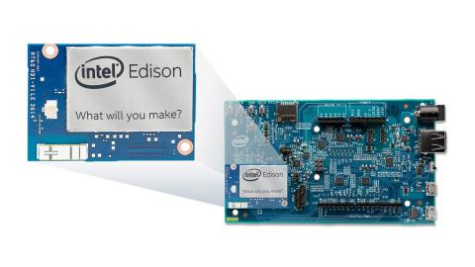
What is Intel Edison®
  Microprocessor
  Expandable breakout board
  Atom Processor @ 500MHz
  4 GB Flash Memory

Slide 15
Learning Objectives and Outcomes
Develop prototype for future projects
Expandable
Cheap
Issues integrating GPS
GPS Accuracy / Need new GPS
  System feedback

Slide 16
Questions?

