Slide 1
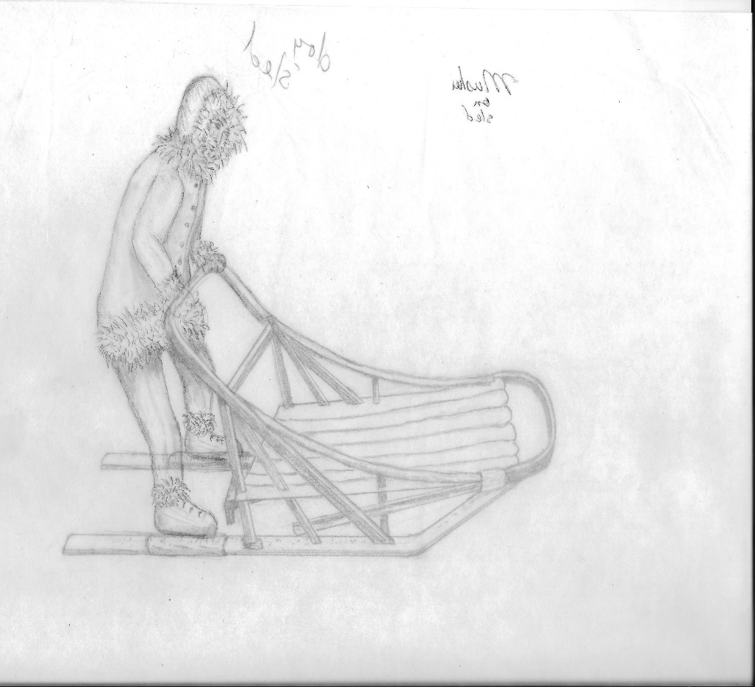
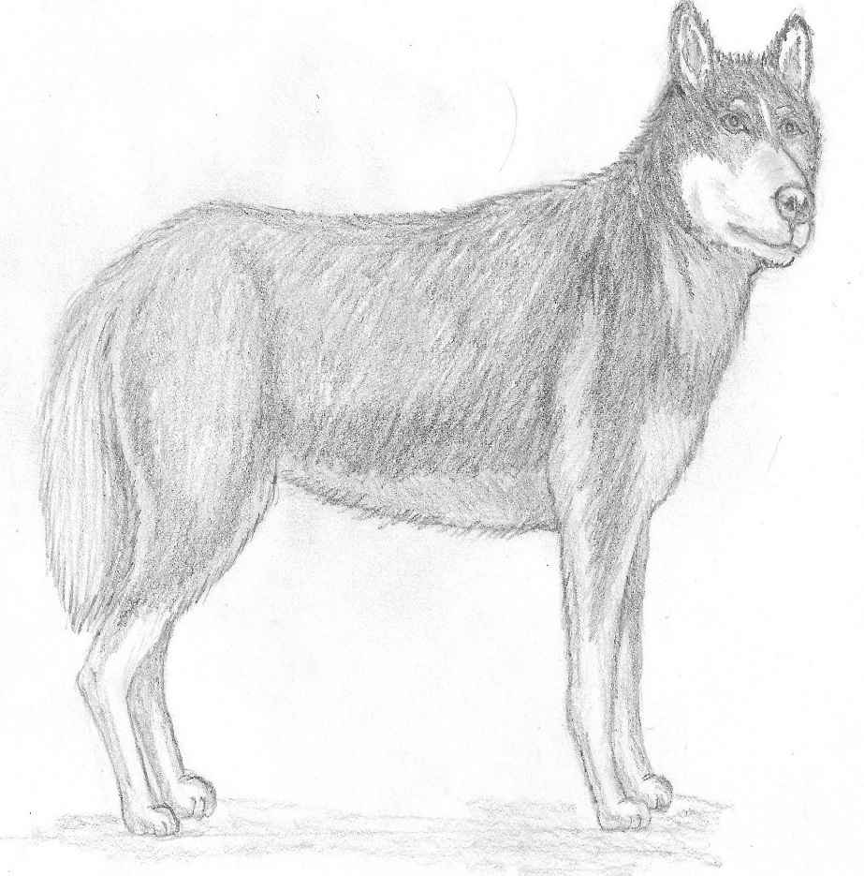
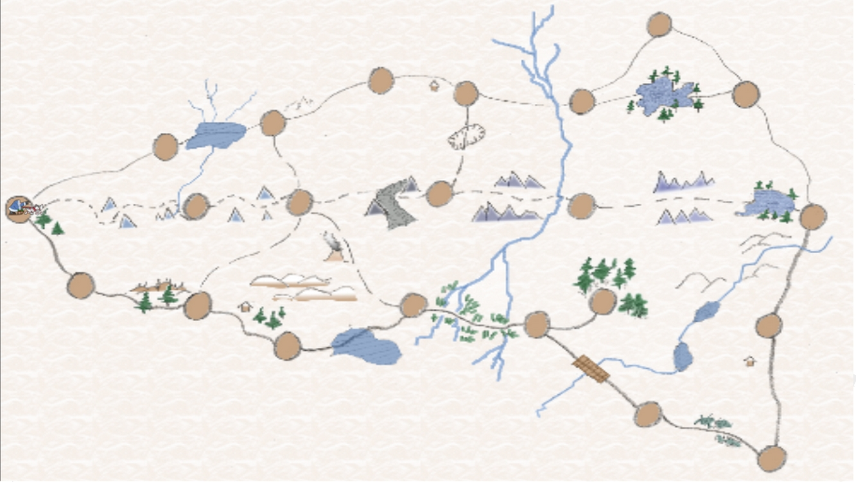
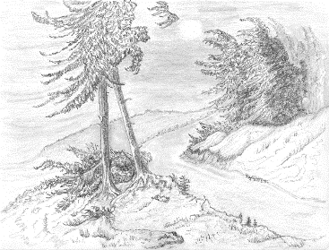
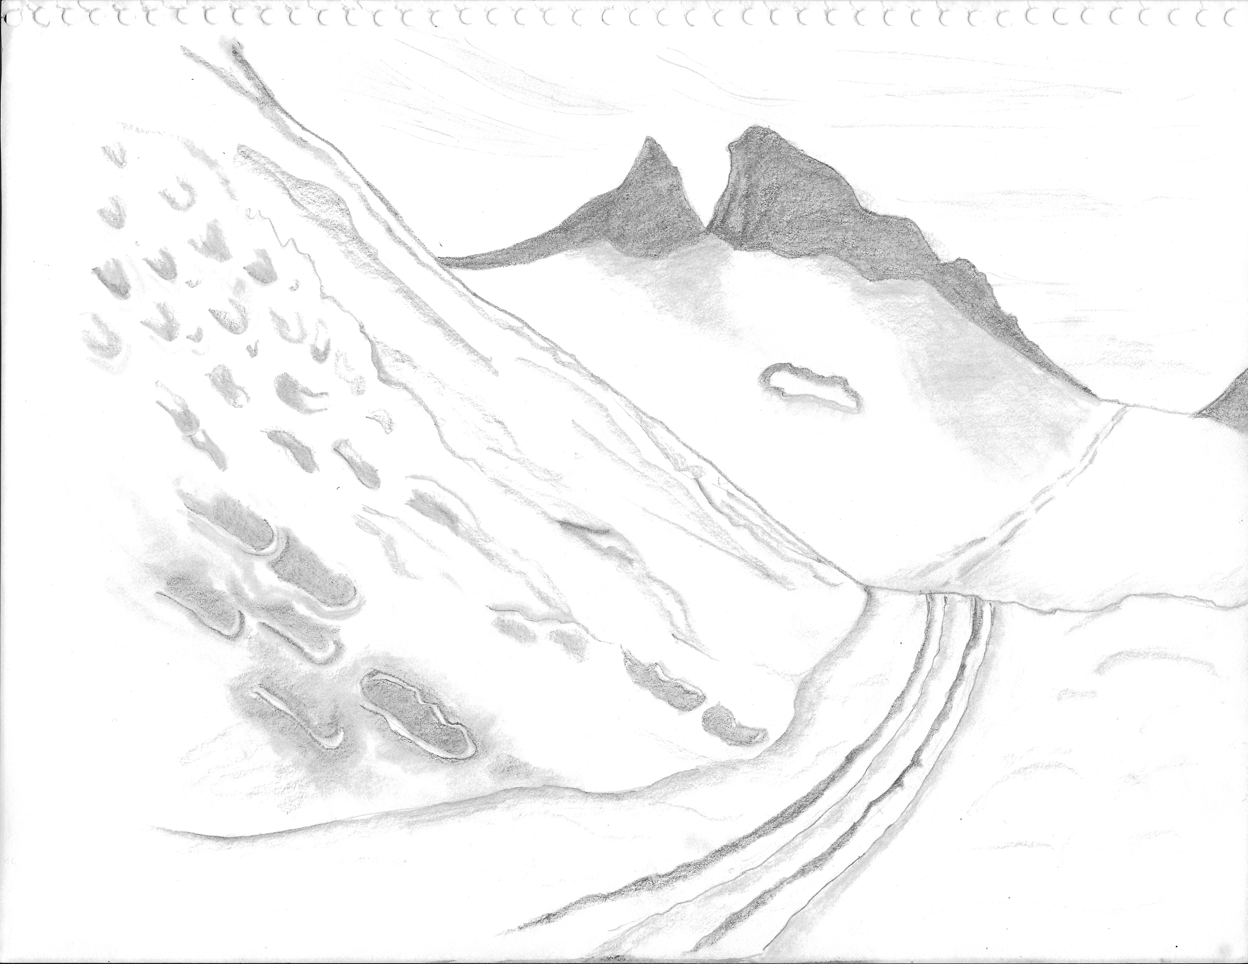
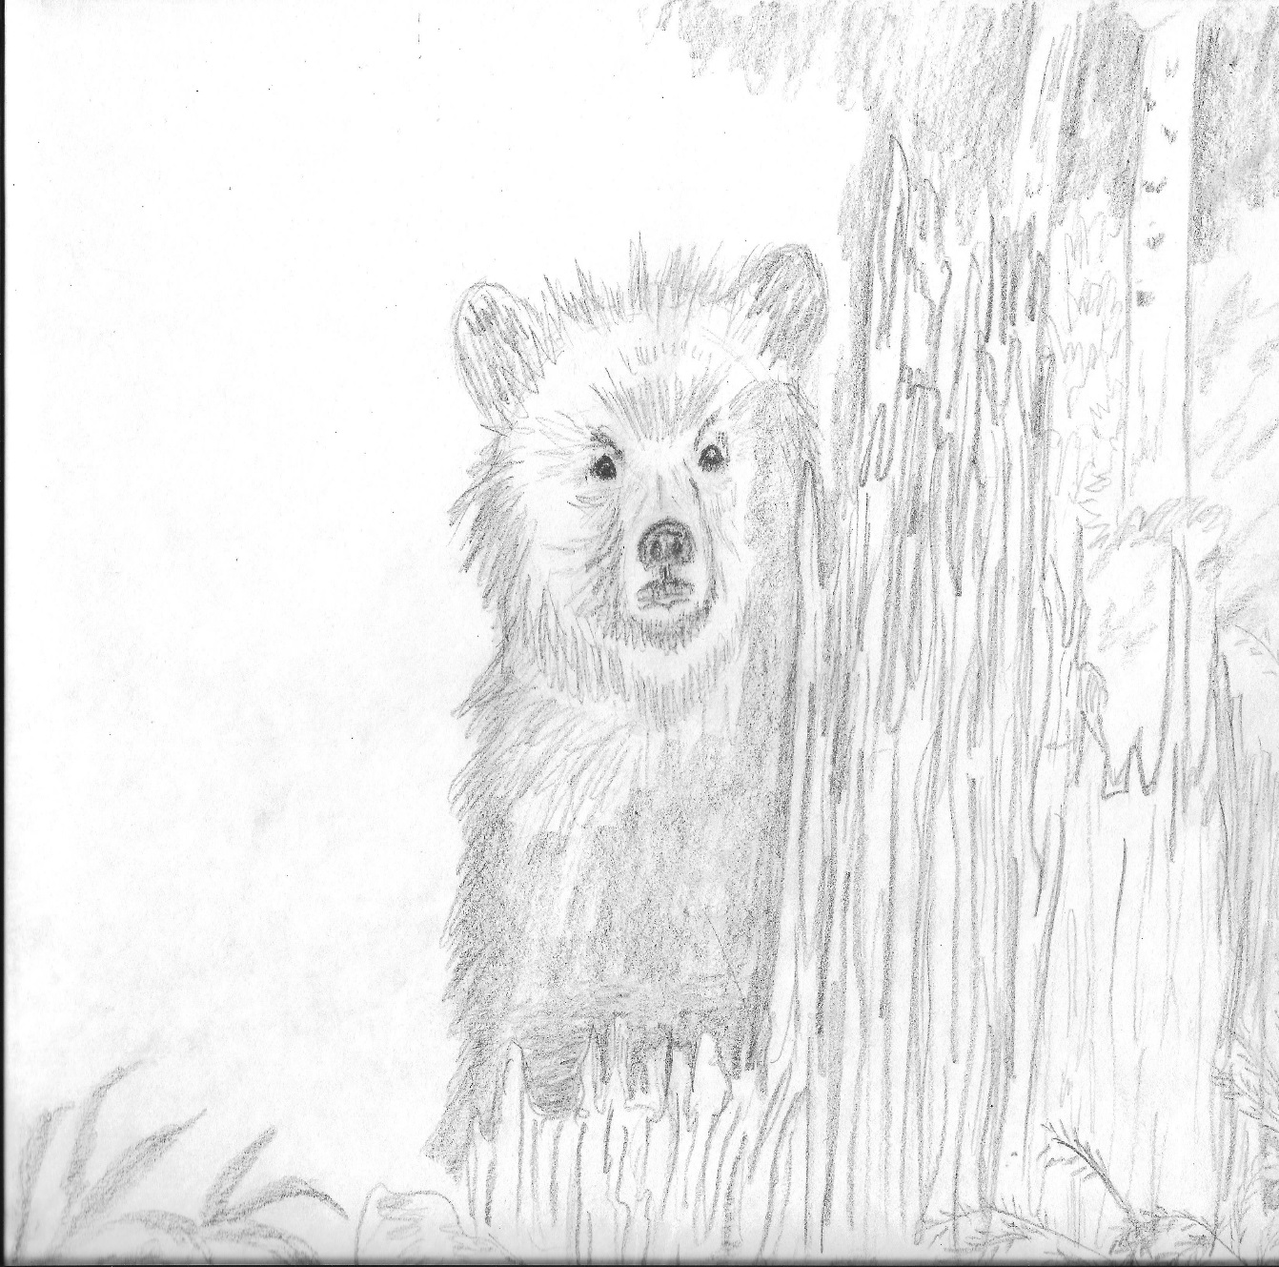
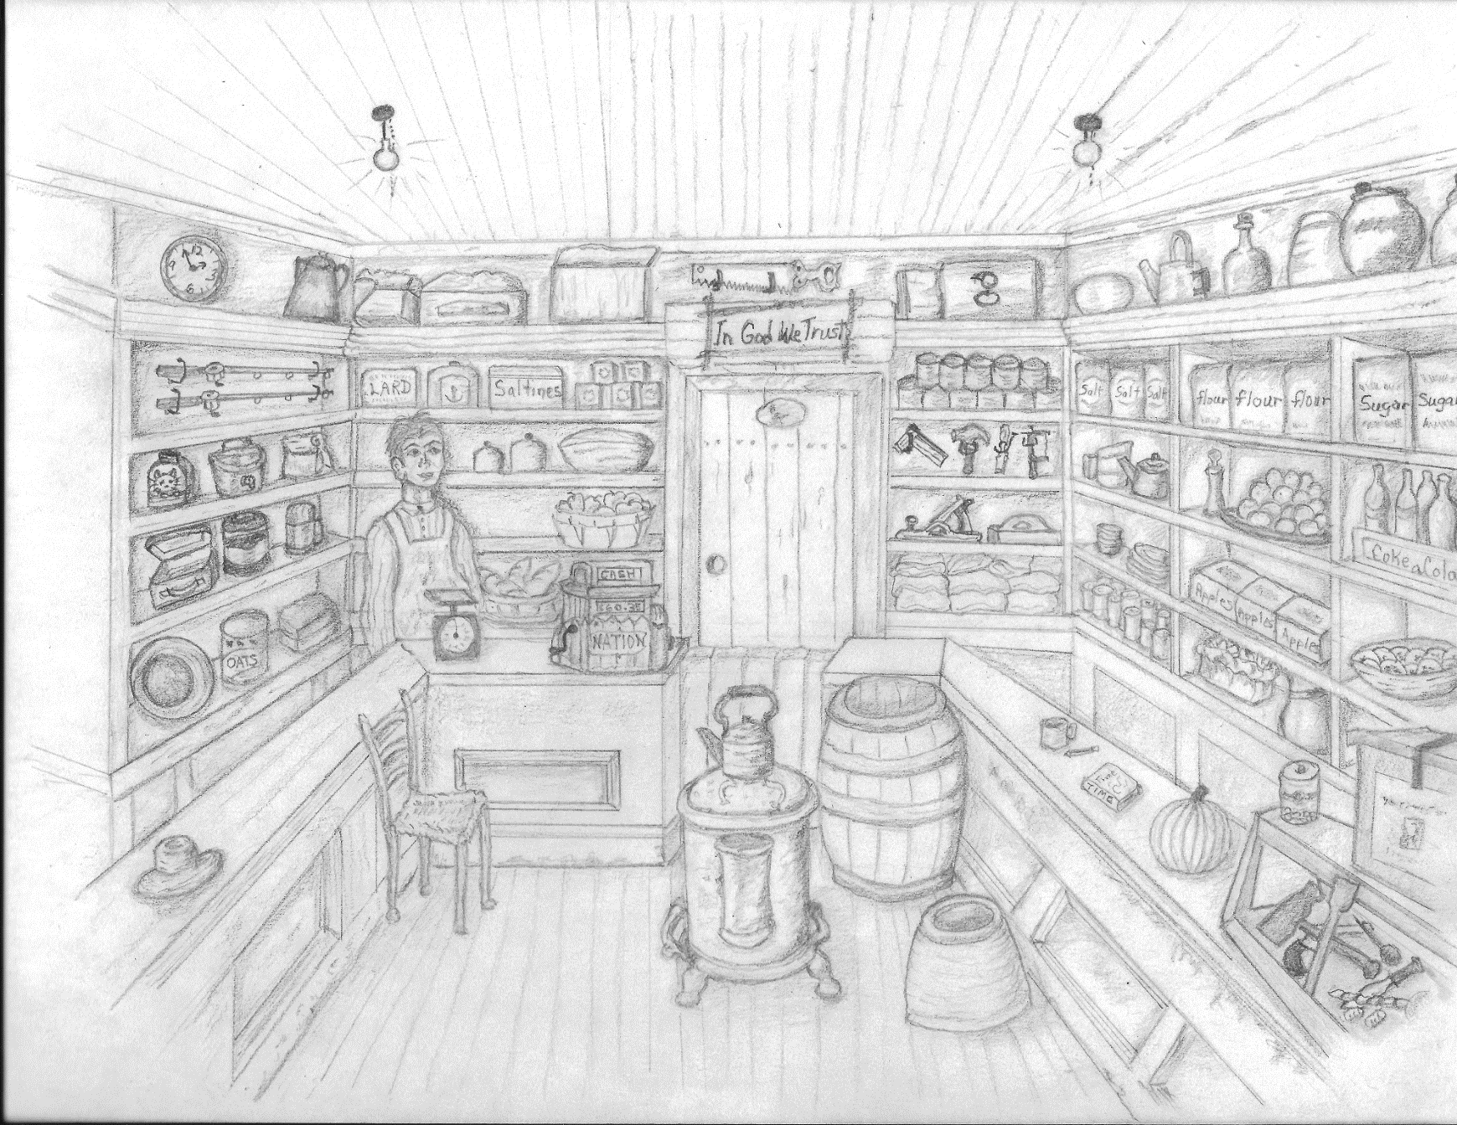
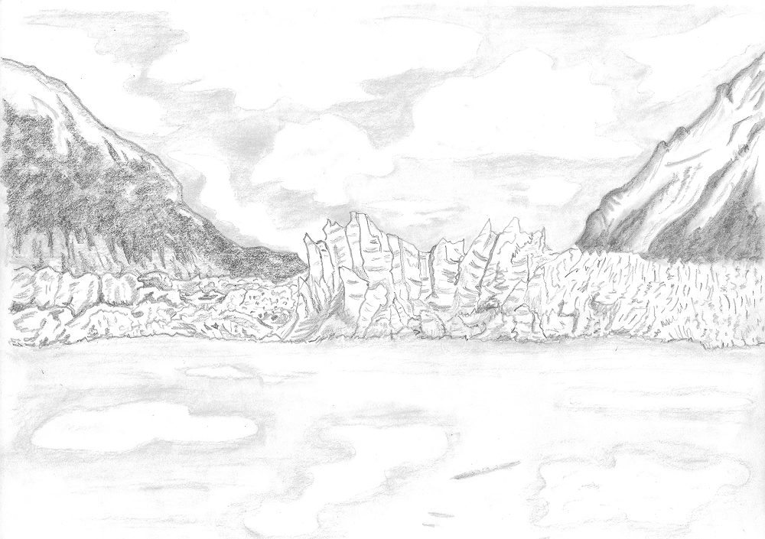
Game Development In Unity “Arctic Rush”
Travel through a variety of unique, hand drawn locations.
Take on the role of a rookie musher living in a town on the brink of an epidemic. Travel by dogsled to a far away town for the cure and return in time to save your town.
Choose your own adventure!
There are many ways to reach your goal.
Experience avalanches, moose, bears, wolves, blizzards, crazy hermits, and many more.
Stock up on supplies at the local stores in preparation for your adventure.
Hundreds of random events make each playthrough unique.
Coming to web browser Summer 2015!
Created By: Alex Odegaard
aodegaard@alaska.edu
Supervisor: Dr. Richard Webb
rlwebb2@kpc.alaska.edu

