Slide 1
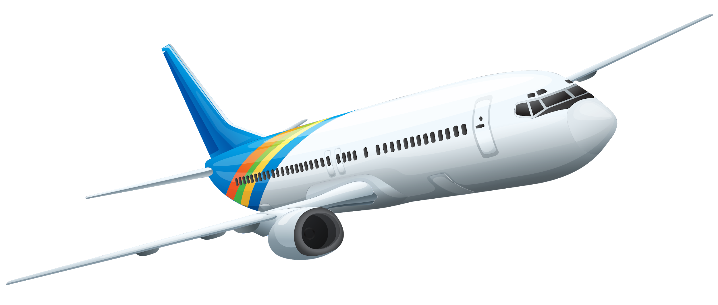
Wing Aerodynamics

Slide 2
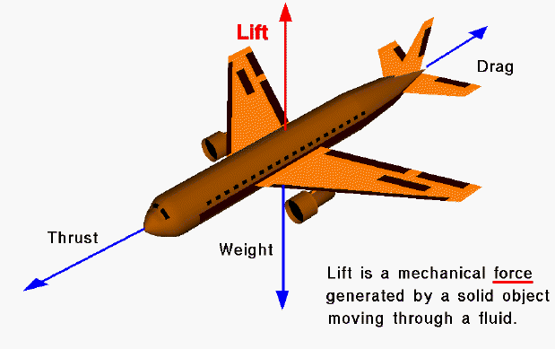
Forces on an Aircraft

Slide 3
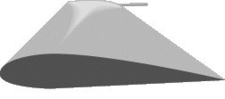
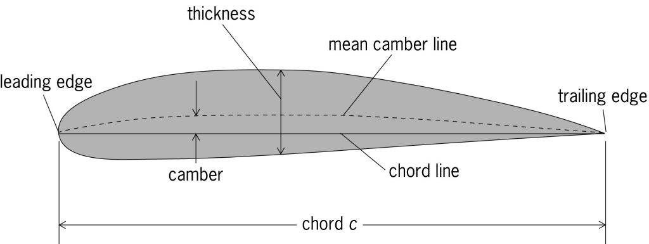
Airfoil Definitions
An airfoil is the 2D cross-section shape of the wing, which creates sufficient lift with minimal drag

Slide 4
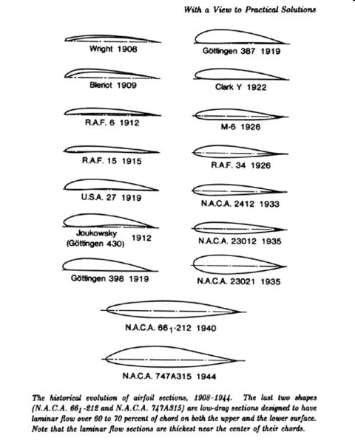
Historical Airfoils

Slide 5
Bernoulli

