Slide 1
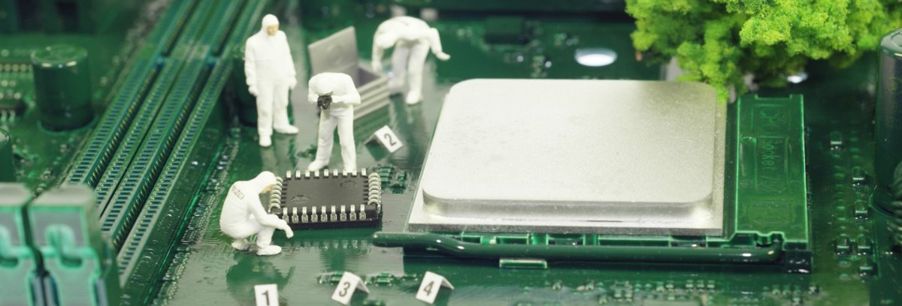
Exploring Civil Engineering through
Spaghetti Towers
Notes:
Note that all images in this presentation are placeholders, and should be replaced by more appropriate images.

Slide 2
Presenter’s Name
Short bio/
Accomplishments
Title

Slide 3
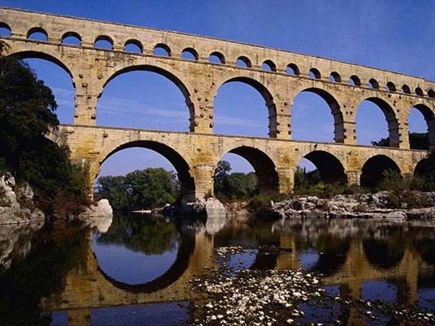
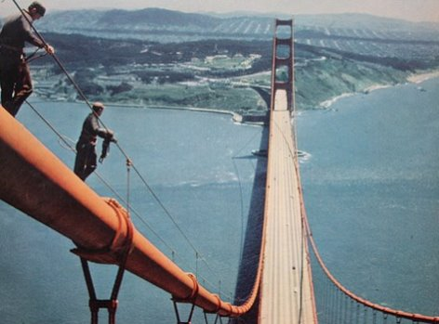
What is Civil Engineering?
Notes:
Engineering discipline that deals with designing, building, and maintaining infrastructure.
Makes transportation, water and waste systems, housing, public monuments, and many more things possible.
Second oldest engineering discipline
Structural Engineers:
Design, construct, maintain, and inspect:
Homes
Public buildings
Monuments
Bridges
Structural engineers are responsible for many notable projects, like the Seattle Space Needle, Hoover Dam, Golden Gate Bridge, and the Trans-Alaska Pipeline
Water Engineers:
Planning city water and waste systems
Ensure quantity and quality of water sources
Design flood defense systems
Transportation Engineers:
Streets and highways
Bridges
Canals
Railroads
Airports
Ports

Slide 4
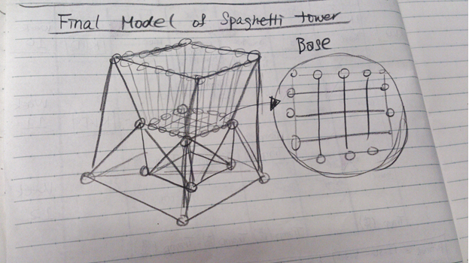
Spaghetti Towers
Your challenge is to design, build, test, and redesign towers made of spaghetti and marshmallows.

Slide 5
Do not eat the building materials!
You may break the noodles, but you may only receive new materials once.

Slide 6
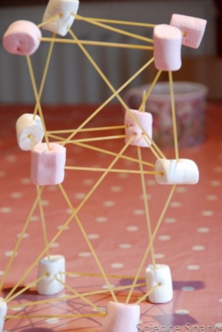
Instructions
Step 1: Brainstorming and Planning
With your group, think up ideas for your tower design. Once you have some ideas, pick the best, and begin sketching it out with labels.
Step 2: Build!
Once your plan has been approved by an instructor, you may begin building.

Slide 7
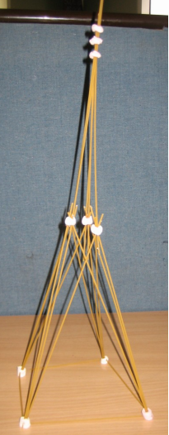
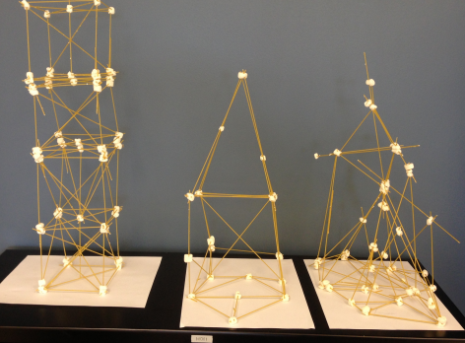
Instructions
Step 3: Redesign
After testing your design, you may get a new kit and try a different design to see if you can make an even taller tower.
Notes:
Adjust these slides as needed. Some projects will need more or less slides, and sometimes the pictures don't fit exactly the same – if you rearrange the pictures and text, MAKE SURE that it still flows easily. Get someone else to check it if you're not sure.

Slide 8
Discussion
What was the hardest part of this project? Why was it hard?
What challenges did your group face while working?
Did anyone change their design while building? Why did your design change
What did you learn?

Slide 9
Questions?

