Slide 1
Road-Building

Slide 2
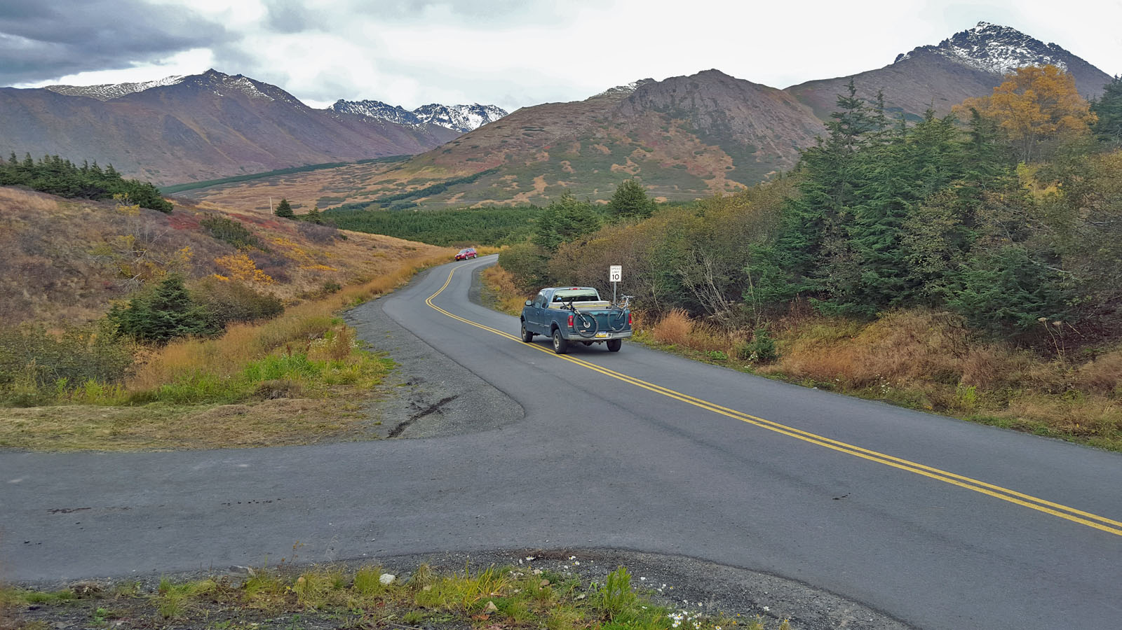
Slope
100 ft
2 ft
2 % Slope

Slide 3
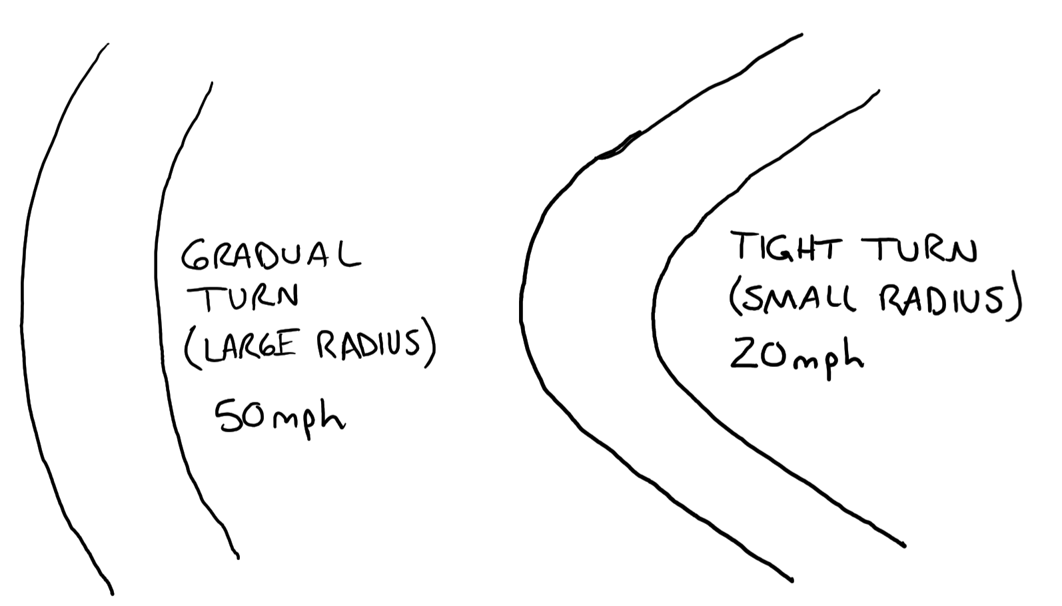
Horizontal Curve

Slide 4
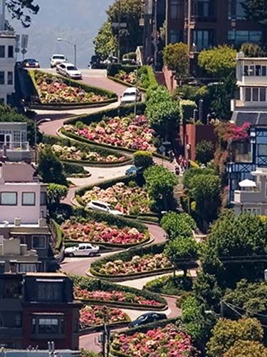
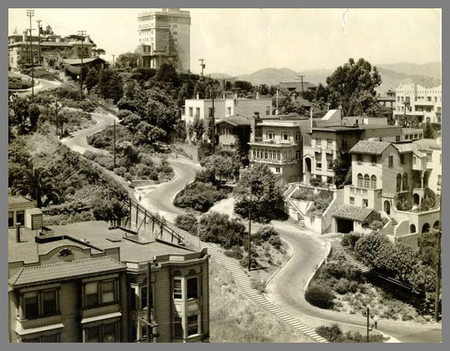
Horizontal Curve
Lombard Street, San Francisco
Prior to construction of curves, street was straight with 27% slope.
With curves (also called switchbacks), road has 16% slope
Sidewalks consist of 250 steps on each side.
1933, before flowers were planted

Slide 5
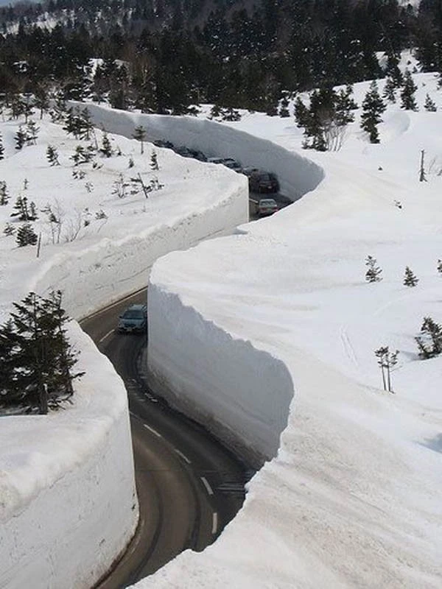
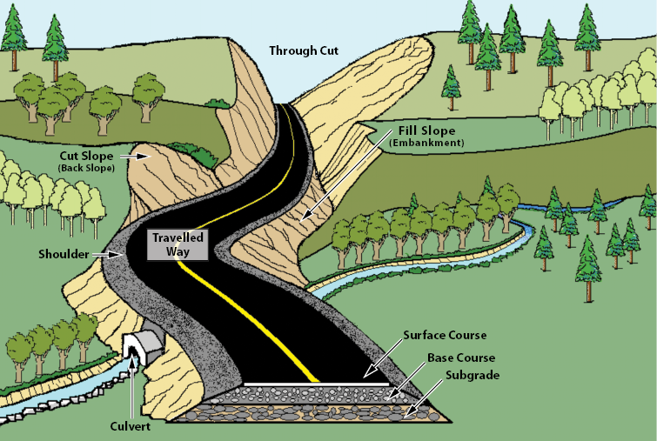
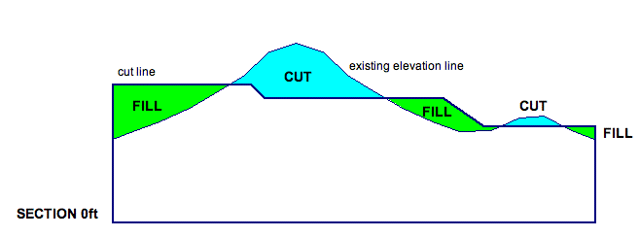
Cut and Fill

Slide 6
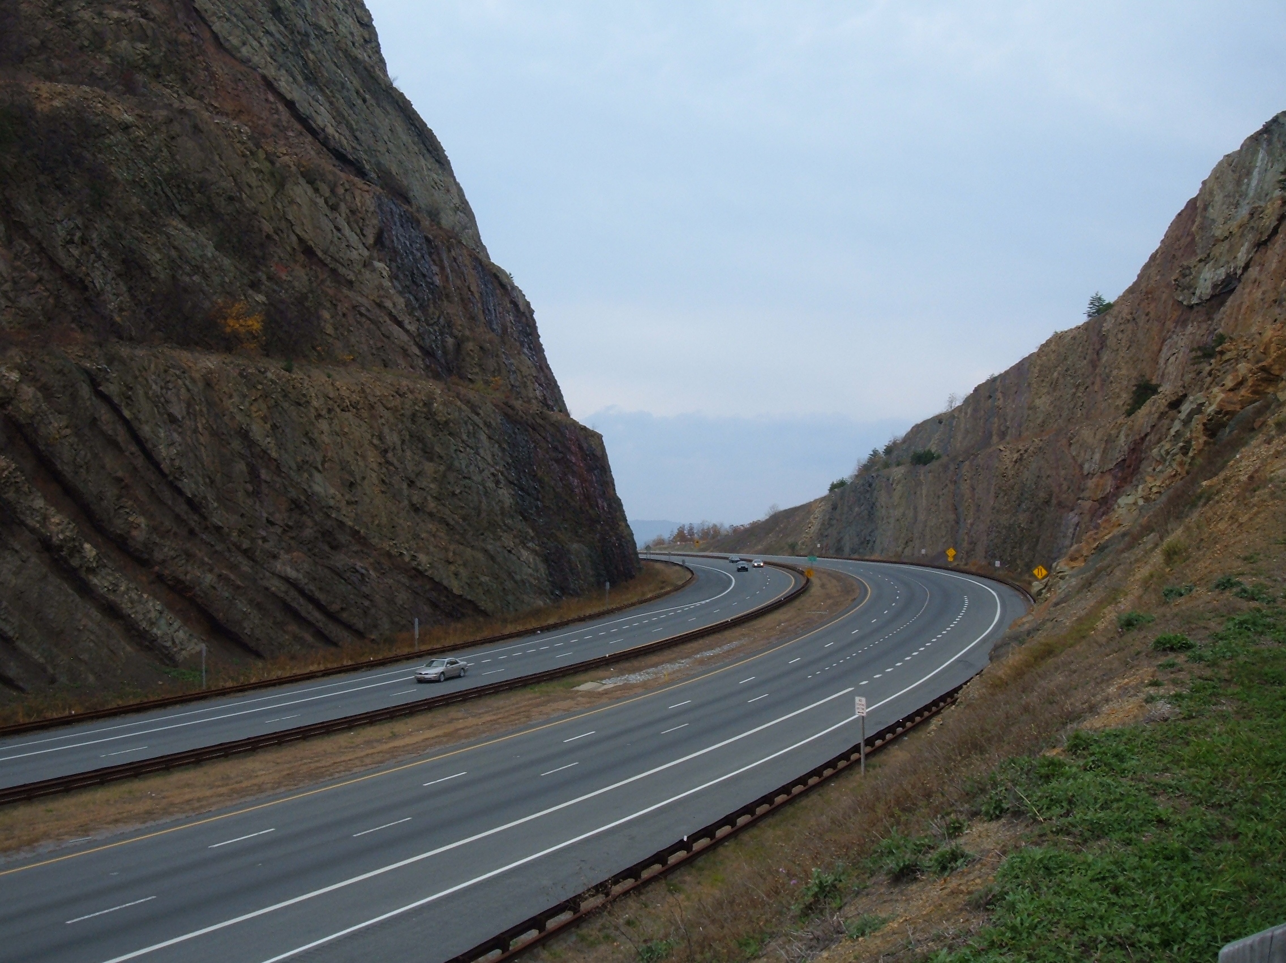
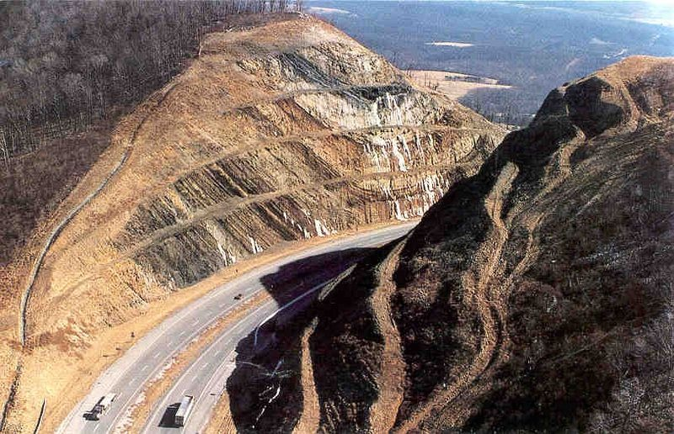
Cut and Fill
Sideling Hill Road Cut (MD)
2 years to complete
340 feet deep (30 story building)
4.5 million cubic yards (10 million tons) of rock
Most of the material was crushed into gravel and used in adjacent roadways
How many dump trucks?

Slide 7
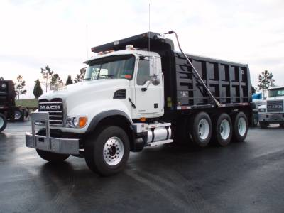
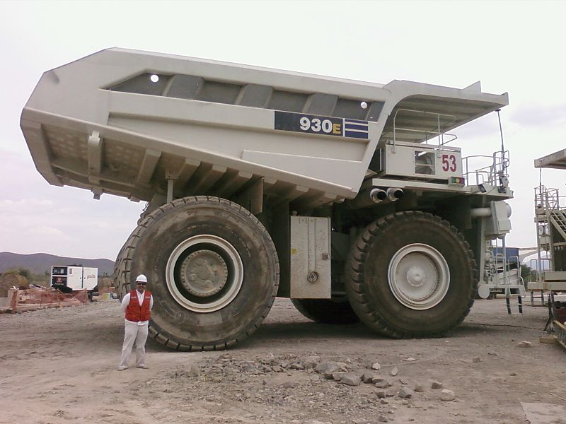
Cut and Fill
400,000 Regular Dump Trucks
OR
35,000 Giant Dump Trucks

Slide 8
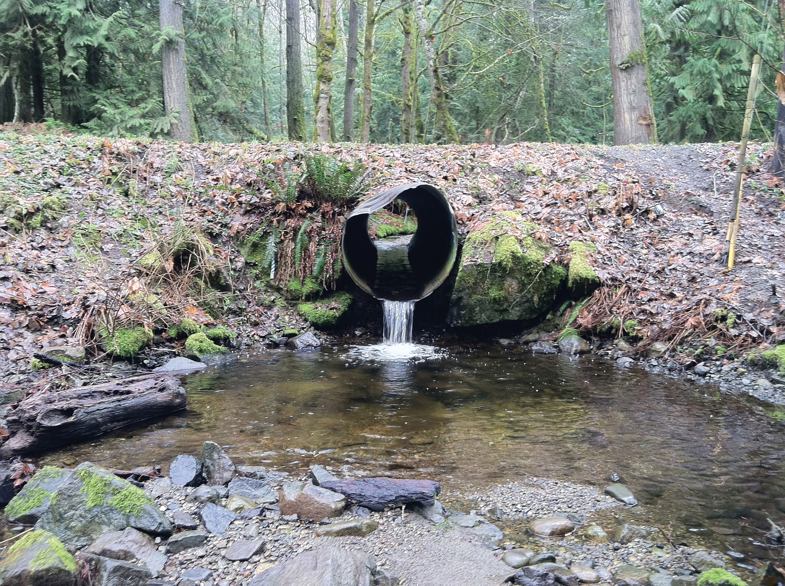
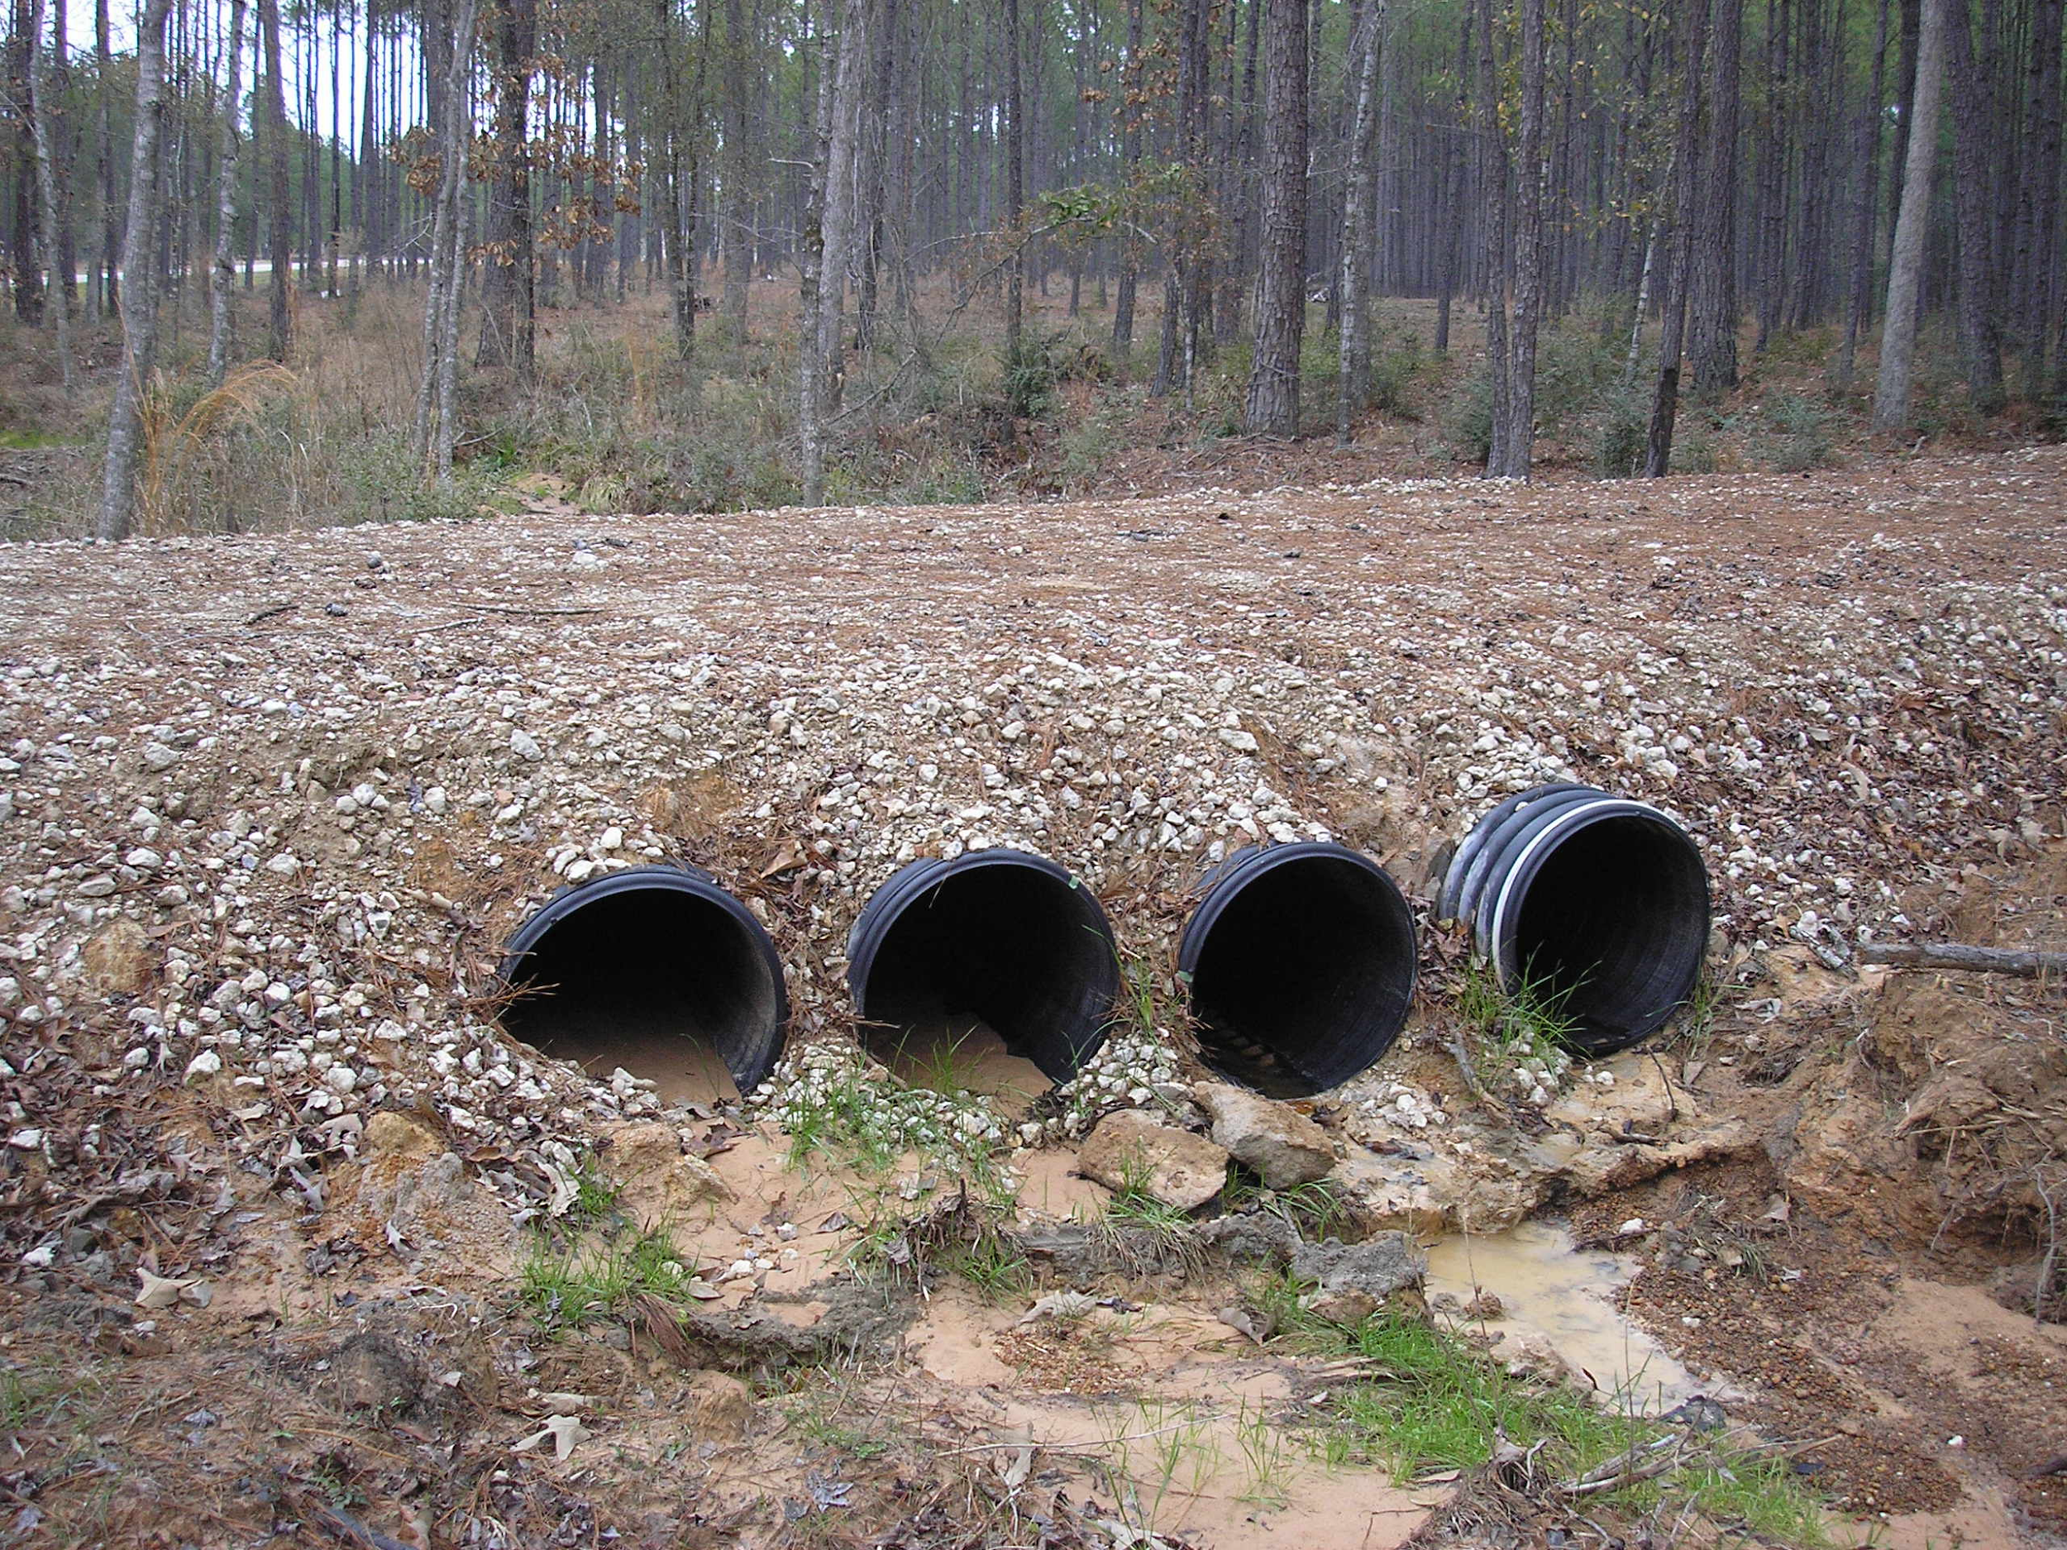
Culverts

