Slide 1
Pipe
Networks

Slide 2
What do engineers do?

Slide 3
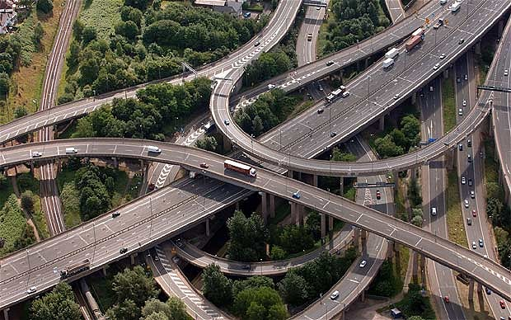
Civil Engineers

Slide 4
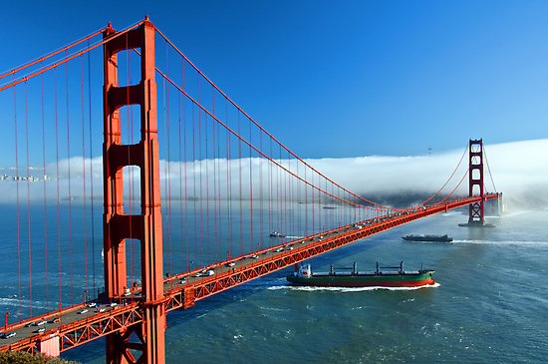
Structural Engineers

Slide 5
Mechanical Engineers

Slide 6
Environmental Engineers

Slide 7
Computer Science

Slide 8
Electrical Engineering

Slide 9
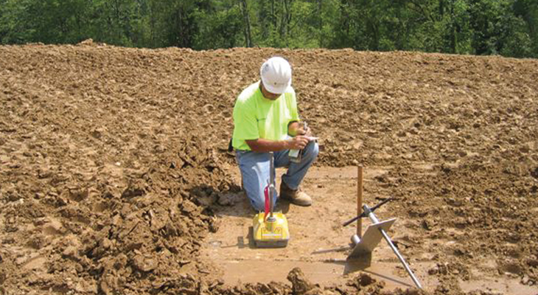
Geotechnical Engineering

Slide 10
Chemical Engineering

Slide 11
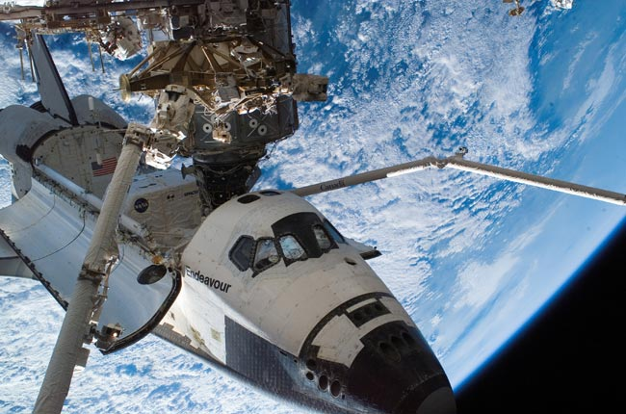
Aerospace Engineering

Slide 12
Water Engineering

Slide 13
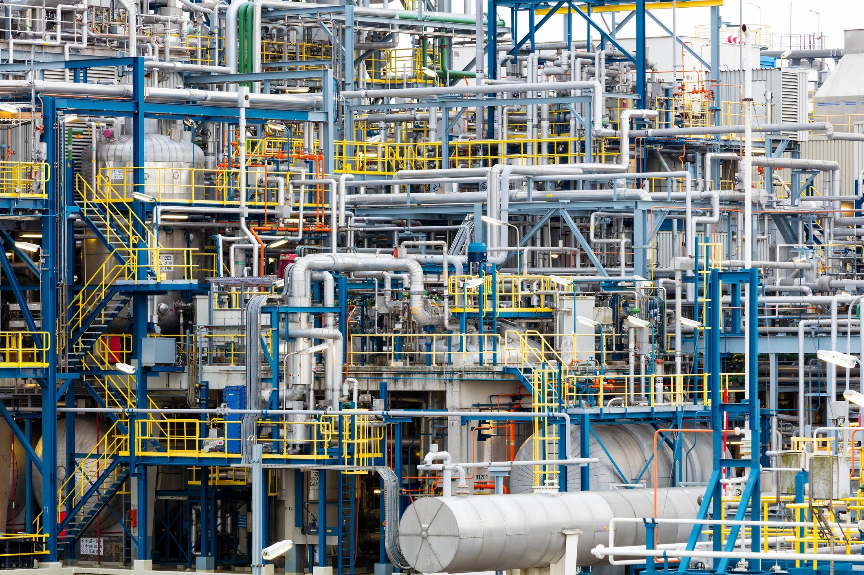
Pipe Networks

Slide 14
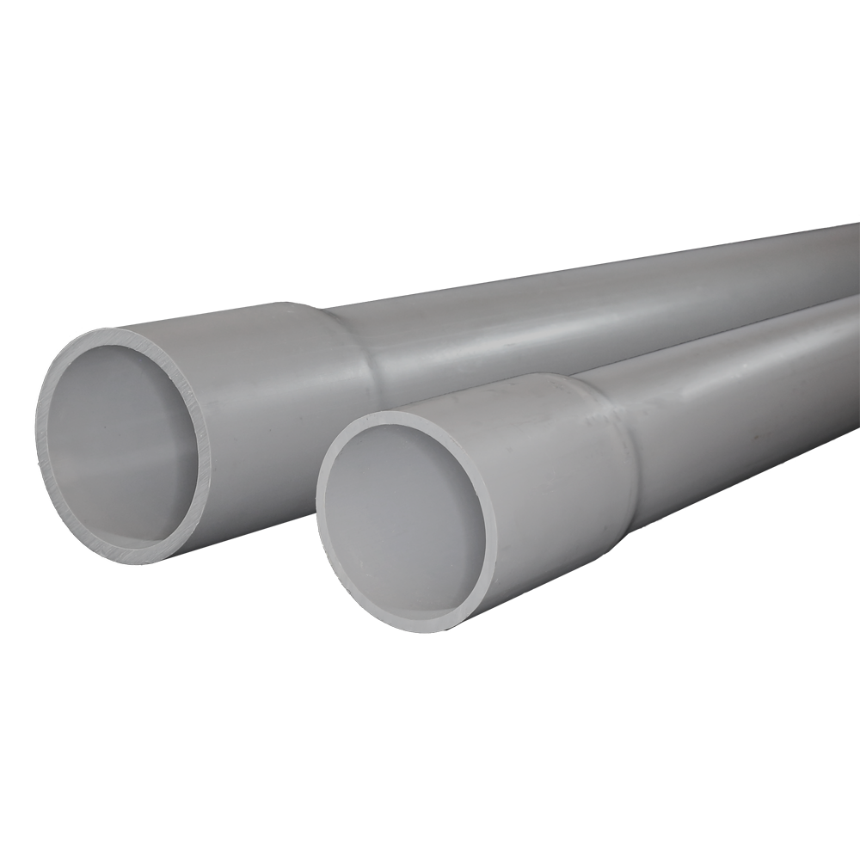
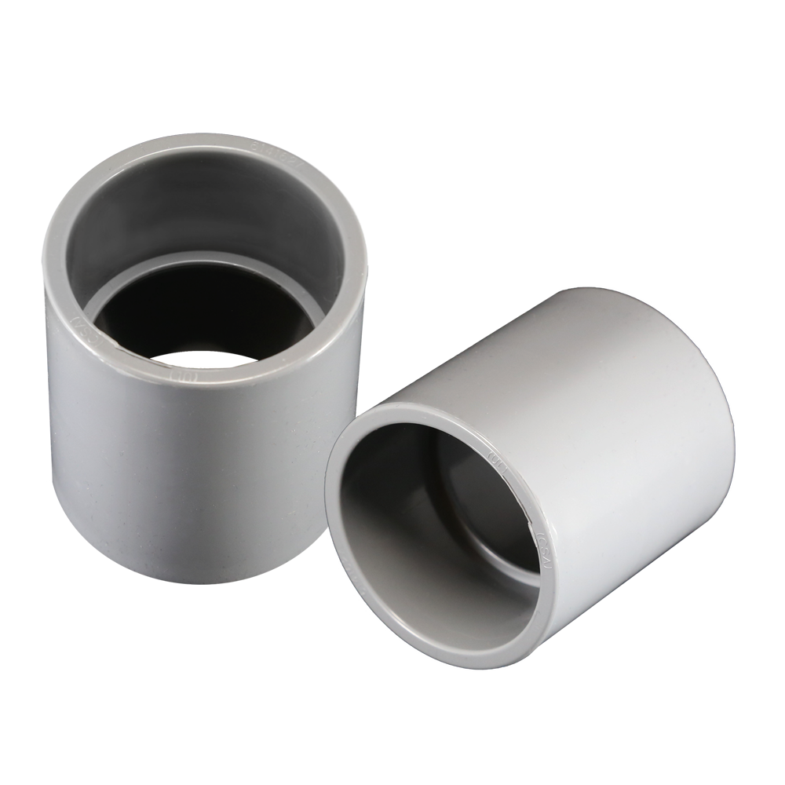
Pipe Systems

