Slide 1
Exploring Engineering through
Straw Rockets
Notes:
Note that all images in this presentation are placeholders, and should be replaced by more appropriate images.

Slide 2
Presenter’s Name
Short bio/
Accomplishments
Title

Slide 3
What is Engineering?
Notes:
Today we are all engineers.
But what to engineers do?
Engineers use math, science, and technology to solve problems and improve existing solutions and to design, build, and improve machines and tools.

Slide 4
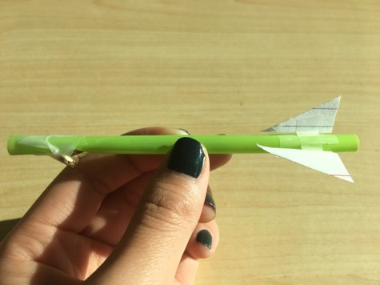
Mini Straw Rockets
Your challenge is to build a miniature straw rocket by testing different designs in order to hit a target using the improved rocket.

Slide 5
Rockets may only be fired in the test zone. Never fire a rocket at another person.
Don't linger in the test zone – get your rocket, and get out.

Slide 6
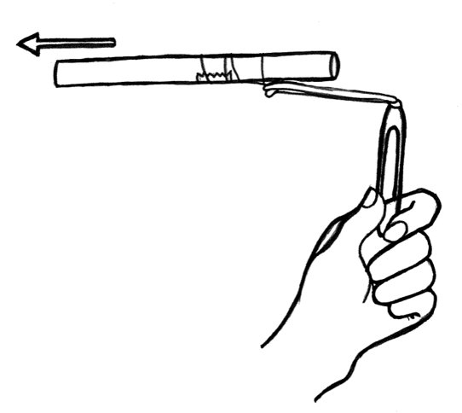
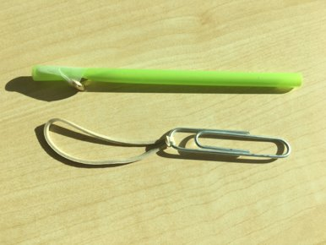
Instructions
Build your rocket according to the instruction handout.
Can you load your rocket in your sling shot like in the picture to the above?

Slide 7
Instructions
Choose one:
Add large or small paper fins to the rocket.
Add weight to the front or back of the rocket.
Notes:
Choose one for the second challenge:
Add large or small paper fins to the rocket.
Add weight to the front or back of the rocket.
When we conduct experiments, we need to identify our variables.
Independent variable: what you changed
Dependent variable: what was different because of the change you made
Controlled variable: everything you kept the same
We also make a hypothesis: what do we think will happen?

Slide 8
Discussion
What was the hardest part of this project? Why was it hard?
Did your rocket fly differently after your modifications?
Did it fly further? Did it fly straighter?
Did your results support your hypothesis?
What did you learn?

Slide 9
Questions?

