Slide 1
Exploring Mechanical Engineering through
Mini Straw Rockets

Slide 2
What is engineering?
Today we are all engineers.
But what to engineers do?
Engineers use math, science, and technology to solve problems and improve existing solutions.

Slide 4
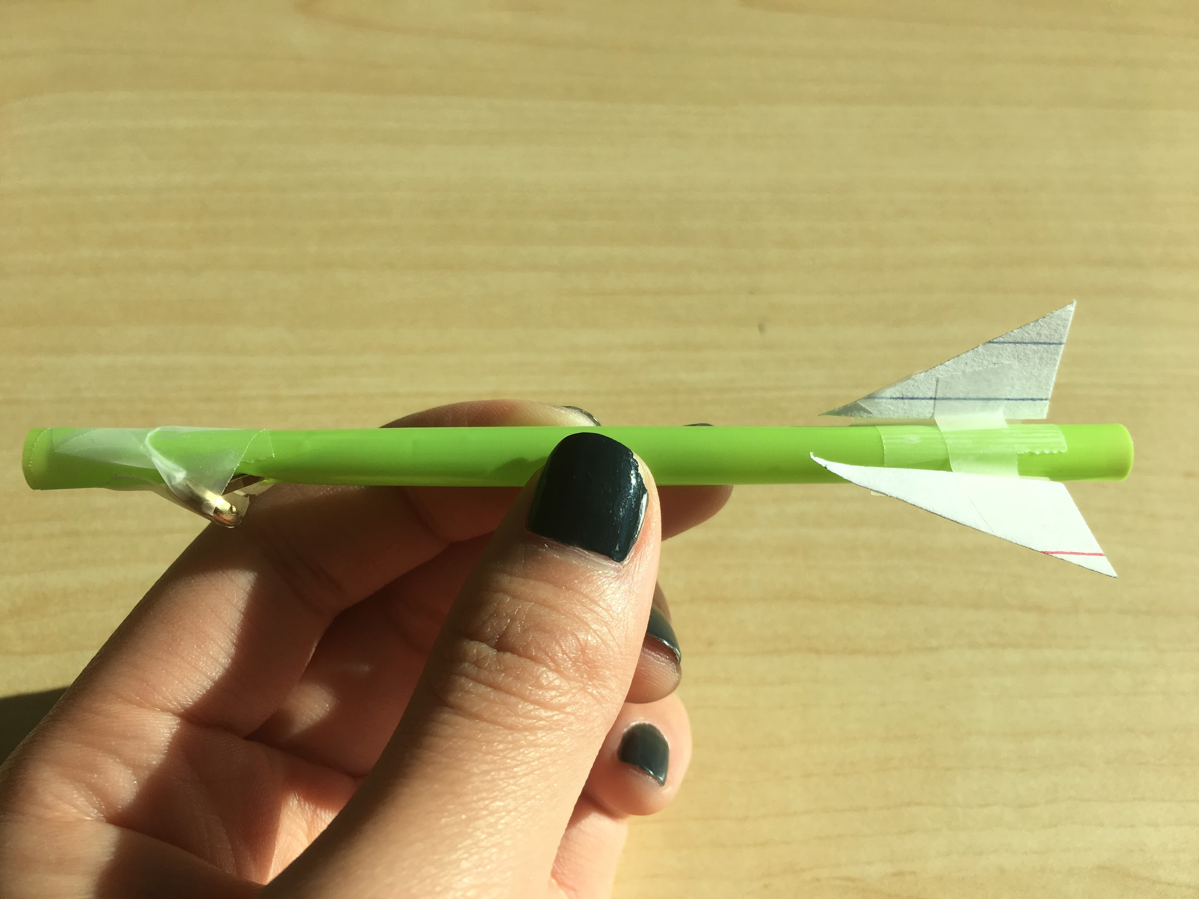
Mini Straw Rockets
Objective:
Students use provided materials to build a miniature straw rocket. Students will test different designs to perfect their rocket through the engineering design process.
Final Challenge: hit a target using the improved rocket.

Slide 5
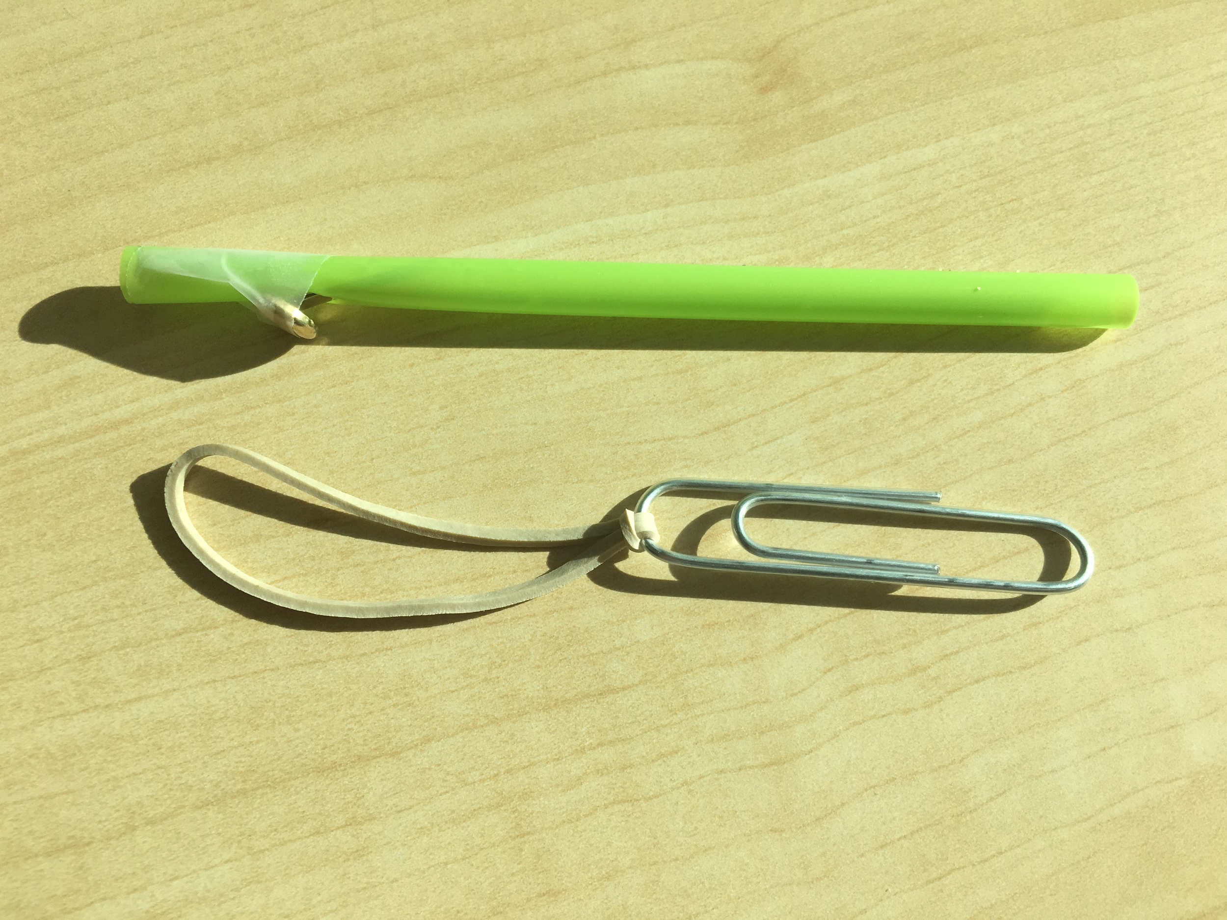
CHALLENGE 1
Build your rocket according to the instruction packet.
Then answer the Challenge 1 questions.
⚠️ Safety reminder: ⚠️
Rockets may only be tested at the Launch Zone. Never fire a rocket at another person.
Build the original miniature straw rocket.

Slide 6
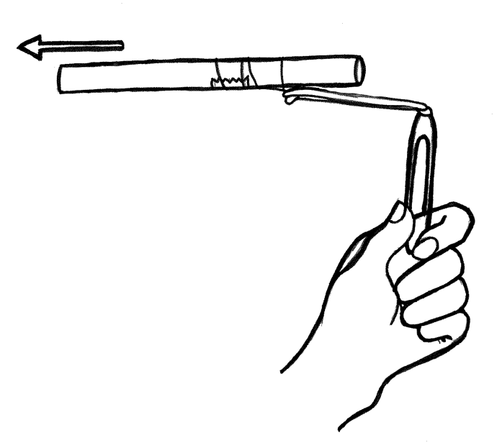
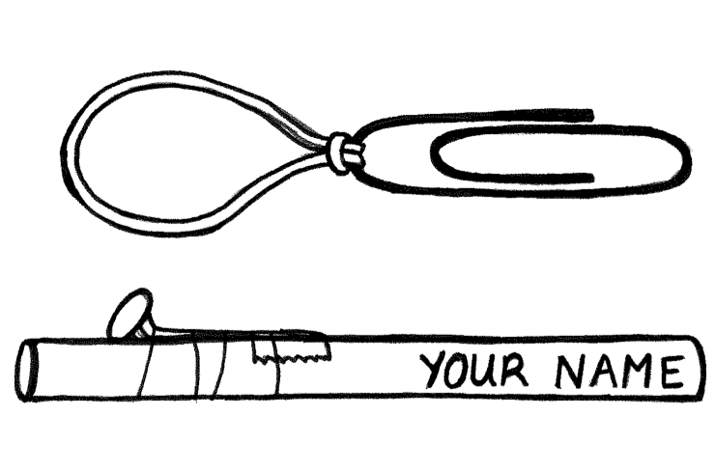
Your final rocket
Test: can you load your rocket in your sling shot like in the picture to the right?

Slide 7
Sharing Findings
How far did your rocket fly?
Did your rocket fly straight through the air?
What shape was its path?

Slide 8
How could we improve our mini straw rockets?

Slide 9
CHALLENGE 2
When we conduct experiments, we need to identify our variables.
Independent variable: what you changed
Dependent variable: what was different because of the change you made
Controlled variable: everything you kept the same
We also make a hypothesis: what do we think will happen?
Choose a modification for your rocket and test it.
Choose one:
Add large or small paper fins to the rocket.
Add weight to the front or back of the rocket.

Slide 10
Sharing Findings
Did your rocket fly differently after your modifications?
Did it fly further? Did it fly straighter?
Did your results support your hypothesis?

Slide 11
Your final challenge: design a new rocket that can hit a target.

Slide 12
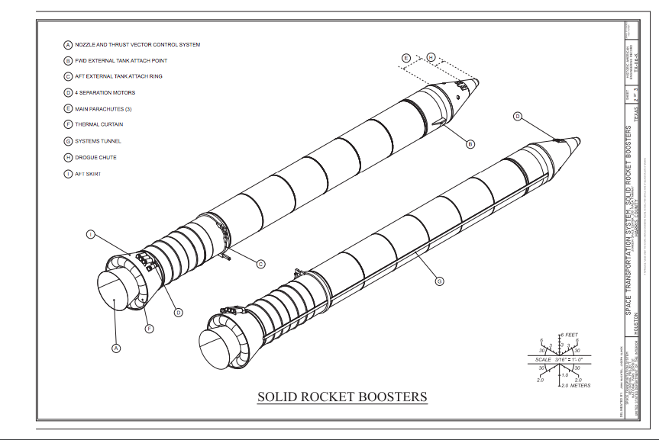
CHALLENGE 3
You must sketch your new design before you start building!
Design a new mini straw rocket.

Slide 13
The Engineering Design Process

Slide 14
Engineering Concept: Energy

Slide 15
Engineering Concept: Energy
There are two types of energy:
Potential energy is the energy stored in an object.
Kinetic energy is the energy from an object’s motion.
What kind of energy is in our sling shots?
What kind of energy does our rocket have when it flies?

Slide 16
Engineering Concept: Energy
When we stretch the rubber band in the slingshot, it has potential energy.
When we release the slingshot, the rubber band pushes the rocket into the air, and that potential energy is transformed into kinetic energy.

Slide 17
Engineering Concept: Air Drag
“Air Flow and Flow Separation” from NASA Langley CRGIS on YouTube
https://www.youtube.com/watch?v=dUhiDctsyfs
Notes:
Cut video to start at 1:31

Slide 18
Engineering Concept: Momentum
Momentum is the ability of an object to resist changes in its motion.
An object with more momentum is harder to stop moving.
momentum = mass x velocity
The more mass we added to our rockets, the more momentum they had. That meant they were less affected by air drag, so they could fly further.

Slide 19
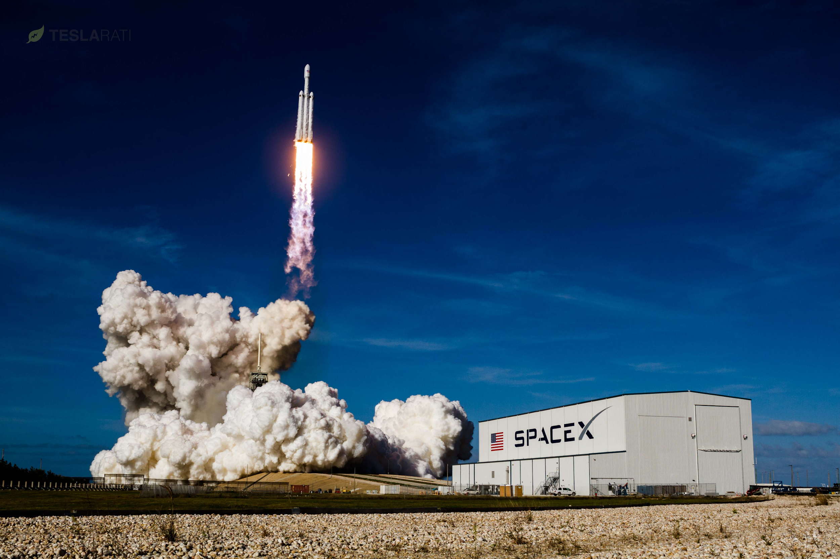
What is Mechanical Engineering?
Mechanical engineers use math and science to design, build, and improve machines and tools.

Slide 20
Almost everything that moves has been created or improved by mechanical engineers.
🚙🛩⛴ 🚀 🛰 🤖
📱 💻 🚑🔬 🎮🎢🚲
Transportation Aerospace Robotics
Electronics Medicine Fun!

Slide 21
Is Mechanical Engineering for you?
Are you interested in how things work?
Are you creative?
Do you like solving problems?
Do you like math?
Are you interested in design?

Slide 22
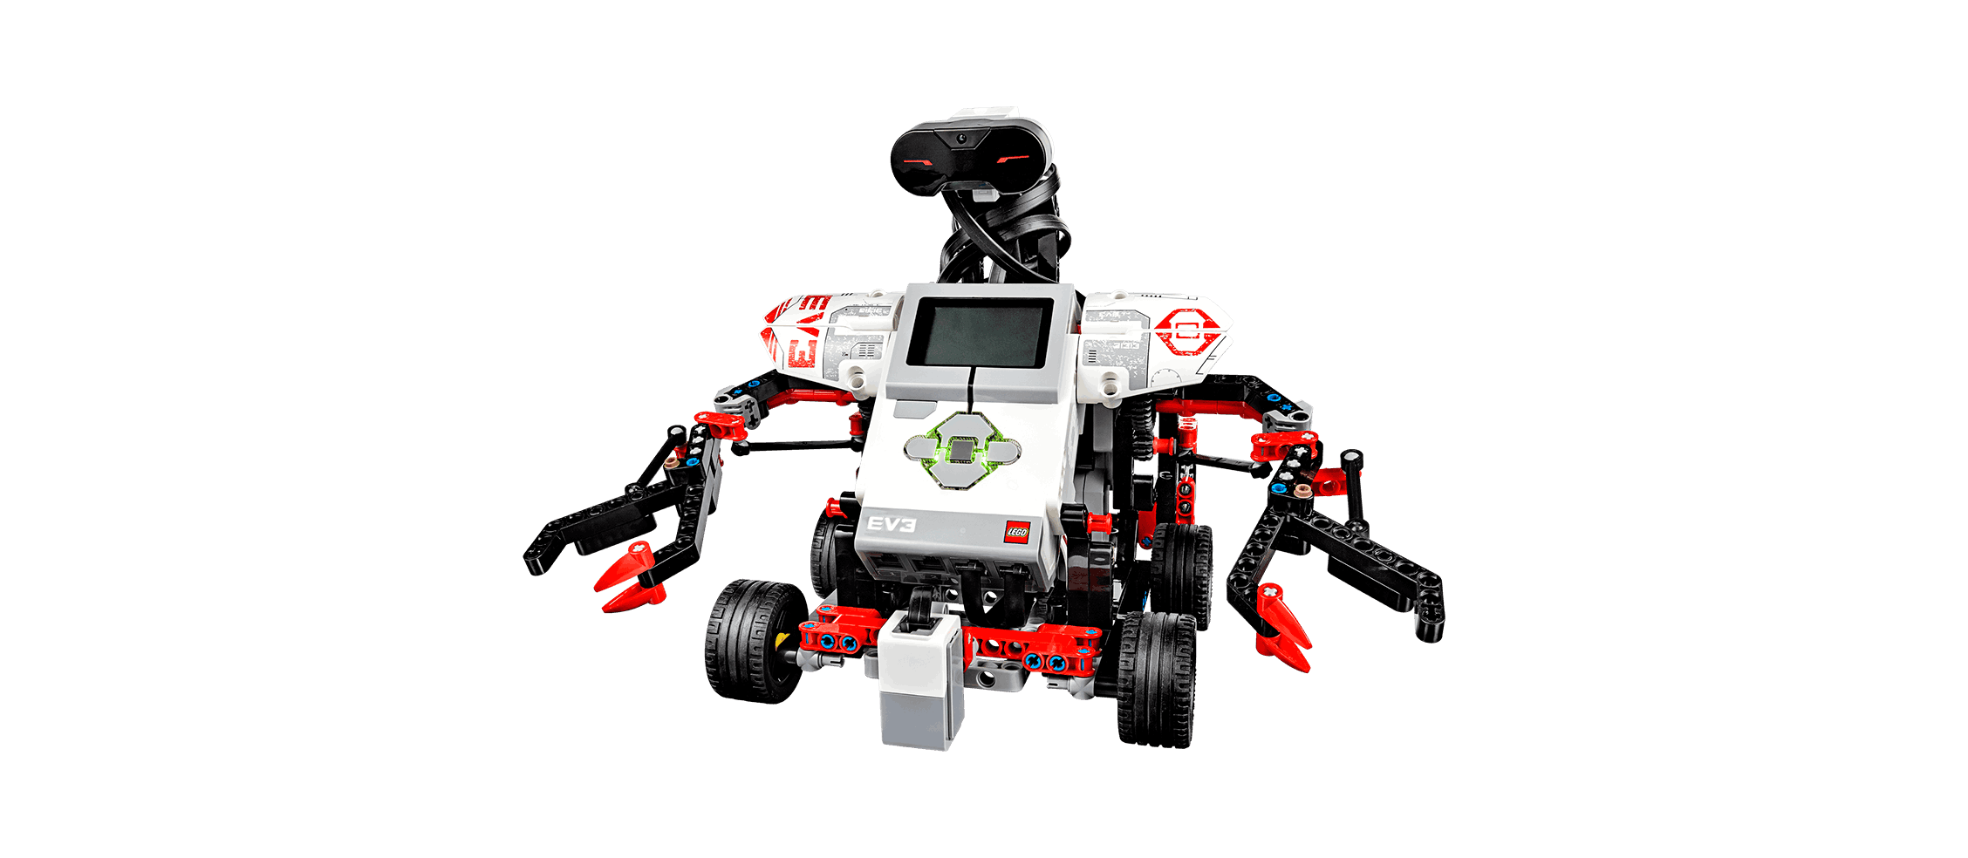
How to get from here to there
Recommended Classes:
Math
Science
Recommended Activities:
Building and tinkering
Robotics
Rocketry
Notes:
Just used as an example

