Slide 1
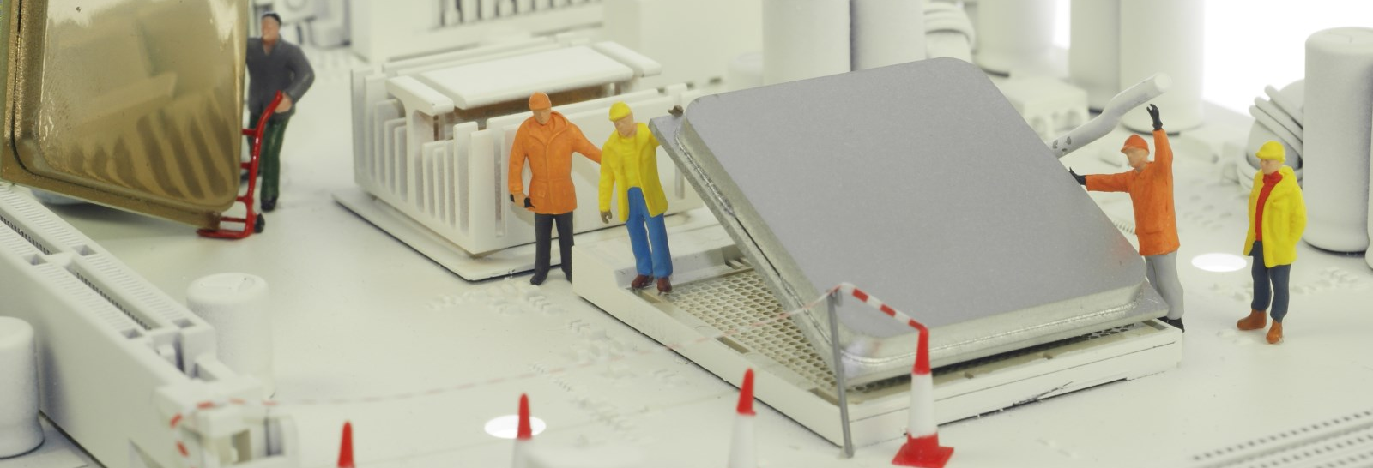
Exploring Electrical Engineering through
BASIC CIRCUITS

Slide 2
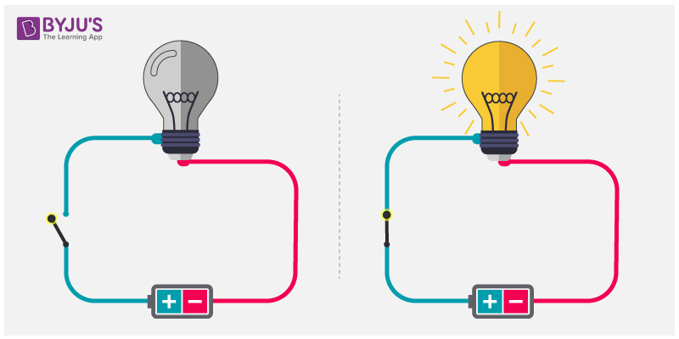
CIRCUITS!
We will learn about electricity and circuits by creating 3 different kinds of circuits:
Simple
Series
Parallel
We will make a piece of glowing art work using Parallel circuits!

Slide 3
What is electricity?
Notes:
Do NOT touch materials until I say GO

Slide 4
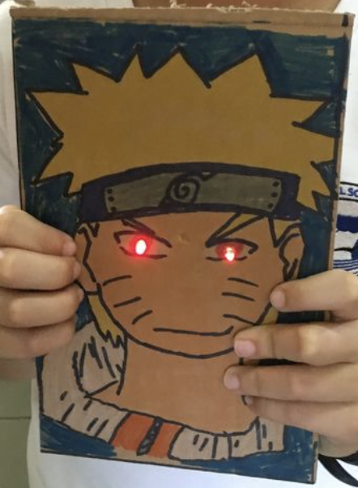
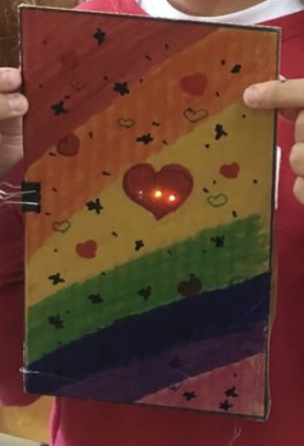
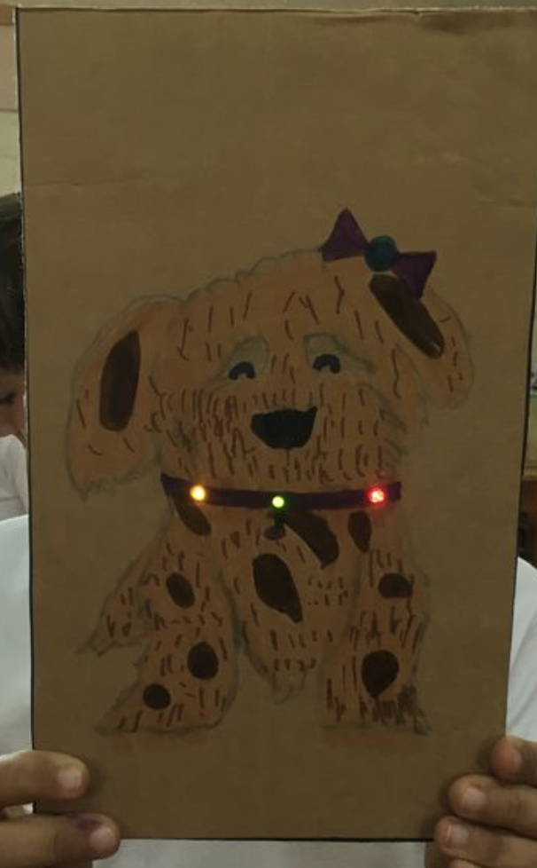
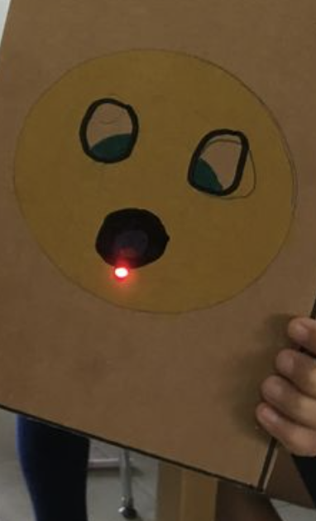
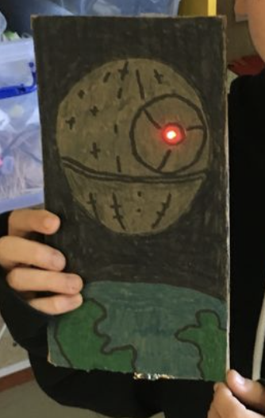
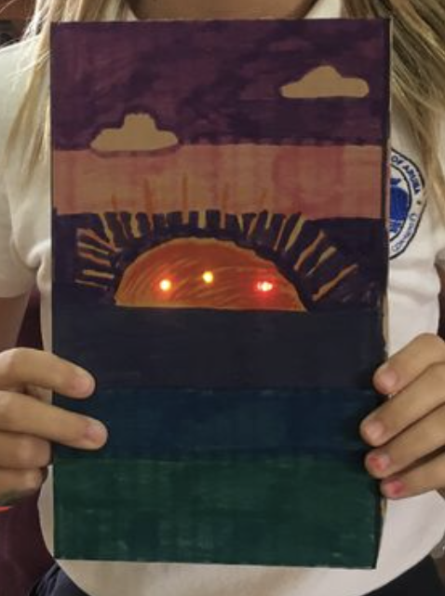
Let’s Build!
Materials:
1 Cardboard Canvas
1-2 Led Light Bulbs
1 Battery
2 feet Copper Tape
Markers and art supplies
Directions:
STEP 1:
Draw a picture on the Cardboard Canvas. Be sure to leave 1 or 2 places for a light to shine through!
Notes:
Do NOT touch materials until I say GO

Slide 5
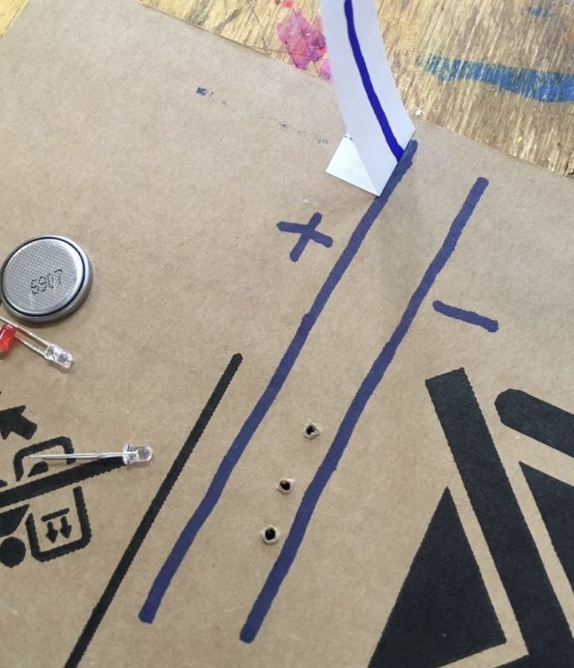
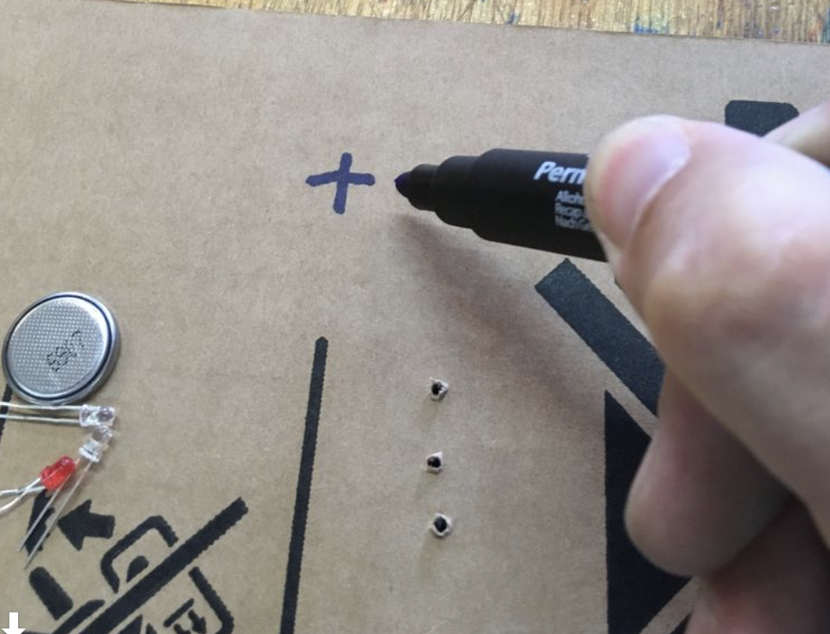
Let’s Build!
STEP 2:
Draw the battery and negative side of the circuit
Notes:
Do NOT touch materials until I say GO

Slide 6
Let’s Build!
STEP 2:
Draw a circuit with a marker on the back side of the cardboard.
Be sure to mark the positive negative side of the circuit
Make sure the circuit line for the tape is close enough for the LED legs to reach
Get the circuit checked by an adult.
Notes:
Do NOT touch materials until I say GO

Slide 7
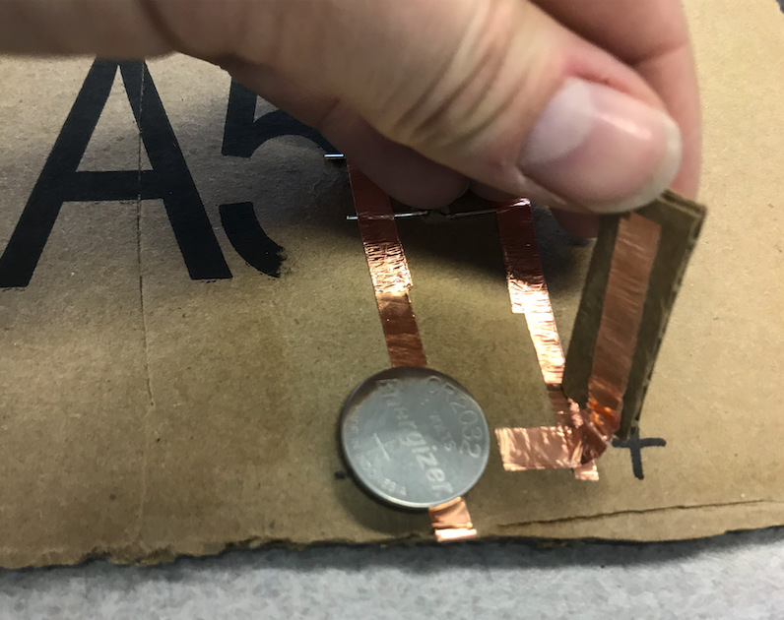
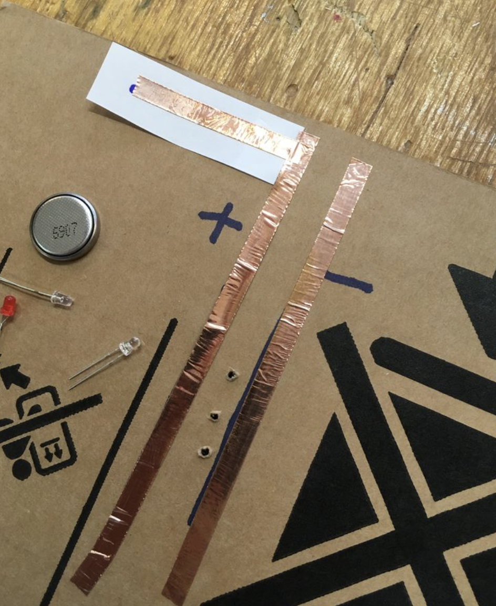
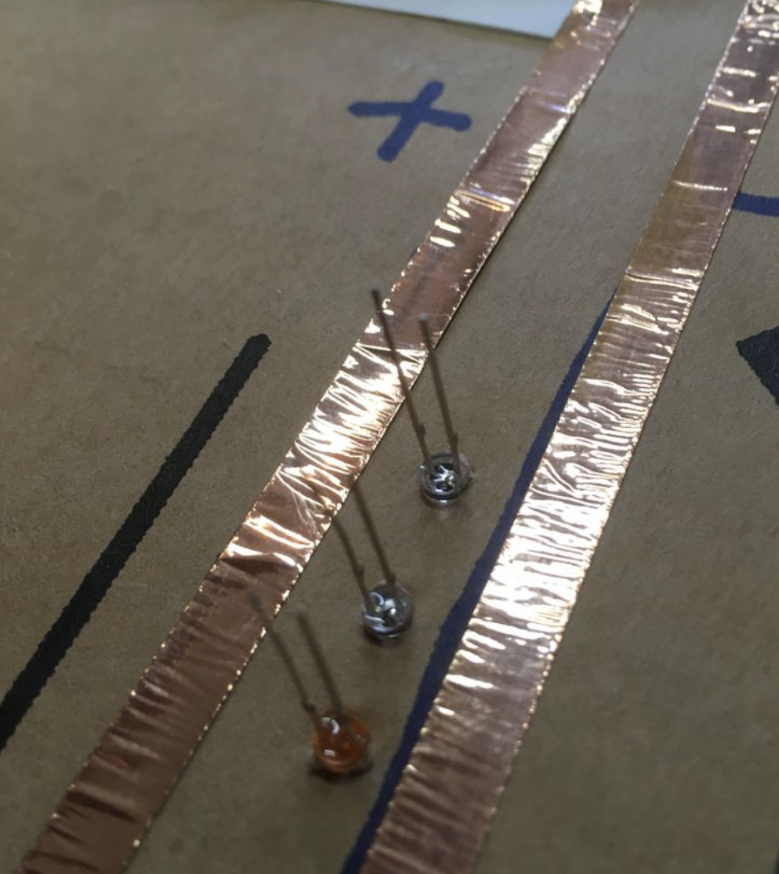
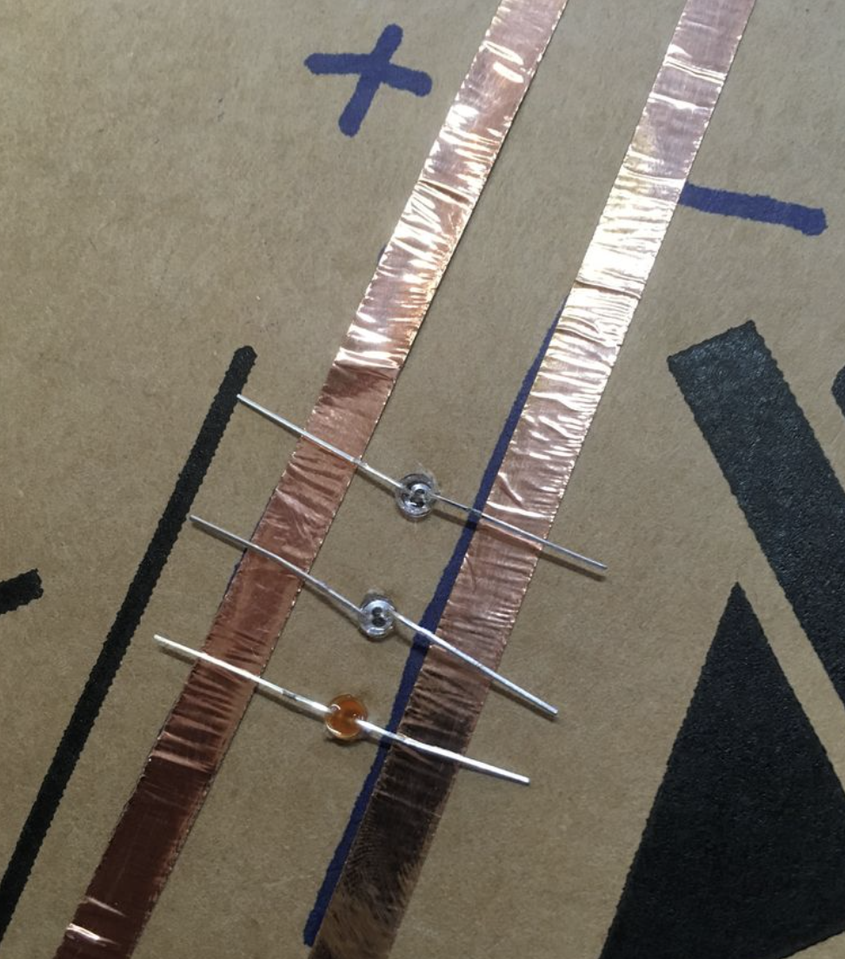
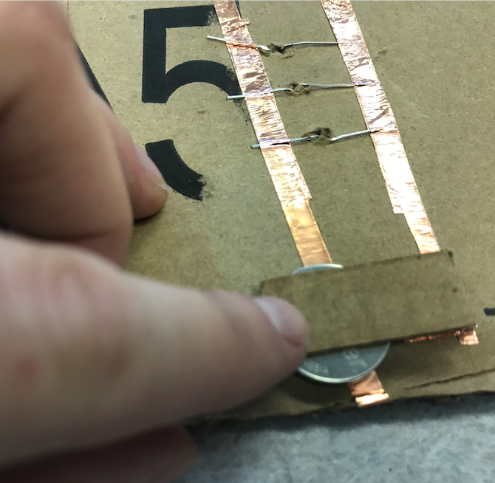
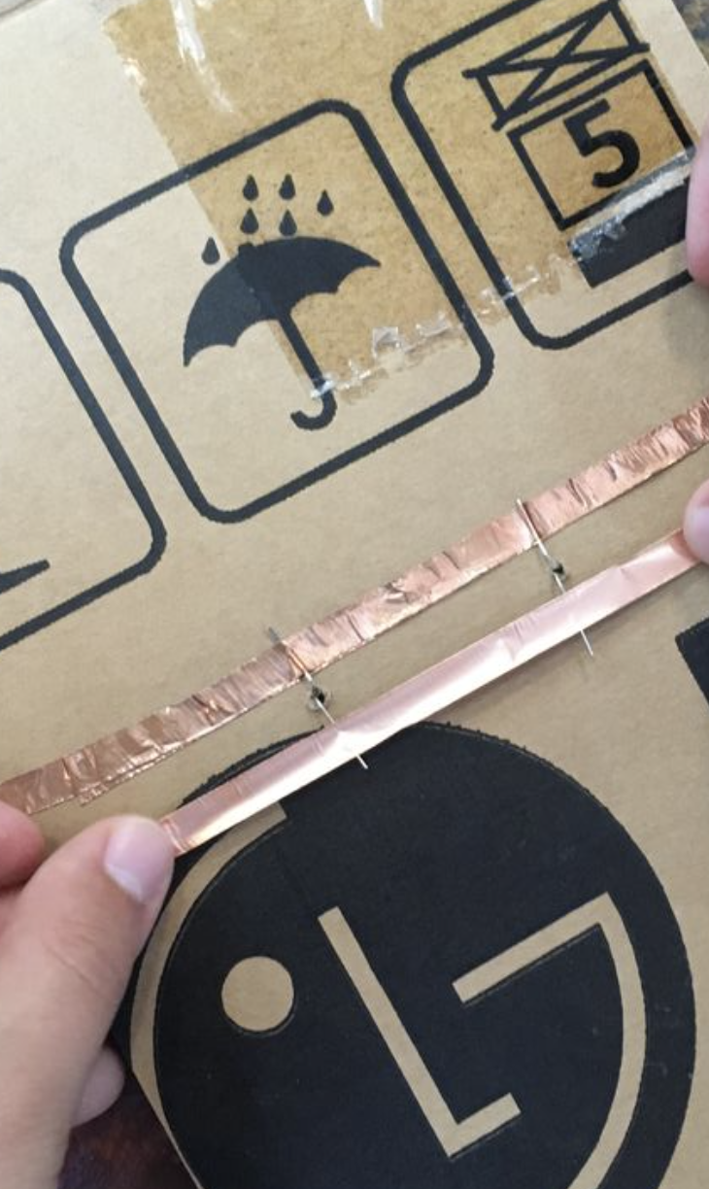
Let’s Build!
STEP 3
Tape the copper tape onto the circuit with the LEDs.
Make sure the long leg is on the negative side of the circuit and the short leg is on the positive side
The legs must be in contact with the top of the copper
You can use a small piece of copper tape on top of the legs to keep them in contact
Use a small piece of cardboard to make a battery switch and watch it glow!
Notes:
Do NOT touch materials until I say GO

Slide 8
Vocabulary
Atoms
Electrons
Current
Conductor
Insulator
Electric Circuit
Open Circuit
Closed Circuit
Simple Circuit
Parallel Circuit
Diode
Light Emitting Diode (LED)
Review

Slide 9
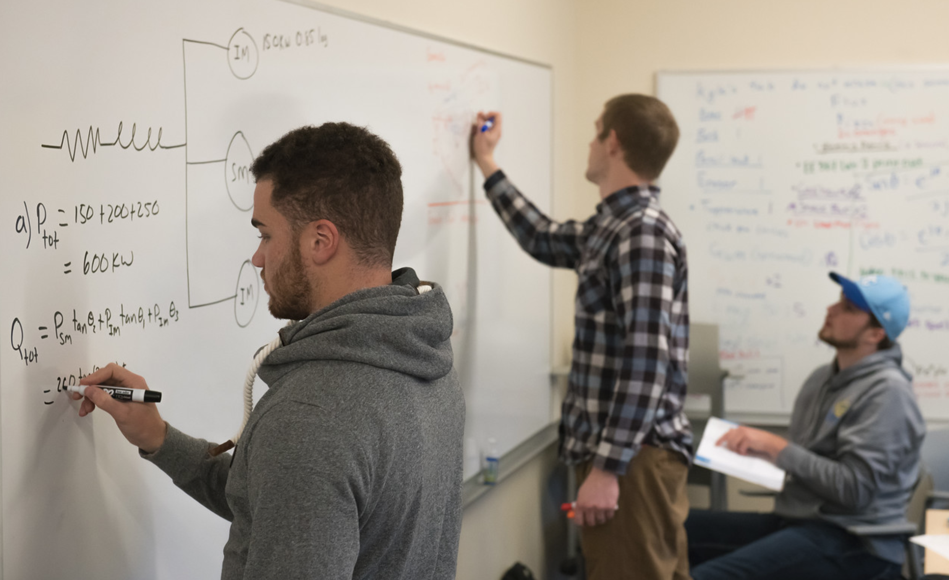
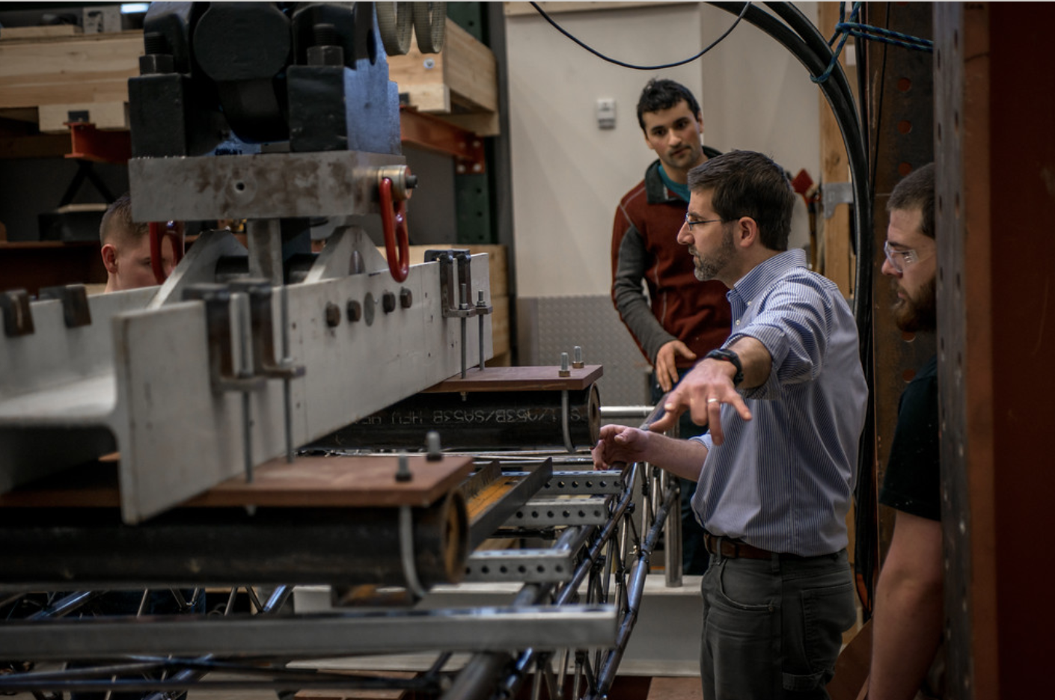
What is Electrical Engineering?
Engineering discipline that deals with the study of electricity, electronics, and electromagnetism.
Makes cellular communication, internet, lights, speakers, drones, and many more things possible.
Notes:
Ask students to take out notebooks and write notes on EE

Slide 10
Questions?

