Slide 1
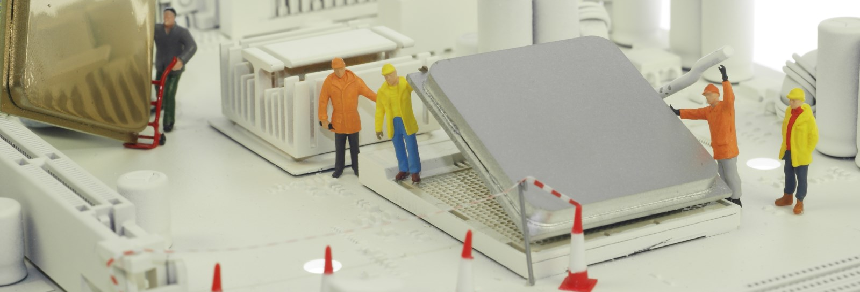
Exploring Electrical Engineering through
Illuminated Artwork
Notes:
Note that all images in this presentation are placeholders, and should be replaced by more appropriate images.

Slide 2
Presenter’s Name
Short bio/
Accomplishments
Title

Slide 3
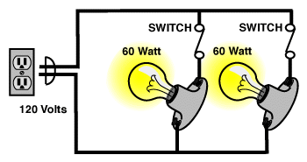
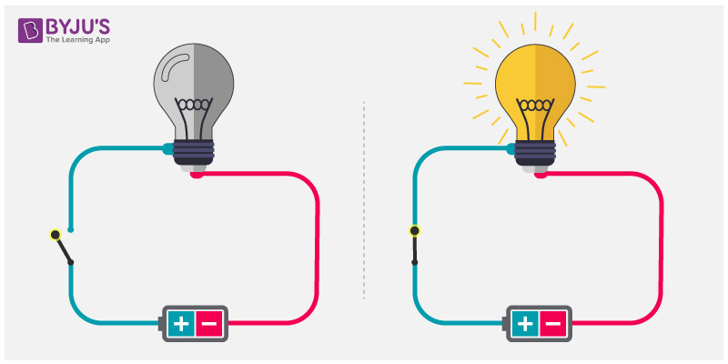
What are circuits?
Series Circuit
Parallel Circuit
Notes:
A series circuit has electricity flowing through a single loop, from positive to negative. That is how a lightbulb works; when electricity flows through it, it lights up. A parallel circuit sends electricity through a loop that splits into other loops. This lets the electricity be used for more, but means that there is less electricity in each loop. For our project today, we'll be using a series circuit.

Slide 4
Illuminated Artwork
Your challenge is to create a circuit that will activate light bulbs in special places to “illuminate” a drawing.

Slide 5
Don't move past a step without getting an instructor's approval
Be respectful of the materials

Slide 6
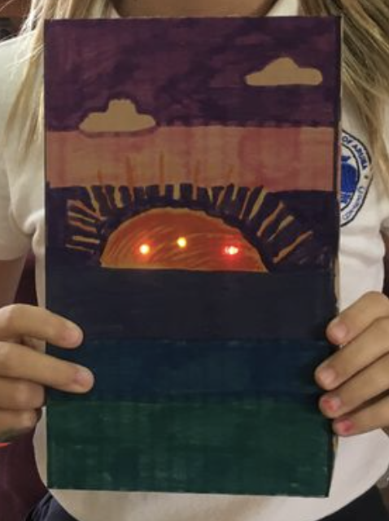
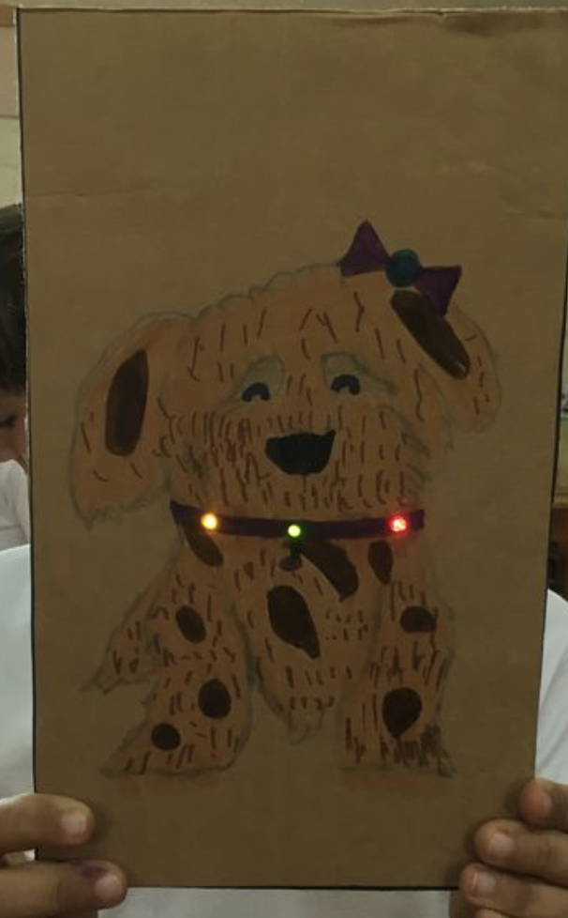
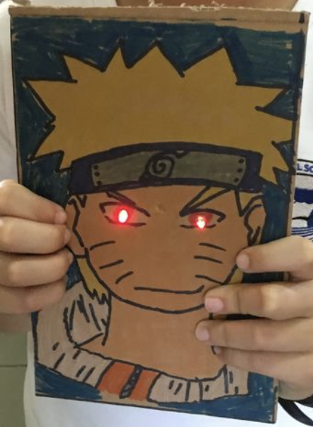
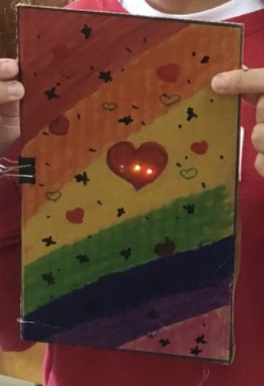
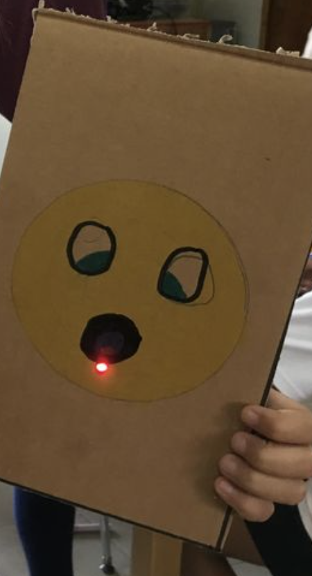
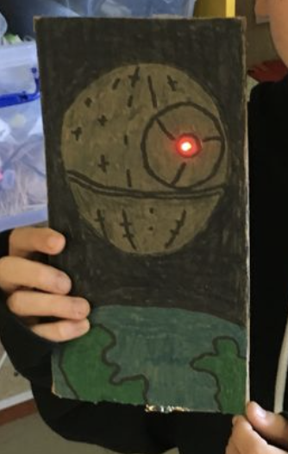
Instructions
Step 1
Draw a picture on the Cardboard Canvas. Be sure to leave 1 or 2 places for a light to shine through!

Slide 7
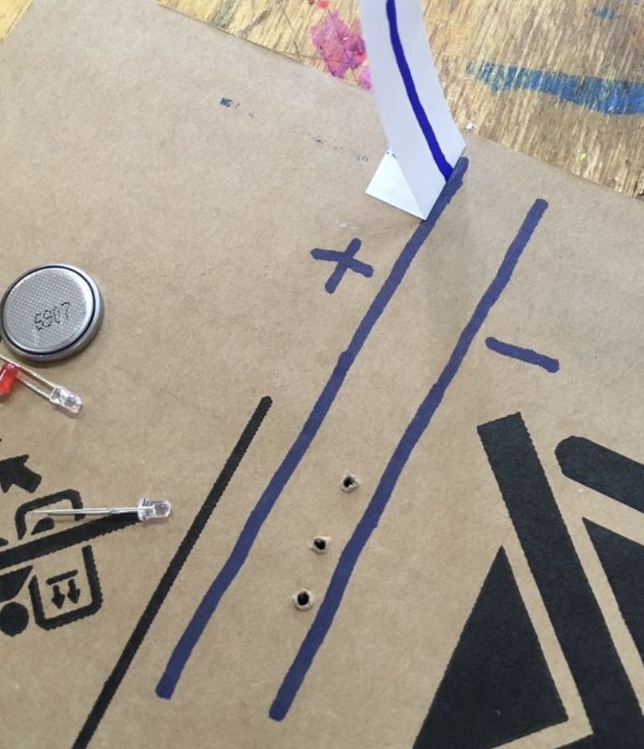
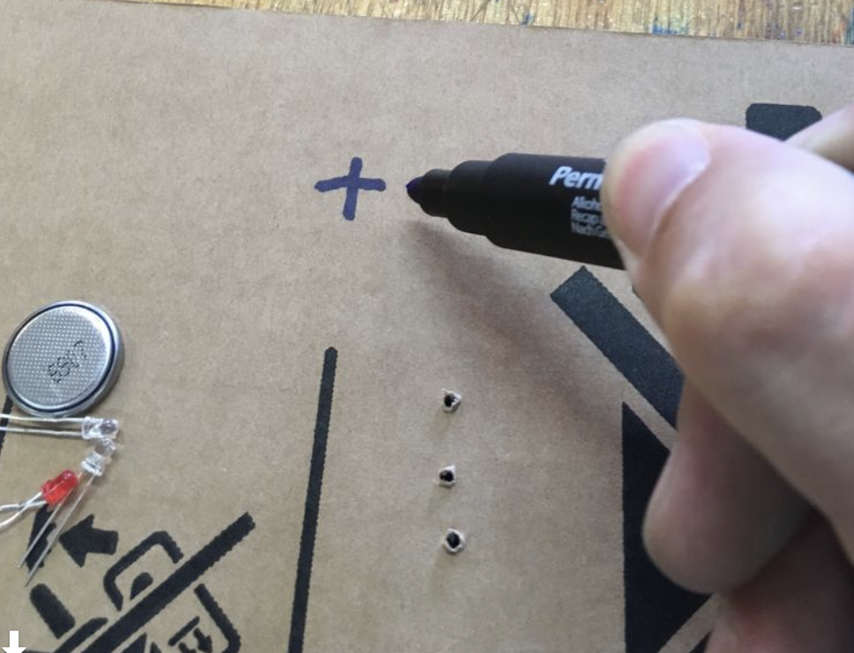
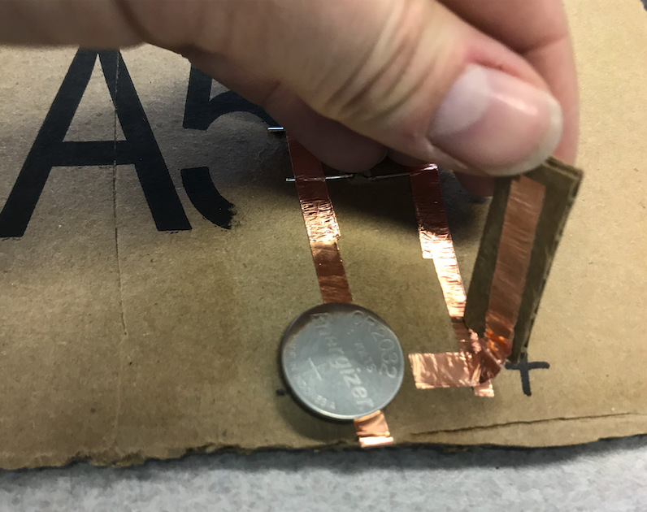
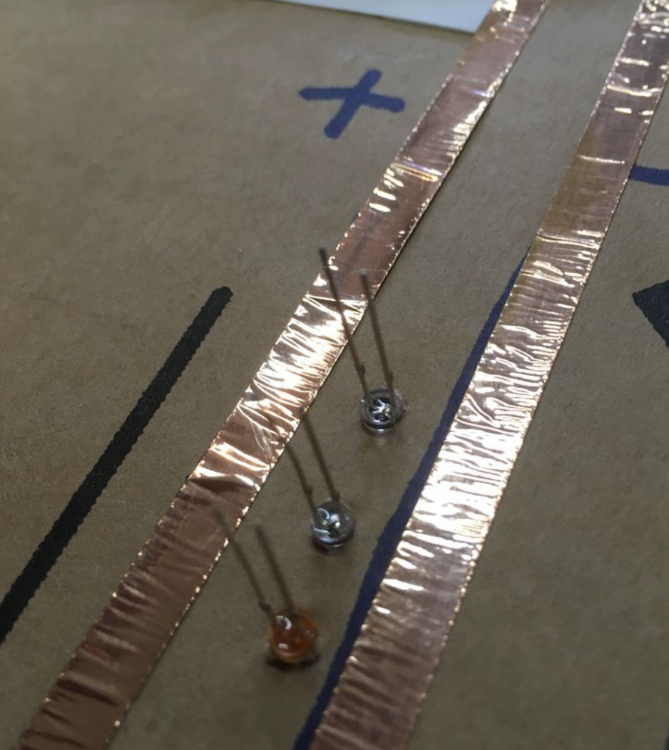
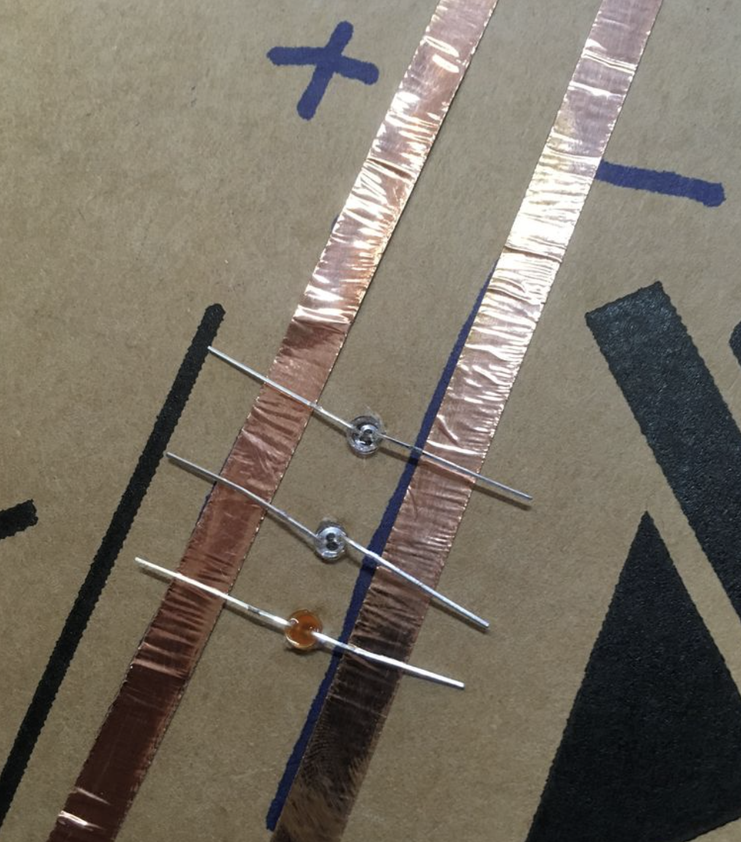
Instructions
Step 2
Sketch a circuit diagram on the back of your drawing as guided by an instructor.
Step 3 After getting your sketch approved by an instructor, lay down copper tape along the guidelines of your sketch. Punch holes for LEDs, and add an on/off switch.
Notes:
Adjust these slides as needed. Some projects will need more or less slides, and sometimes the pictures don't fit exactly the same – if you rearrange the pictures and text, MAKE SURE that it still flows easily. Get someone else to check it if you're not sure.

Slide 8
Discussion
What was the hardest part of this project? Why was it hard?
Do you know why/how the circuit makes the lightbulb glow?
Why do you think the on/off switch works?
What did you learn?

Slide 9
Questions?

