Slide 1
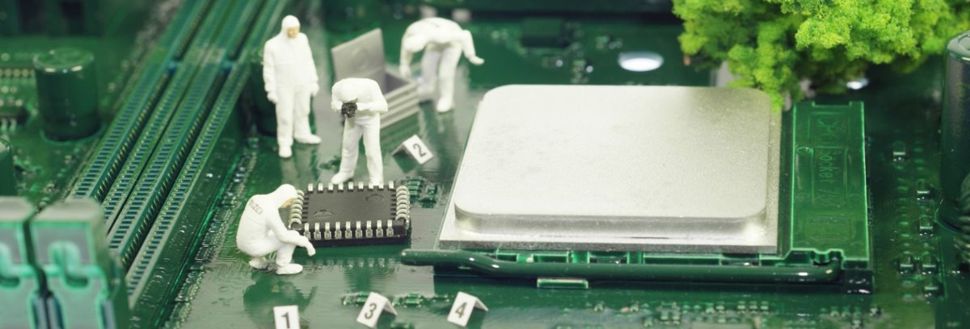
Exploring the Engineering Design Process through the
Egg Drop
Notes:
Note that all images in this presentation are placeholders, and should be replaced by more appropriate images.

Slide 2
Presenter’s Name
Short bio/
Accomplishments
Title

Slide 3
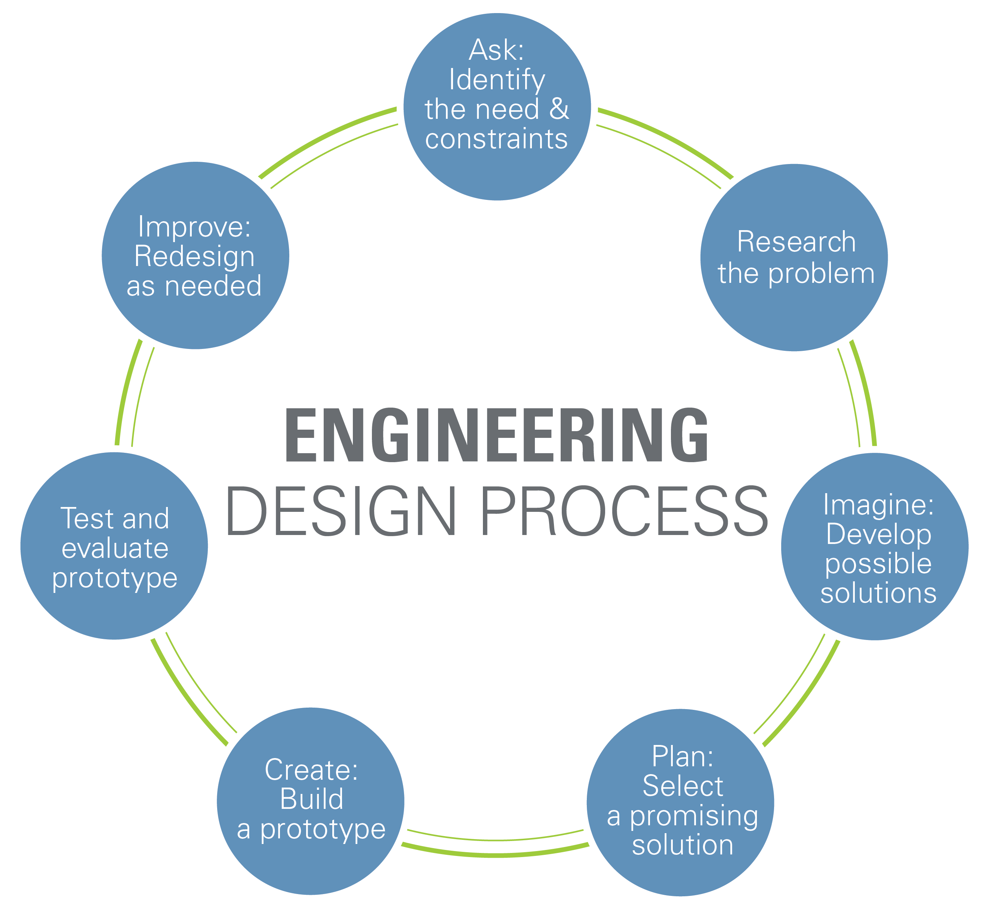
What is the Engineering Design Process?
Notes:
Engineers ask critical questions about what they want to create, whether it be a skyscraper, amusement park ride, bicycle or smartphone. These questions include: What is the problem to solve? What do we want to design? Who is it for? What do we want to accomplish? What are the project requirements? What are the limitations? What is our goal?
This includes talking to people from many different backgrounds and specialties to assist with researching what products or solutions already exist, or what technologies might be adaptable to your needs.
You work with a team to brainstorm ideas and develop as many solutions as possible. This is the time to encourage wild ideas and defer judgment! Build on the ideas of others! Stay focused on topic, and have one conversation at a time! Remember: good design is all about teamwork!
For many teams this is the hardest step! Revisit the needs, constraints and research from the earlier steps, compare your best ideas, select one solution and make a plan to move forward with it.
Building a prototype makes your ideas real! These early versions of the design solution help your team verify whether the design meets the original challenge objectives. Push yourself for creativity, imagination and excellence in design.
Does it work? Does it solve the need? Communicate the results and get feedback. Analyze and talk about what works, what doesn't and what could be improved.
Discuss how you could improve your solution. Make revisions. Draw new designs. Iterate your design to make your product the best it can be. And now, REPEAT!

Slide 4
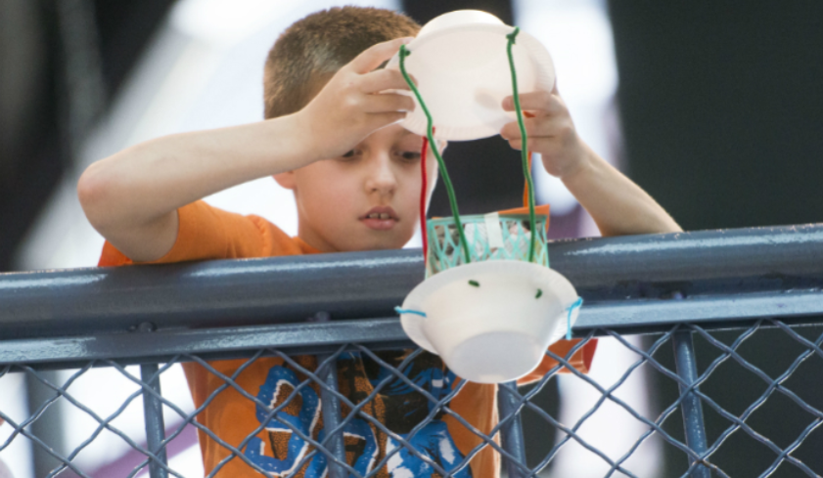
Egg Drop
Your challenge is to design, build, and test a container to protect an egg when dropped from a great height.

Slide 5
Only drop your eggs in the drop zone, and with an instructor's approval.
Don't walk through the drop zone.
If you get egg on your hands, wash them immediately.

Slide 6
Instructions
Start thinking about what kinds of materials and designs will protect your egg from the fall. Then, get building!
After you've tested your design, re-design it to be more effective.

Slide 7
Discussion
Did your crash-test egg survive the fall? Why do you think that is?
What was the strongest part of your design?
What was the weakest part of your design?
What would you do differently if you built a prototype again?

Slide 8
Questions?

