Slide 1
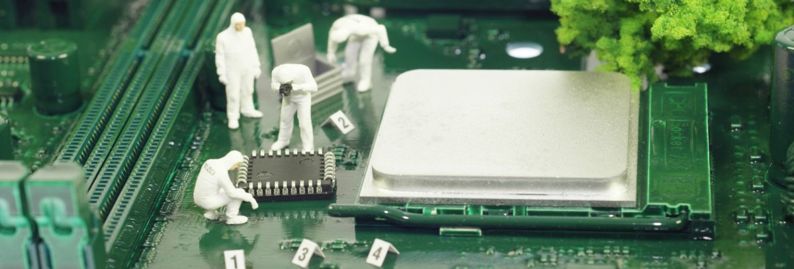
Exploring Civil Engineering through
Popsicle Bridges
Can you build the bridge that can hold the most weight?
Notes:
Note that all images in this presentation are placeholders, and should be replaced by more appropriate images.

Slide 2
Presenter’s Name
Short bio/
Accomplishments
Title

Slide 3
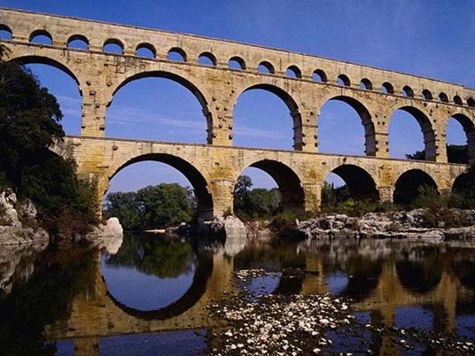
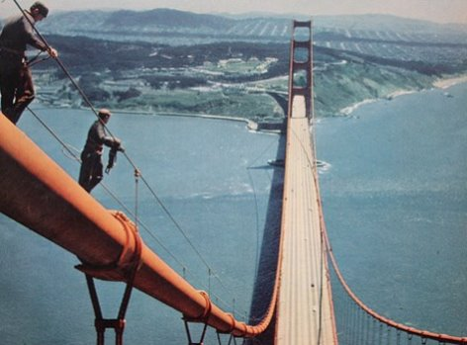
What is Civil Engineering?
Notes:
Engineering discipline that deals with designing, building, and maintaining infrastructure.
Makes transportation, water and waste systems, housing, public monuments, and many more things possible.
Second oldest engineering discipline
Structural Engineers:
Design, construct, maintain, and inspect:
Homes
Public buildings
Monuments
Bridges
Structural engineers are responsible for many notable projects, like the Seattle Space Needle, Hoover Dam, Golden Gate Bridge, and the Trans-Alaska Pipeline
Water Engineers:
Planning city water and waste systems
Ensure quantity and quality of water sources
Design flood defense systems
Transportation Engineers:
Streets and highways
Bridges
Canals
Railroads
Airports
Ports

Slide 4
Where A Civil Engineering Degree Can Take You
74%
Beginning at $55,000, experienced Civil Engineers can get $70,000 - $140,000.
11% growth rate
Can lead to:
Mechanical Engineering
Architect
Surveying
Environmental
Construction
Business
Law
Alaska will need
Students offered jobs before graduation
300
Engineering professionals annually through
2022
96 new positions
204 to replace retirees
Notes:
Note: Here or at the end hand out the "Is Civil Engineering For You?" Handout.
You can work towards a civil engineering degree right now in middle/high school by taking a lot of math and science classes, including elective like woodshop or computer science. As well, AP classes will allow you to get a faster start once you're in college.

Slide 5
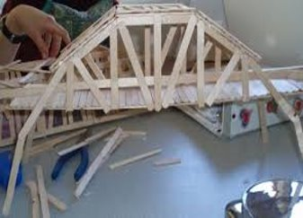
Building Bridges
Your challenge is to use provided materials to design, build, and test a popsicle stick bridge to support the maximum amount of weight possible.

Slide 6
Design, then Build, then Test!
Only use your group's materials
Get an instructor's help with hot glue

Slide 7
Materials
You will need:
Paper
Pencil
Bridge Building Kit

Slide 8
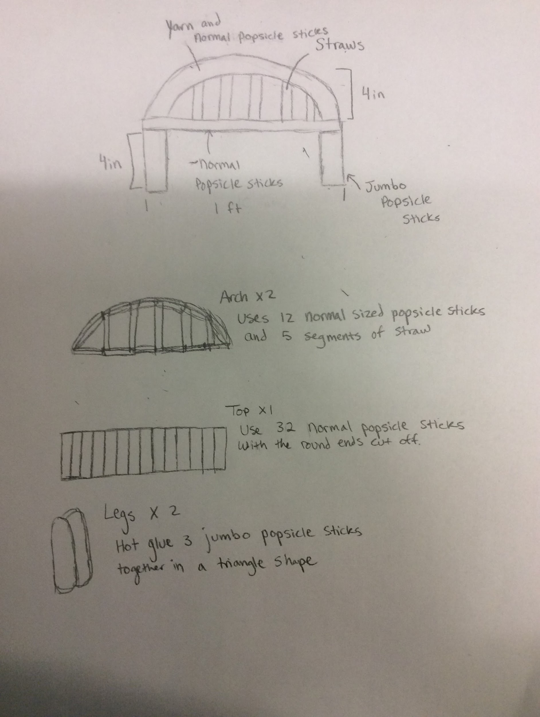
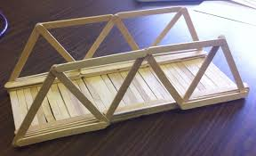
Instructions
Step 1
Design your bridge. Sketch out your bridge design with labels and dimensions. When you're finished, get an instructor's approval to move on.
Step 2
Build your bridge. Using your kit, begin constructing your bridge. Get help from an instructor with hot glue.

Slide 9
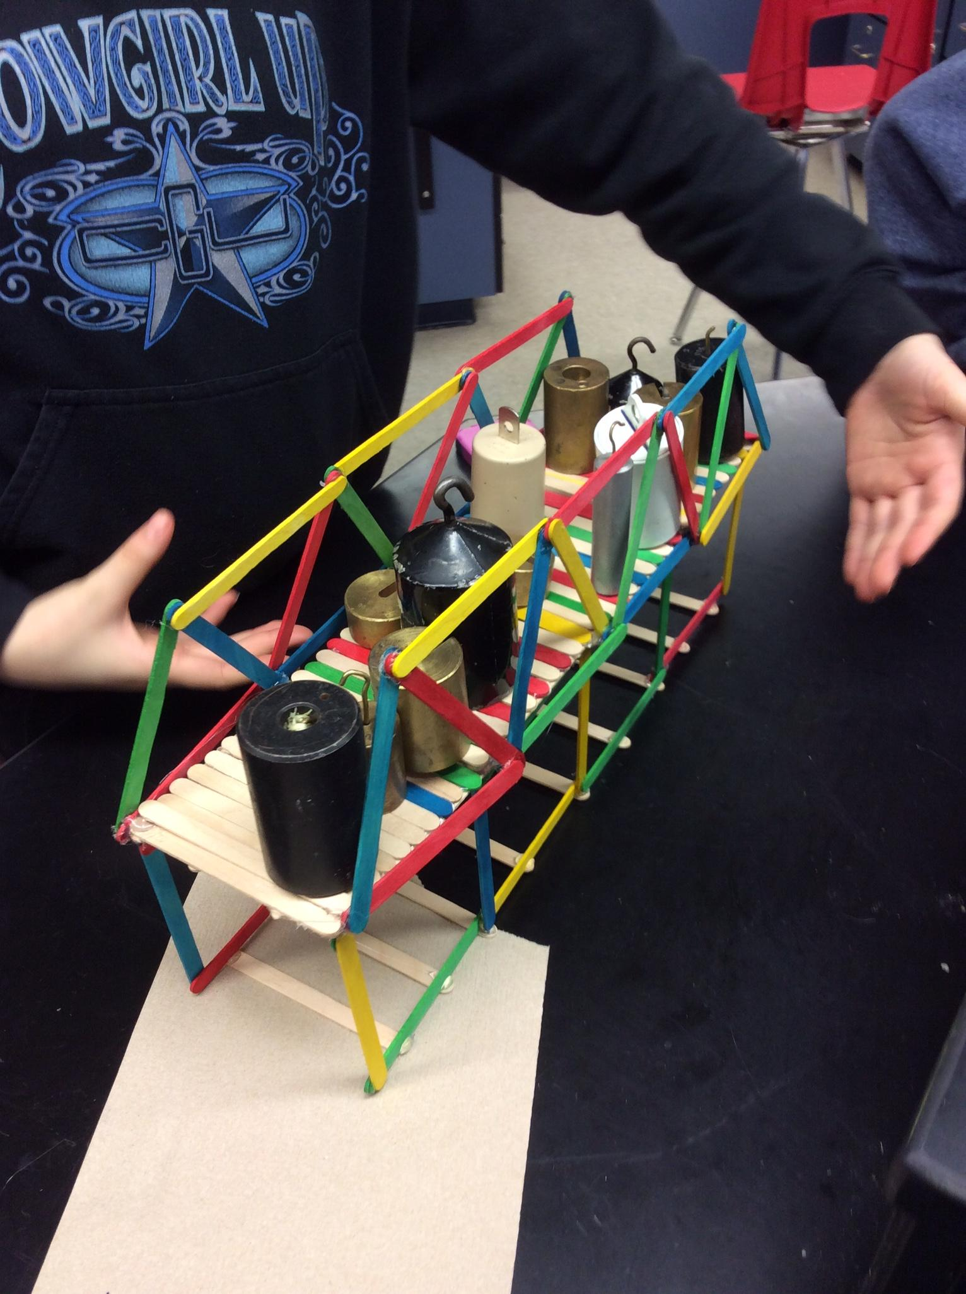
Instructions
Step 3
Finally, it's time to test your bridge. Follow an instructor's guidance to test your bridge by putting it across the gap and adding weights until it break, or there are no more weights.
Notes:
Adjust these slides as needed. Some projects will need more or less slides, and sometimes the pictures don't fit exactly the same – if you rearrange the pictures and text, MAKE SURE that it still flows easily. Get someone else to check it if you're not sure.

Slide 10
Discussion
What was the hardest part of this project? Why was it hard?
Did your bridge survive the weight? Why do you think that is?
What was the strongest part of your design?
What was the weakest part of your design?
What would you do differently if you built a prototype again?
What did you learn?

Slide 11
Questions?

