Slide 1
Exploring Computer Science through
Binary Code Bracelets
01000010 01001001 01001110 01000001 01010010 01011001 01000011 01001111 01000100 01000101

Slide 2
Presenter’s Name
Short bio/
Accomplishments
Title

Slide 3
What is Binary Code?
Any code that uses only two symbols to represent information
Examples include Braille and Morse code
We will be using the type of binary code that computers and computerized devices use
This type of code comes in the form of 1s and 0s
Computers convert the 1s and 0s into different letters, symbols, and instructions
The 1s represent “on” and the 0s represent “off”
Each set of binary code can only hold 8 binary digits, or “bits”
A binary digit is a digit’s location in the binary number, binary numbers cannot be rearranged
Each binary number is separated by one or more characters called a delimiter
Notes:
Binary code is any code that uses only two symbols to represent information. Different types of binary code includes Braille, which uses raised and non raised bumps, and Morse code, which uses long and short signals to relay information.
The type of binary code we are using for the bracelets is the type that computers and computerized devices such as calculators, printers, and microwaves use to send, receive, and store information.
Binary code for computers come in the form of 1s and 0s. Computers convert the 1s and 0s into different letters, symbols, and instructions. The 1s represent “on” and the 0s represent “off.”
Each set of binary code can only hold 8 bits, or binary digits. This is why each of the letters are translated to 8 different 1s and 0s. Each binary number is separated by one or more characters called a delimiter

Slide 4
Important Definitions
Binary- A notation that uses only two options for each selection.
Bit- Short for “Binary Digit.” It is one digit’s location in a binary number.
Code/Coding- Transformation from one representation to another.
Decode- Convert a coded message into something familiar.
Delimiter- A delimiter is one or more characters that separates text strings.
Encode- Convert a familiar message into code.

Slide 5
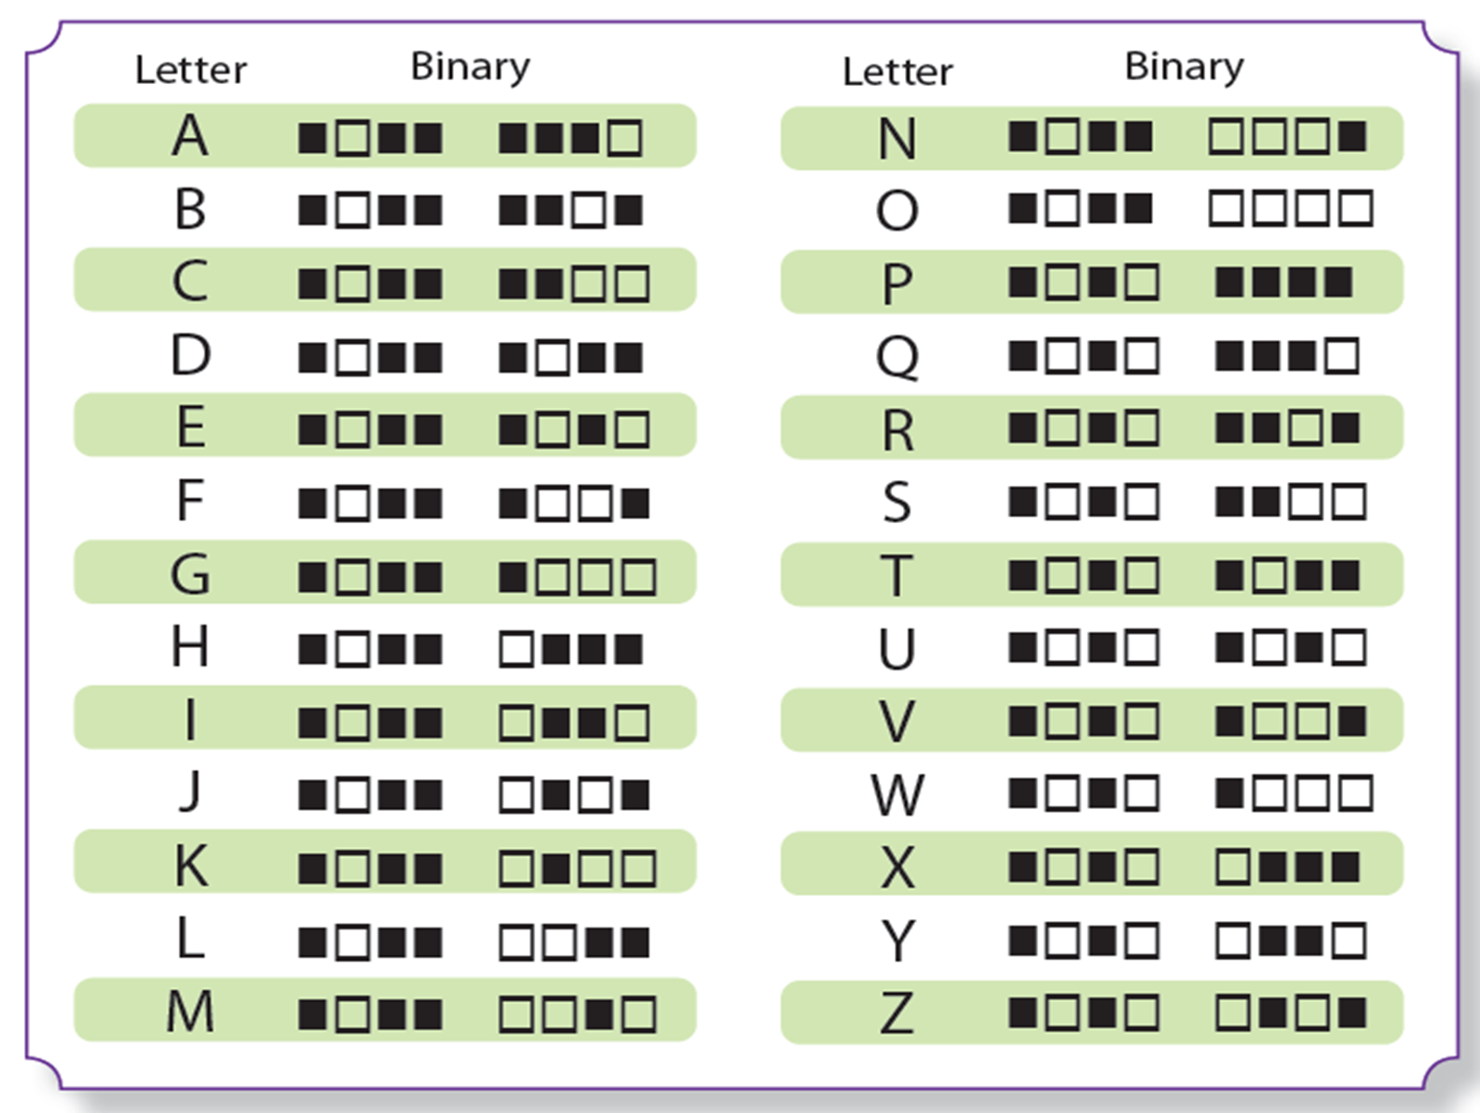
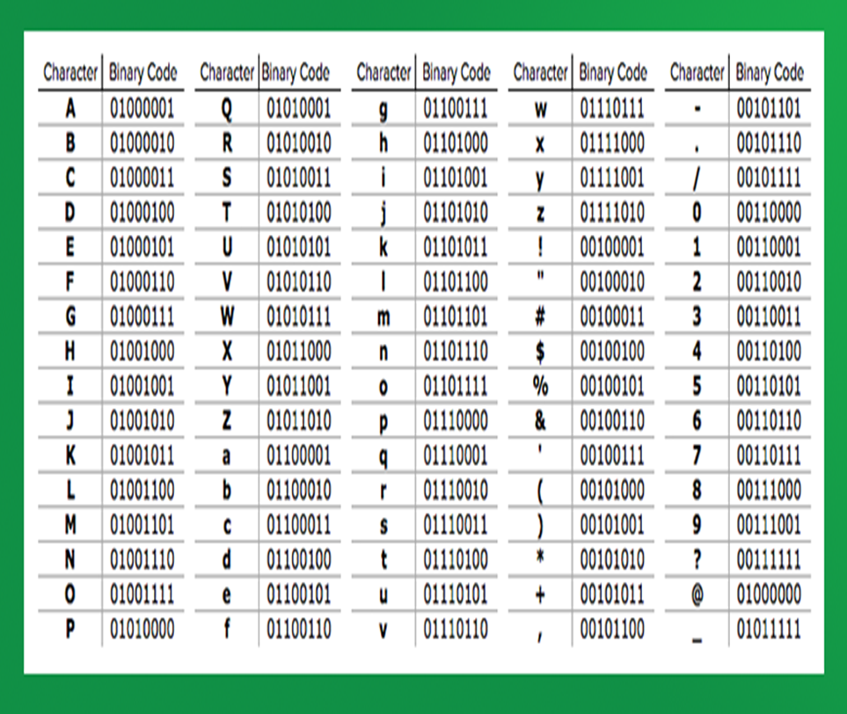
Binary Alphabet
We will be using the ASCII binary alphabet
The form we are using uses boxes instead of 1s and 0s
The black boxes represent 0s and the white boxes represent 1s
For example, the letter A would be translated to 01000001
Using this form is easier for the project
Notes:
ASCII-American Standard Code for Information Interchange

Slide 6
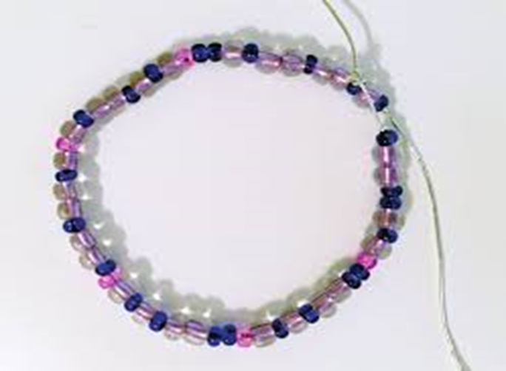
Binary Bracelets
Objective: Your challenge is to create a bracelet by converting the English alphabet to binary code. You can then take your own binary code sheet home and create secret messages!

Slide 7
You may only choose 3 different colored beads
Make sure to put a delimiter between each letter
You must check that your code is correct with an instructor before beginning your bracelet

Slide 8
Materials
You will need:
Paper
Pencil
1 piece of string
3 different colors of beads (You may only choose 3! Otherwise the project will not work)
Binary code sheet

Slide 9
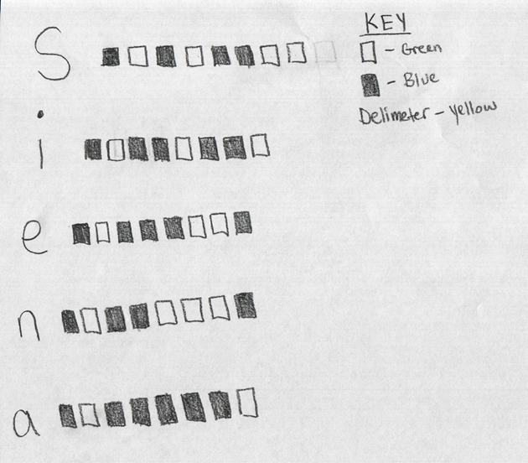
Instructions
Step 1
Write out your name on a piece of paper. Use the Binary alphabet sheet to translate the letters in your name into the binary alphabet. Create a key to remember which colored beads you will use.
Step 2
Choose three different colors. Choose one color for the white boxes, one color for the black boxes, and one color to separate the letters (delimiter).

Slide 10
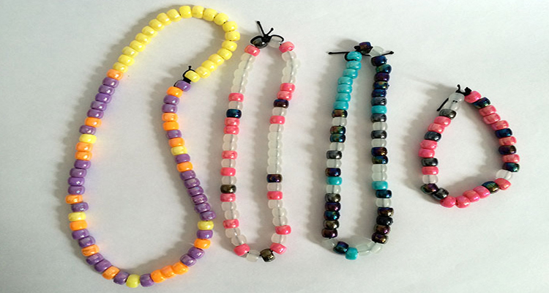
Instructions
Step 3
Tie a knot at one end of your string. Begin stringing the beads following the binary alphabet starting with the first letter. Continue with each letter, making sure to put a separate colored bead between each letter. If there are too many bits, you may convert your bracelet into a necklace.
Step 4
When you have finished putting the beads on, tie both ends to make a loop. You now have your binary bracelet or necklace!

Slide 11
Discussion
What was the hardest part of this project? Why was it hard?
Why do you think it is important that the bits are in the correct order?
What other computerized devices use this type of binary code?

Slide 12
Questions?

