Slide 1
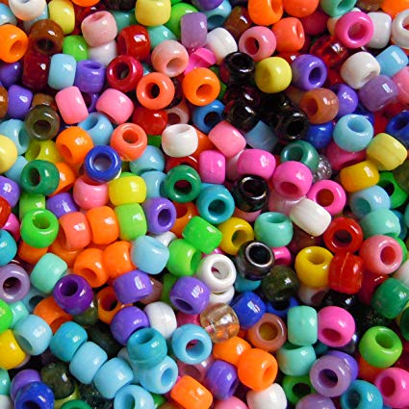
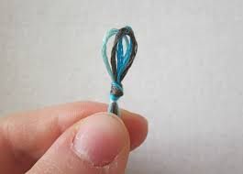
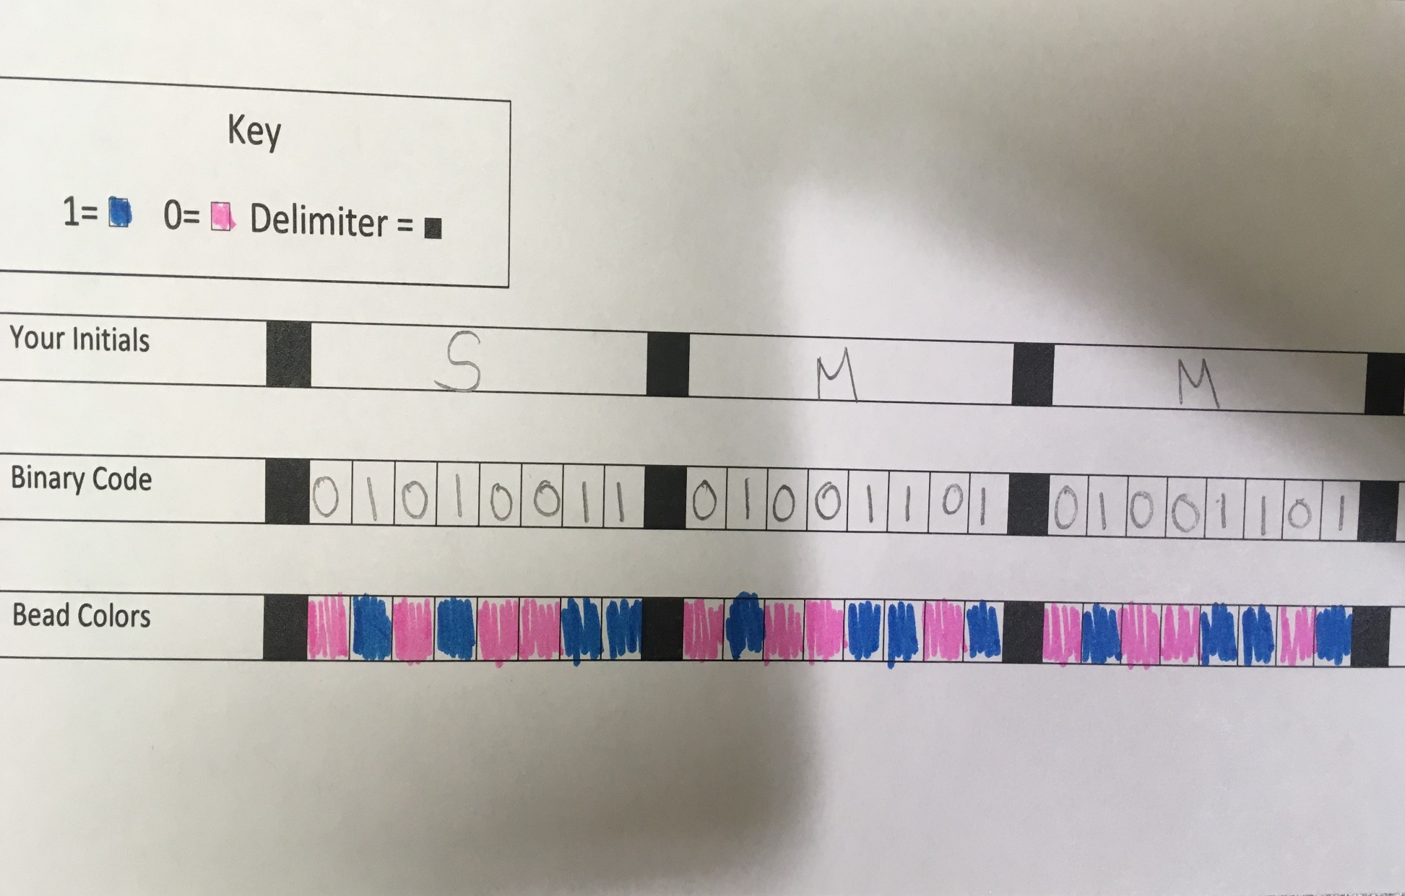
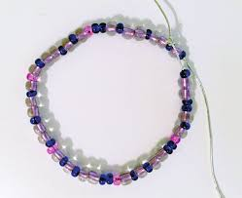
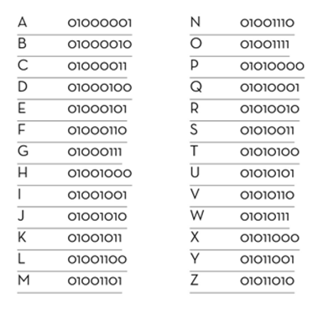
Binary Code Bracelets
Your Mission:
Build Instructions:
Important Definitions:
Binary- A language that uses only two symbols to communicate. For example, 1s and 0s, long and short dashes, or black and white boxes.
Bit- Short for “Binary Digit,” is the smallest unit of information communicated by a computer.
Code/Coding- Changing from the English language into computer language or other symbols.
Decode- To change the symbols or computer language into the English language.
Delimiter- Separates each of the letters.
Encode- Change a message into symbols.
Your challenge is to create a bracelet by encoding your initials into binary code and following the instructions on this board. You can then take your own binary code sheet home and create secret messages!
STEP 2: Fill out the planning sheet. You will be writing out your initials, translating them into binary digits, and then planning the colors you will use. Use the binary alphabet sheet to translate the letters in your initials into binary code.
STEP 3: Tie a knot at one end of your string so there is a loop. Wrap the loop around a pencil. Begin stringing the beads following the bead colors on your planning sheet. Continue with each letter, making sure to put a black delimiter between each binary code.
STEP 1: Choose two different colors. Choose one color for the ones, and one color for the zeros. Your delimiter, or separating bead, will be black.
What is Binary Code?
Binary code is any code that uses only two symbols to represent information. Different types of binary code includes Braille, which uses raised and non raised bumps, and Morse code, which uses long and short signals to relay information.
The type of binary code we are using for the bracelets is the type that computers and computerized devices such as calculators, printers, and microwaves use to send, receive, and store information.
Binary code for computers come in the form of 1s and 0s. Computers convert the 1s and 0s into different letters, symbols, and instructions. The 1s represent “on” and the 0s represent “off.” For example the letter A would be translated to 01000001.
Each set of binary code can only hold 8 bits, or binary digits. This is why each of the letters are translated to 8 different 1s and 0s. Each binary number is separated by one or more characters called a delimiter.
STEP 4: When you have finished ask an adult for help tying a knot. You now have your binary bracelet!

