Slide 1
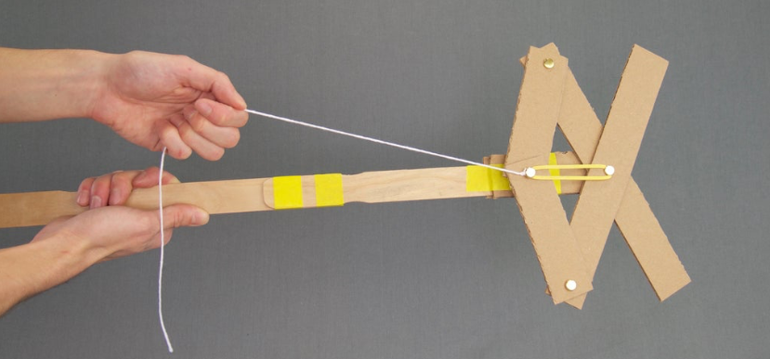
Exploring Mechanical Engineering through
Articulated Grabbers
Notes:
Note that all images in this presentation are placeholders, and should be replaced by more appropriate images.

Slide 2
Presenter’s Name
Short bio/
Accomplishments
Title

Slide 3
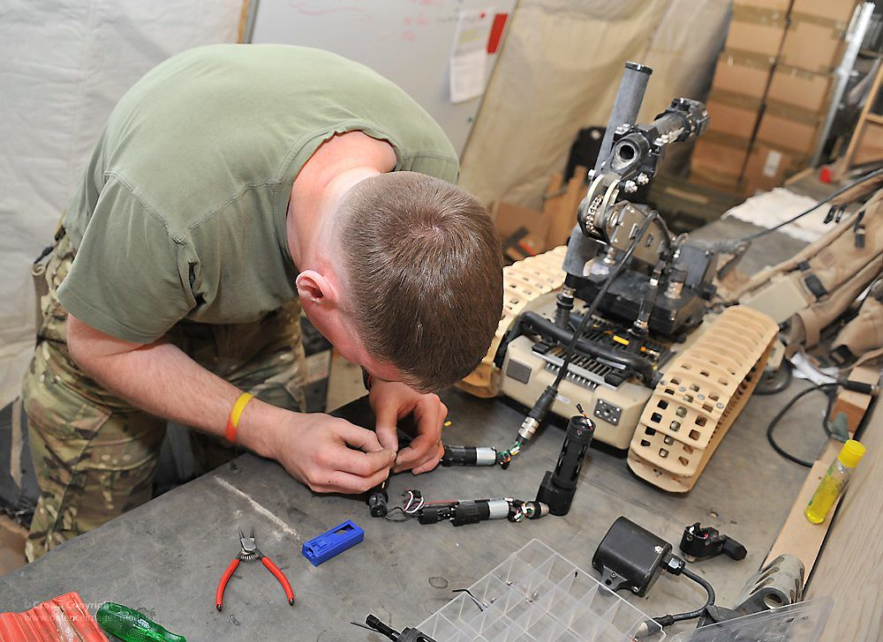
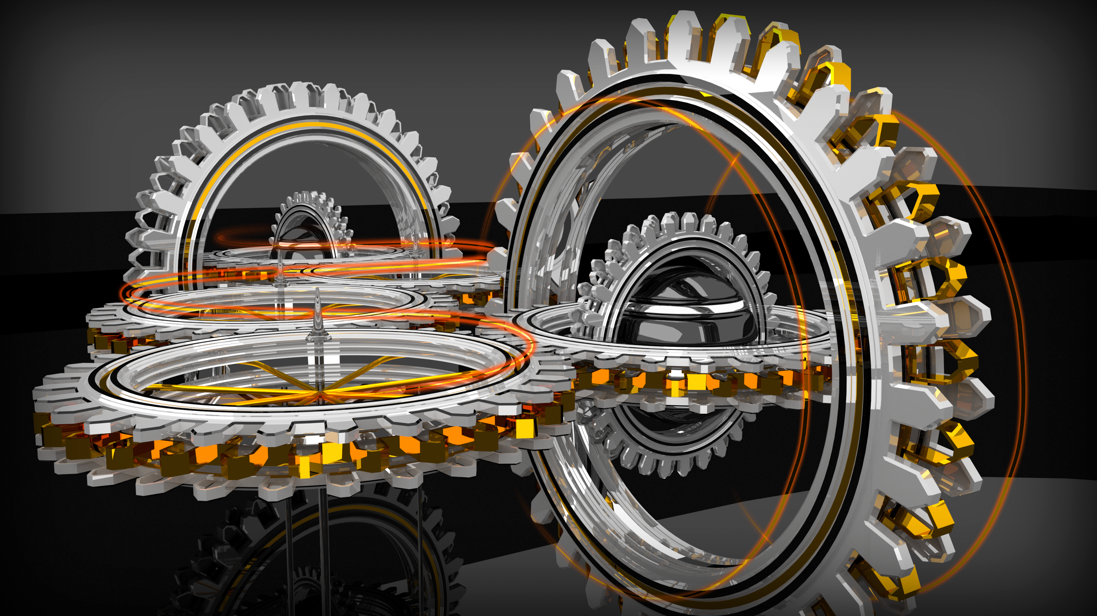
What is Mechanical Engineering?
Notes:
Mechanical engineering combines creativity, knowledge and analytical tools to complete the difficult task of shaping an idea into reality. Mechanical engineers design components, machines, systems, and processes. This ranges from the macro to the micro, from the largest systems like cars and satellites to the smallest components like sensors and switches. Anything that needs to be manufactured—indeed, anything with moving parts—needs the expertise of a mechanical engineer.

Slide 4
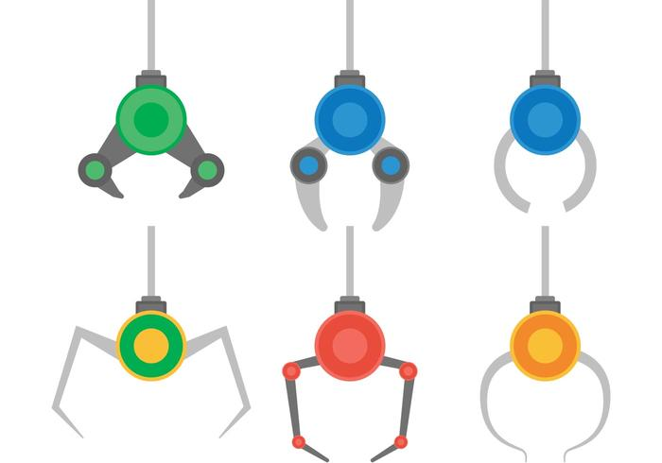
Articulated Grabbers
Your challenge is to build an articulated grabber using the following instructions with the provided materials. You must then try different attachments to be able to pick up different objects.

Slide 5
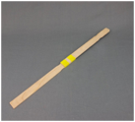
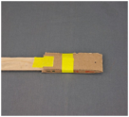
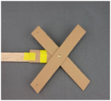
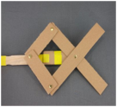
Instructions
Step 1
Build the handle. Overlap the paint stirrers and wrap tightly with masking tape in at least two places. Take the piece that doesn’t have holes, bend it in half, and tape it to the end of the handle. Leave about 1" of the folded side not overlapped with the wood. Poke a hole through that part of the cardboard.
Step 2
Assemble the cardboard as shown using a metal fastener. On the other side, fold the fastener tabs completely flat, and secure in place with a piece of tape. Attach the two 5" pieces as shown. Remember to fold and tape the fastener tabs.
Notes:
These are placeholder photos.

Slide 6
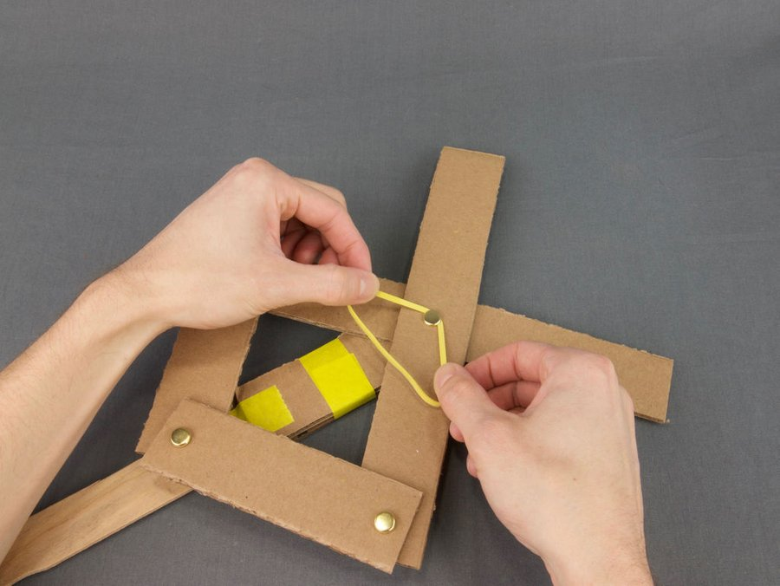
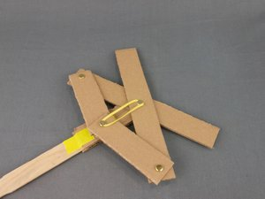
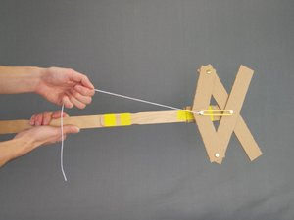
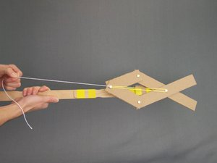
Instructions
Step 3
Attach the rubber band! This will help automatically open up the grabber. Start by stretching the rubber band with both hands, and slipping it under the middle fastener, then repeat with the other side.
Step 4 Tie a piece of string to the fastener as shown. The grabber is ready to test! Give the string a tug, and your grabber should close.
Notes:
Adjust these slides as needed. Some projects will need more or less slides, and sometimes the pictures don't fit exactly the same – if you rearrange the pictures and text, MAKE SURE that it still flows easily. Get someone else to check it if you're not sure.

Slide 7
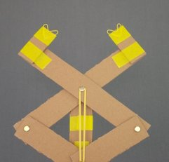
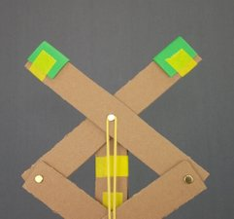
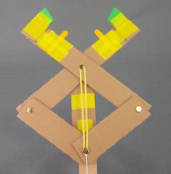
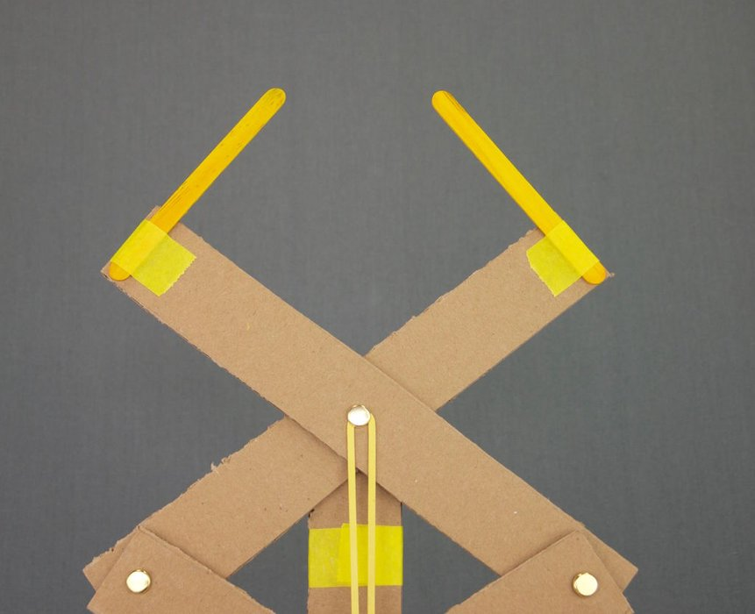
Other Attachments
Now you get to try out adding your own attachments! Here are some examples to get you started:

Slide 8
Discussion
What was the hardest part of this project? Why was it hard?
Can you explain how this articulated grabber works?
What materials worked best at the end of the grabber claw?
How could you improve this design?
What did you learn?

Slide 9
Questions?

