Slide 1
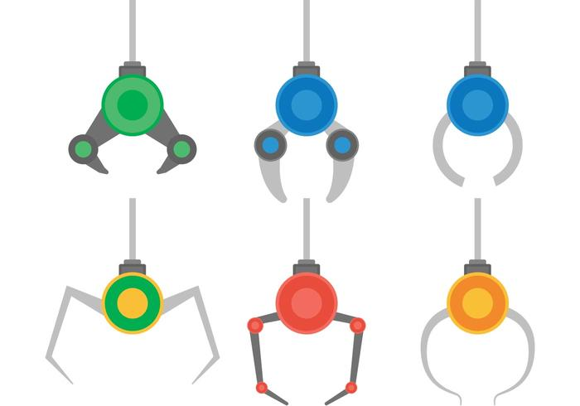
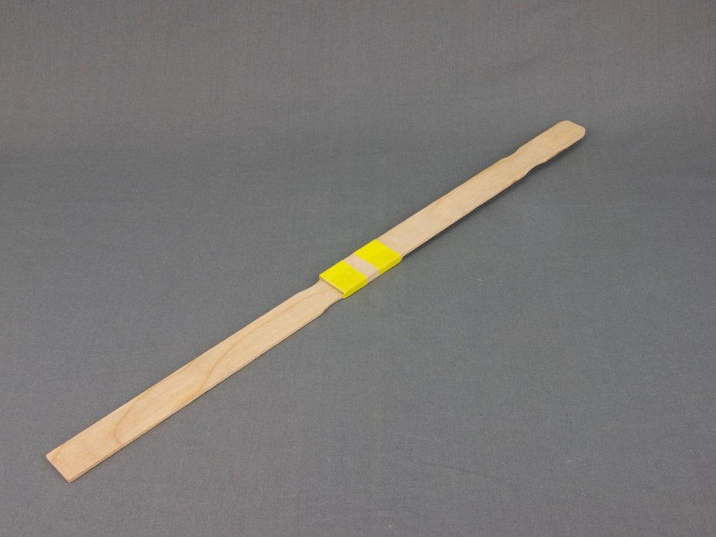
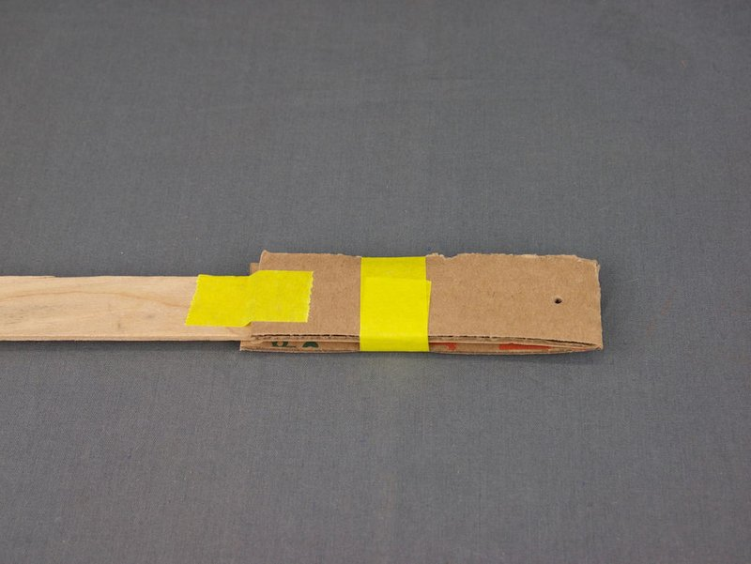
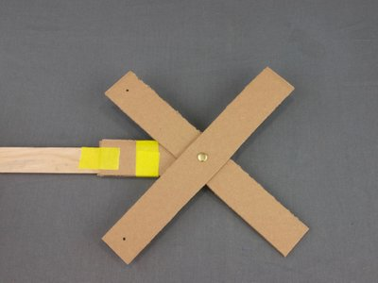
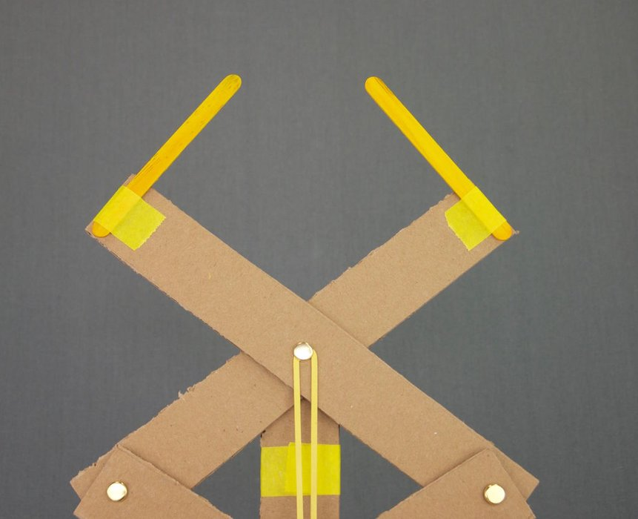
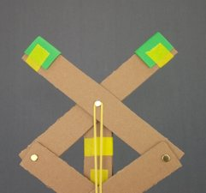
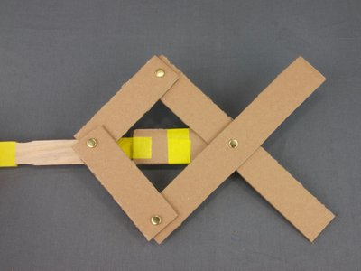
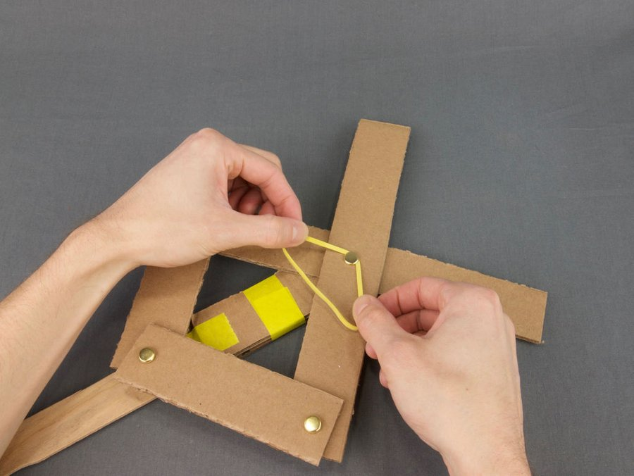
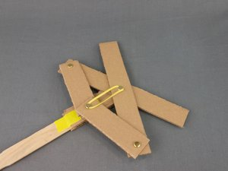
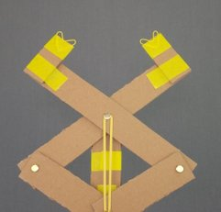
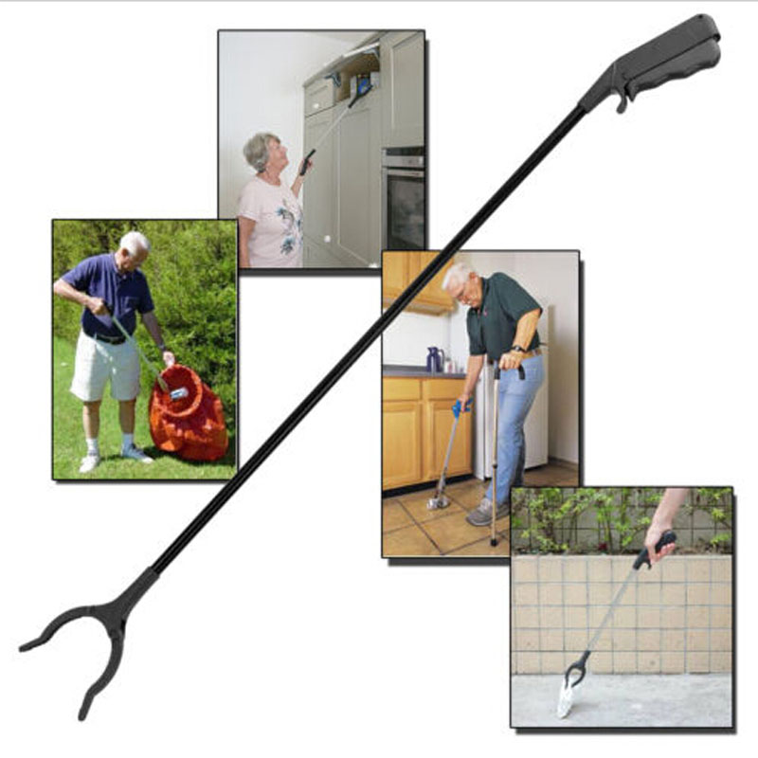
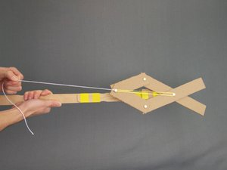
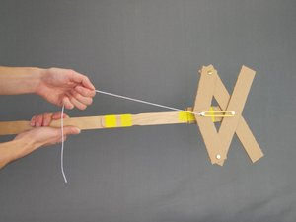
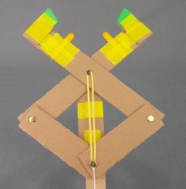
Articulated Grabber
Your Mission:
Build Instructions:
Final Touches:
STEP 7: Add attachment to the end of the grabber. You can experiment with different type of craft materials to make different types of grippers. Here are some idea to help you out:
Your challenge is to build an articulated grabber using the following instructions with the provided materials. You must then try different attachments to be able to pick up different objects.
STEP 1: Build the handle. Overlap the paint stirrers and wrap tightly with masking tape in at least two places
STEP 2: Take the piece that doesn’t have holes, bend it in half, and tape it to the end of the handle. Leave about 1" of the folded side not overlapped with the wood. Poke a hole through that part of the cardboard.
STEP 3: Assemble the cardboard as shown using a metal fastener. On the other side, fold the fastener tabs completely flat, and secure in place with a piece of tape.
What is an Articulated Grabber?
“Articulated” means that this simple mechanical design uses two or more parts with moving joints.
Grabbers like this are used to help people reach things on high shelves or off the ground. Similar designs are also used in claw machines and on robotic arms.
STEP 4: Attach the two 5" pieces as shown. Remember to fold and tape the fastener tabs.
STEP 5: Attach the rubber band! This will help automatically open up the grabber. Start by stretching the rubber band with both hands, and slipping it under the middle fastener, then repeat with the other side.
STEP 6: Tie a piece of string to the fastener as shown. The grabber is ready to test! Give the string a tug, and your grabber should close.

