Slide 1
UAA Spirit Quest
By Kevin Bartlett
Supervisor: Kenrick J. Mock

Slide 2
What's The Point?
Gamify Student Success at UAA

Slide 3
What's Gamification?
The use of game design techniques to increase interest, motivation, and engagement of a user in contexts other than gaming.

Slide 4
How Does That Work?
All work and no play makes Jack a dull boy
All work and no play makes Jack a dull boy
All work and no play makes Jack a dull boy
All work and no play makes Jack a dull boy
All work and no play makes Jack a dull boy
All work and no play makes Jack a dull boy
All work and no play makes Jack a dull boy
All work and no play makes Jack a dull boy

Slide 5
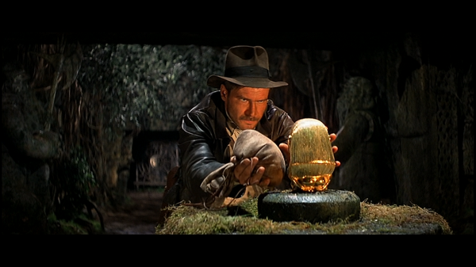
Copyright 1981 Lucasfilm Ltd.

Slide 6
The Team
Project Manager, Concept and Gameplay Design: Jennifer Stone
Artwork: John Cripps
Software: Kevin Bartlett, Kenrick Mock
Development Team meetings in two week iterations.
Monthly meetings with entire team.

Slide 7
Development Method Waterfall
Collect Requirements
Game Logic Design and Testing
Database Design and Testing
GUI Design and Testing
Mobile Version Design and Testing
Further Testing and Pilot Study
End of Spring Cycle

Slide 8
Requirements
Database to save/load game progress of each User.
Web technologies to implement game logic.
Web technologies to implement a graphical UI.
Rewards in the form of Spirit (points) and virtual Badges (achievements).

Slide 9
Solutions
Database: MySQL
Game logic: PHP/JQuery/JavaScript
GUI: PHP/JQuery/JavaScript/HTML/CSS
Rewards: Awarded with Web tech above. Saved into MySQL databse.

Slide 10
Testing Methodology
Small Unit Tests (series of assertions).
No use of PHPUnit.
No Test Suite.
Mostly Hands-On Testing for the UI.

Slide 11
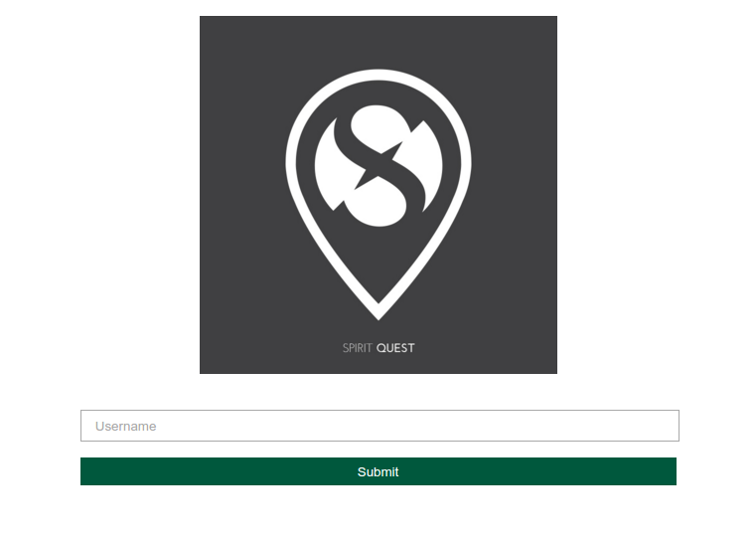

Slide 12
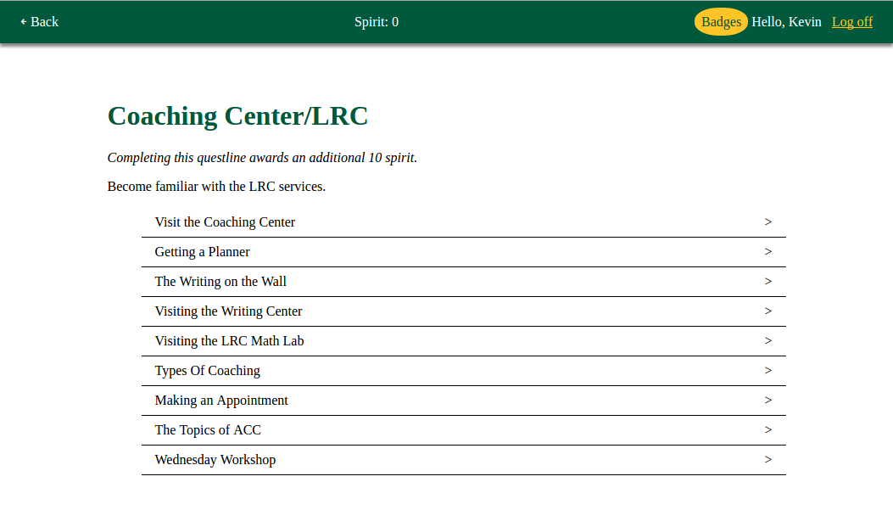

Slide 13
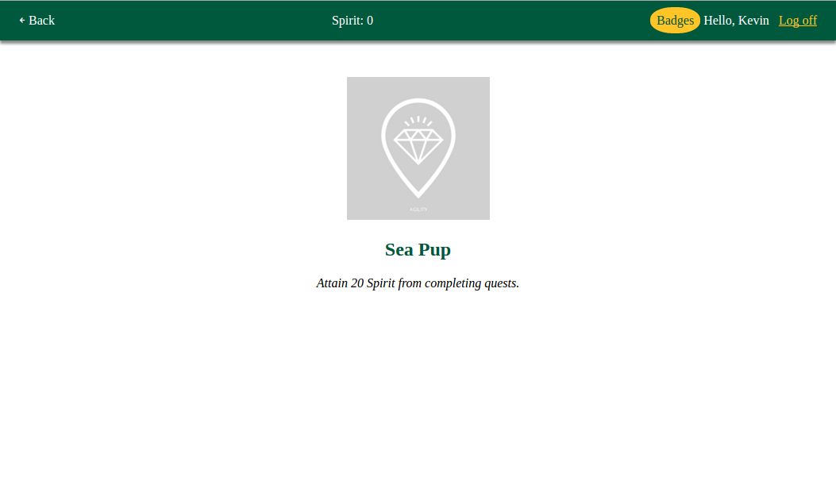

Slide 14
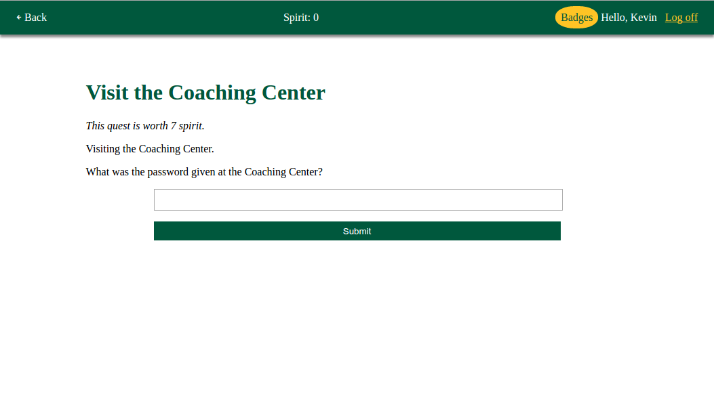

Slide 15
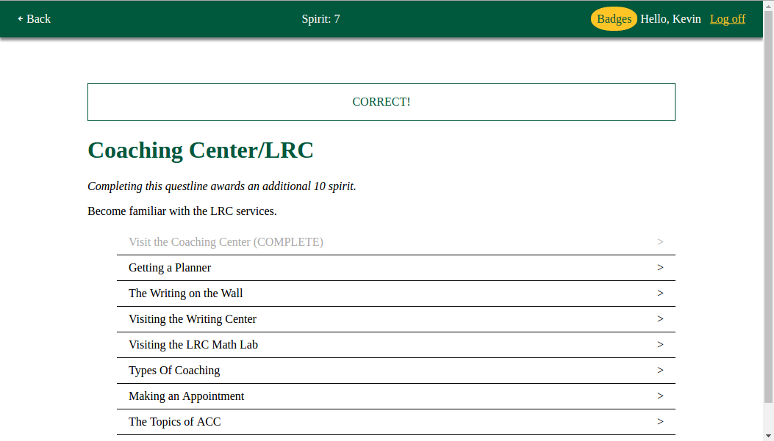

Slide 16
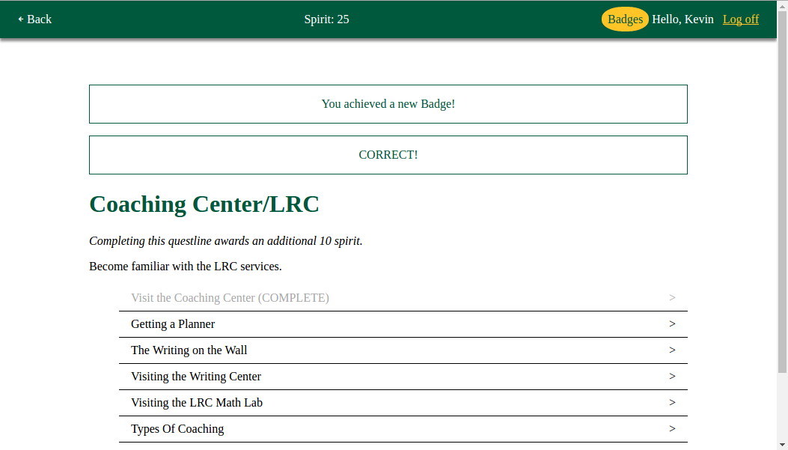

Slide 17
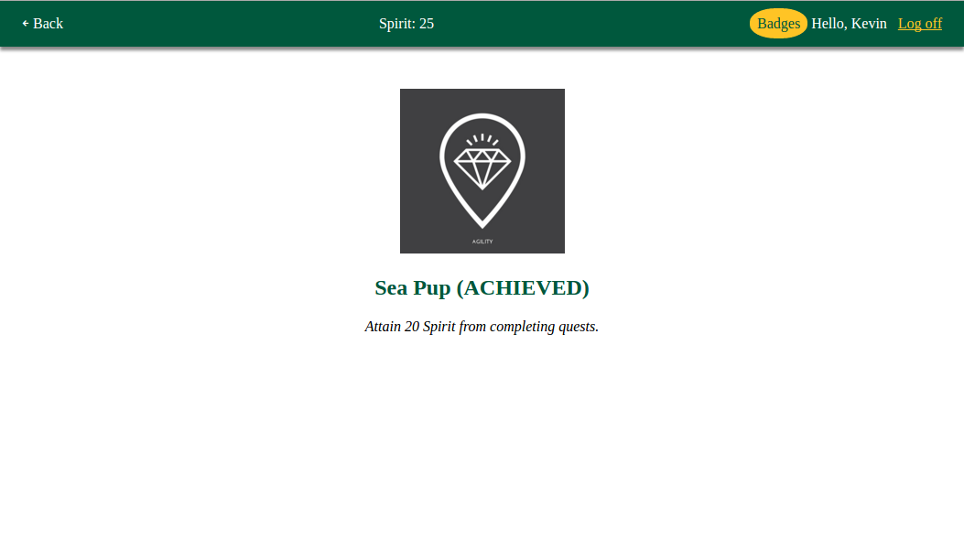

Slide 18
To be continued...

Slide 19
Questions?
Author unknown, Image retrieved from: https://anadventureinfindingbalance.com/2013/05/31/travel-fashion-packing-for-europe/

