Slide 1
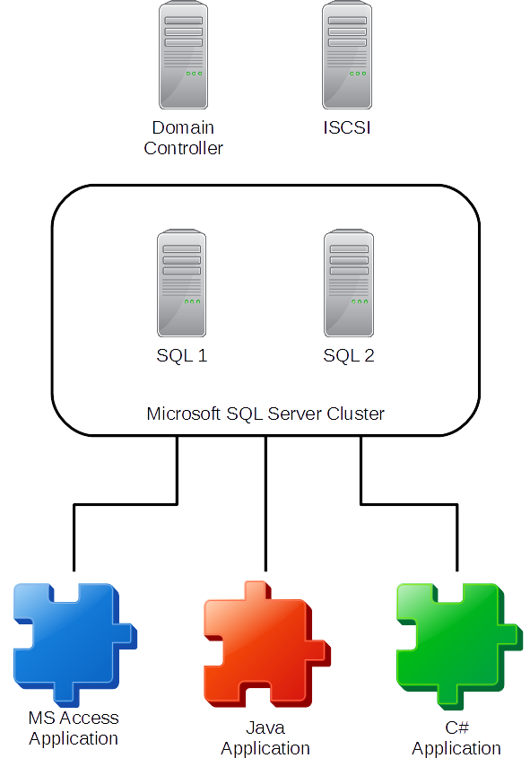
SQL Server Failover Effects on Applications Connected to the Cluster
REPLACE THIS BOX WITH YOUR ORGANIZATION’S
HIGH RESOLUTION LOGO
James A. Tweet
Abstract
Microsoft Access
In this project I will examine what happens to programs that are connected to a SQL Server cluster during a failover. Then try to mitigate the effects of the failover on the software.
I have a good range of results from restarting the program is the only option to nothing needs to be done.
After the cluster failover would sometimes give a generic ODBC error. Other times I would receive an ODBC linked table error.
I updated the following form events: Form_Load, Form_OnConnect, Form_Open, Form_Query, and Form_BeforeQuery. These events would now refresh the link to the linked table. This did not work. Also I tried to use a new connection string to connect to the table. This also did not work.
The only way to reconnect was by exiting out and opening the database again.
Virtual Systems
Java
Domain Controller Computer:
Windows 2012 R2
Microsoft Windows Domain Controller
DNS Server
ISCSI Computer:
FreeNAS
ISCSI Target Server
SQL1 & SQL2 Computers
Windows 2008 R2
Microsoft Cluster Services
Failover Cluster Node 1 & 2
SQL Cluster Node 1 & 2
Client Computer:
Windows 8.1
Microsoft Access 2016
JAVA 8
Visual Studio Community 2015
With Java I had much more success. After the failover I would get a SQLServerException Connection reset by peer error. My program could also detect that the connection was closed.
At this point the program could successfully reconnect to the database. I would also need to recreate the Statement and ResultSet but the system could continue from that point.
For a production system you could copy the ResultSet into an Array. Then send updates back to the server through function calls.
C#
The C# program I created gave me the most surprising results of all. After it connected to the database I caused a failover and the program stayed connected. No errors. When I opened the RecordSet and caused a failover the program stayed connected. Again no errors. I added, updated and deleted records each time causing a failover. Still no errors and the program stayed connected.
I have a hypothesis why C# is so robust for SQL connections. SQL Azure is a cloud based system so Microsoft had to make the connection more robust. Otherwise people would not want to use SQL Azure.
Contact
James A. Tweet
Email: JamesTweet@yahoo.com

