Slide 1
Hardware Virtualization
By: Kyle, Robert, and Paul
Supervisor: Prof. Randy Moulic PhD.
Instructor: Prof. Adriano Cavalcanti PhD.

Slide 2
Overview
Concept
Goals
Architecture
Hardware Used
Key Findings
Conclusion

Slide 3
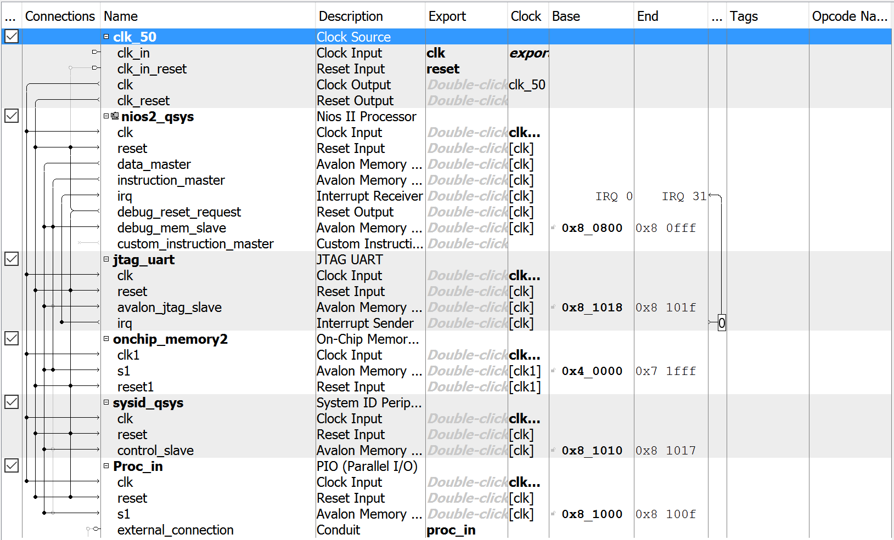
Concept
Virtualize a portion of the cable delivery system.
4 pieces of hardware down to one.
Generic pieces to allow for greater flexibility in delivery

Slide 4
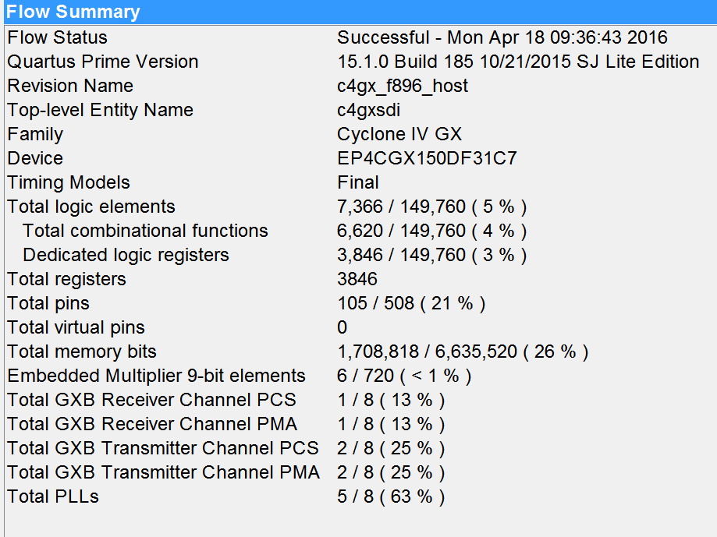
Goals
Implement the following features in the project
SDI TX/RX
Encryption/Decryption
User Notification of signal acquisition
Use current Hardware on campus
Allow for future development by students

Slide 5
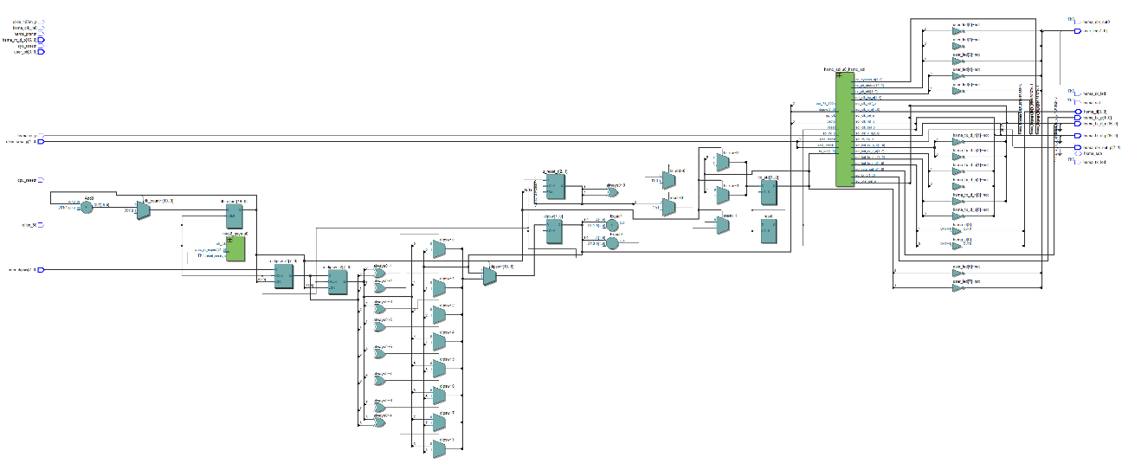
Architecture
FPGA
Verilog modules
NIOS II
C Files for signal decoding and UART/COM channel Display
165 MHz F-Max

Slide 6
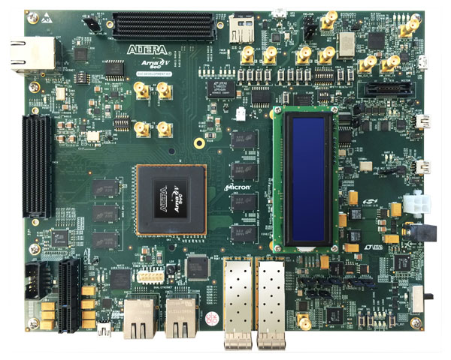
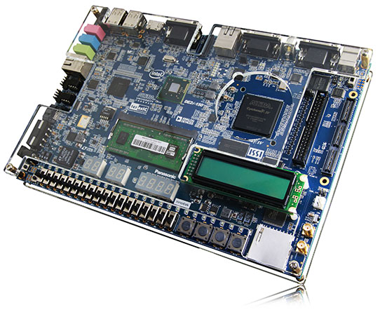
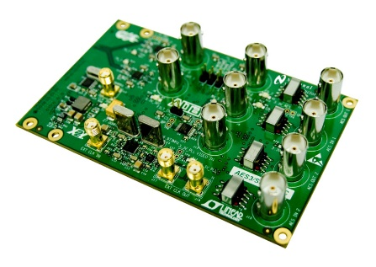
Hardware Usage
Original Plan
Altera Arria V
Current Implementation
Altera DE2i-150 with Cyclone IV GX
SDI Daughter Card

Slide 7
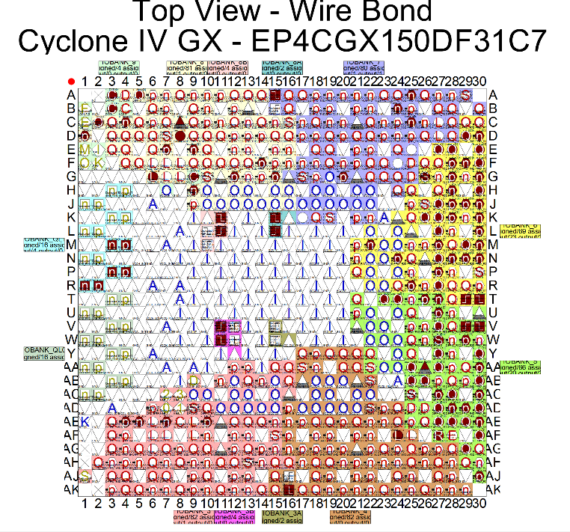
Key Findings
Altera Pin Planner is not that great
FPGA utilization is low allowing for more complex implementations
Complex Task requiring multiple semesters and disciplines

Slide 8
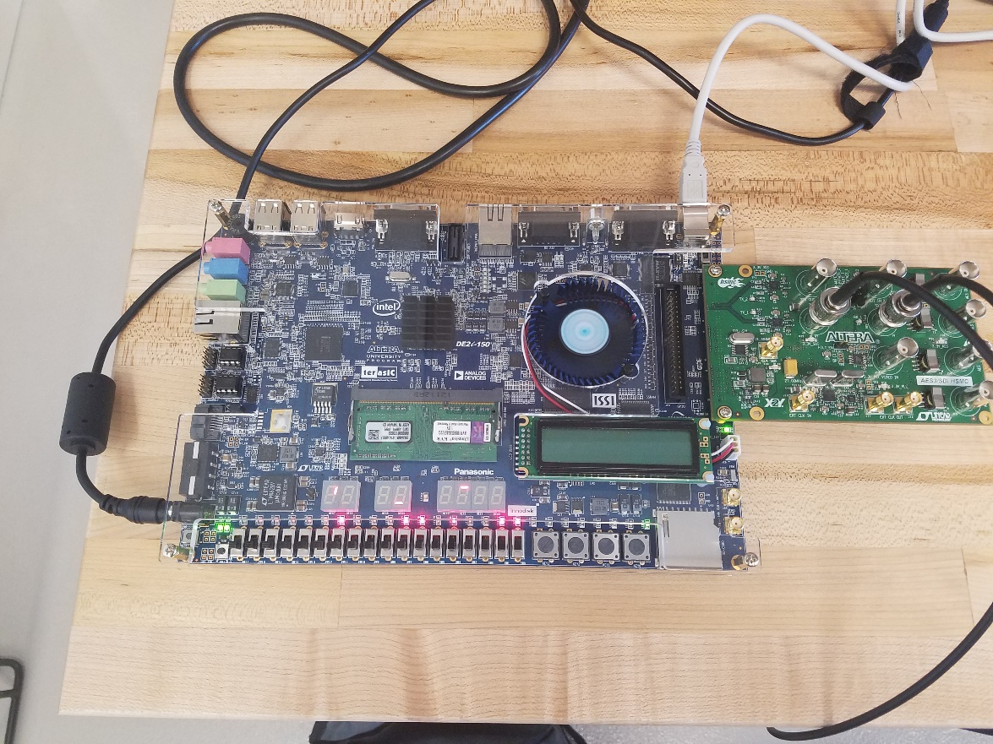
Conclusion
We would like to thank all those who supported the project through the semester.
Project Team:
Kyle, Robert and Paul

