Slide 1
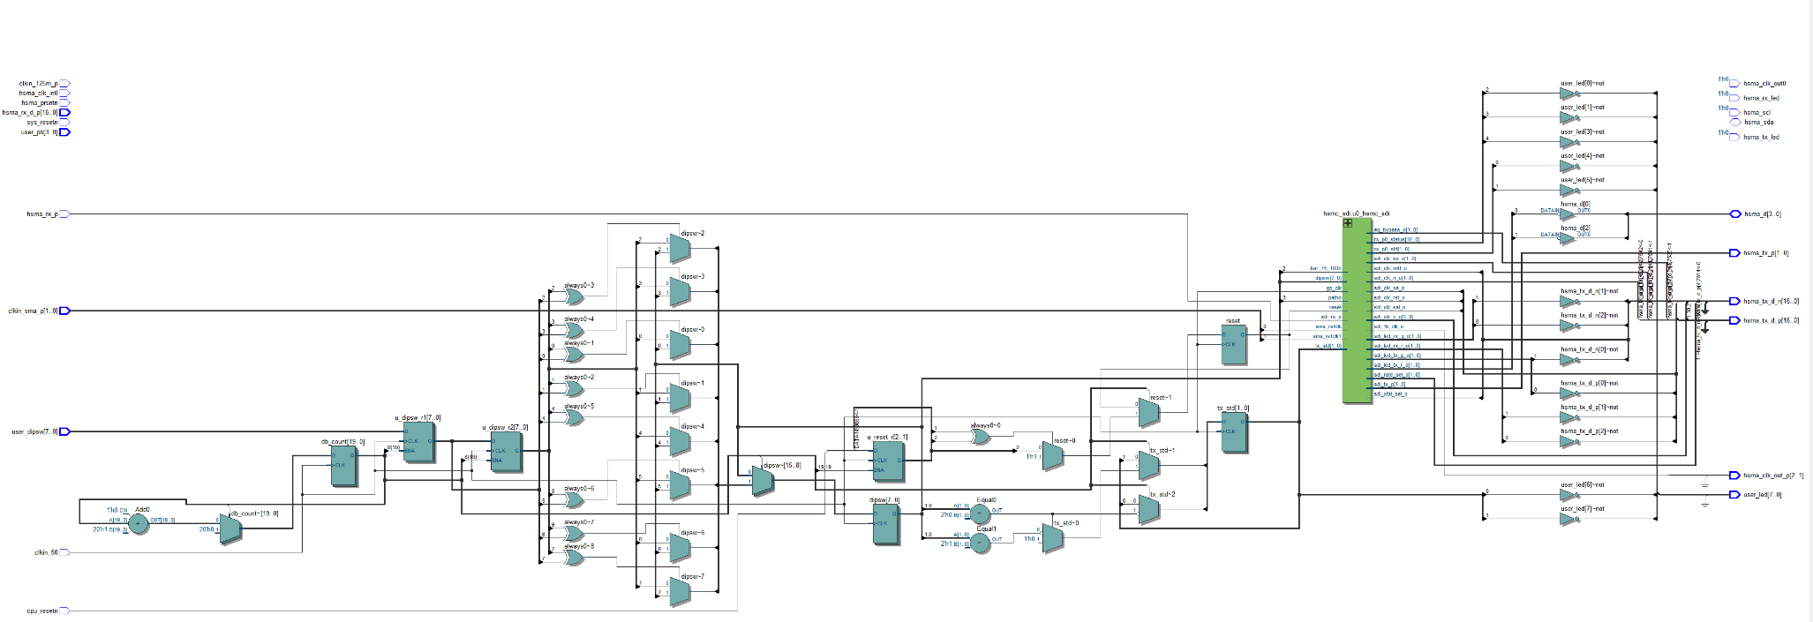
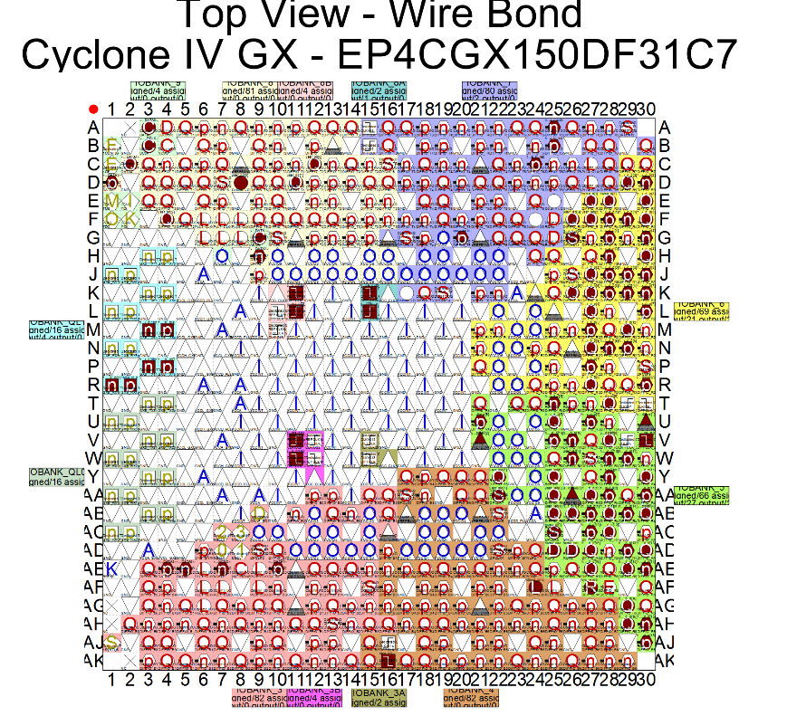
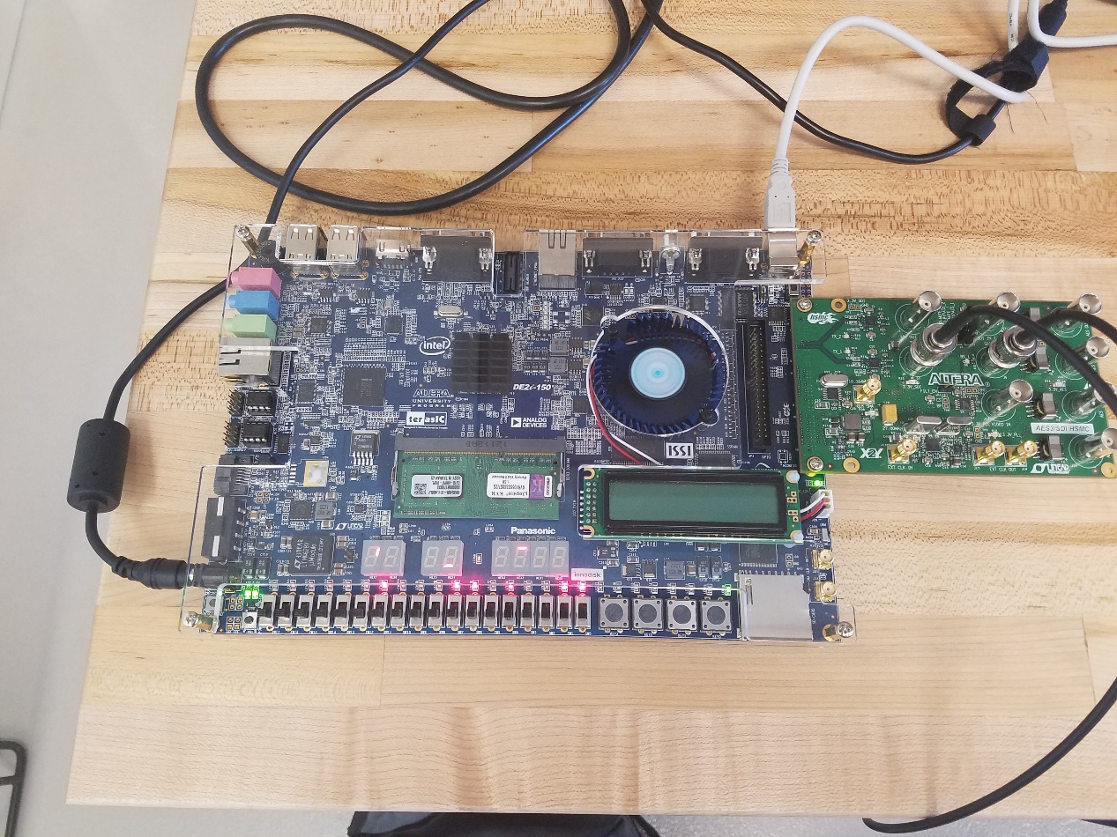
Cable Headend Virtualization
Gapinski, Kyle M., Aschenbrenner, Robert O., Kelly, Paul R.
Supervisor: Dr. James “Randy” Moulic, Ph.D.
abstract
methods
results
Using FPGAs to virtualize a portion of the cable delivery process. FPGAs give us the ability to choose multiple carrier waves and channel selections on those carrier waves by building the receiver unit virtually that is currently being performed on dedicated physical receivers for each channel. The transcoding and encoding of the video signal to meet the distribution requirements. The BISS Decryption follows RSA guidelines for future use. The final step of recombining into one IP stream will also be handled on the FPGA.
Quartus Prime used to create Verilog files to allow for SDI transmission.
OpenCL C++14 used to decrypt L-Band BISS encryption and allows for future upgrades using new software guidelines.
results
background
Cable headend system equipment take up a lot of space.
Current implementations of technology do not allow for generalized hardware.
FPGA boards have made advancements in recent years making them able to process at faster rates and allow for greater virtualization.
FPGA boards can be reprogramed to virtually simulate a variety of hardware components, meaning that it is easier to keeps spares on hand.
Several components can be simulated by one FPGA board, improving performance and reducing space.
conclusions
objectives
5% of the Cyclone IV GX FPGA utilized for a single SDI transmitter/receiver core
NIOS 2 Processor capable at 50 MHz (241 clock cycles)
Splitting signal into two Y(x) and Y(y) we were able to achieve a overall increase of 13% signal Decryption speed
We showed through two case simulations that the OpenCL-to-FPGA ﬂow is not only feasible, but also effective in designing high-performance circuits.
Our framework generated circuits for the benchmark suite that provide high throughput and has been shown to have a wide coverage of the OpenCL language, including synchronization using barriers, support for local memory, as well as floating point operations.
Develop Virtualized Hardware to allow for replace Hardware
Design method to decrypt SDI signal from transmitter
Design method to create SDI test signal
Implement past knowledge in current design to allow for hardware virtualization

