Slide 1
OBDII Automotive Data Logger Design
Kristian Smith
Advisor: Dr. Randy Moulic
Computer Systems Engineering
University of Alaska anchorage

Slide 2
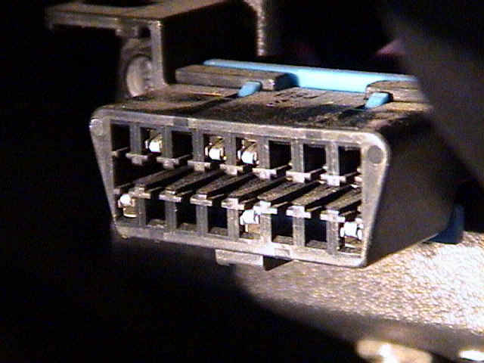
Introduction to On-Board Diagnostics (OBDII)
OBDII is a standardized communication protocol
Emissions Monitoring
Diagnostic Interface
Starting in 1996 model years, required by US government
Common monitors:
Vehicle Speed/RPM
Emissions Component Monitors
 Coolant, ambient, and air intake temperatures
http://www.diydiagnostics.com/images/connectorCloseup.jpg

Slide 3
Design Goals
Design a device with the following features:
Translates OBDII data
Collects GPS coordinates
Streams data through cellular network
Highly Adaptable
Access different vehicle PID’s for desired application
Communicate over 3g/4g and SMS
Low price point
Must not be cost prohibitive for everyday consumer

Slide 4
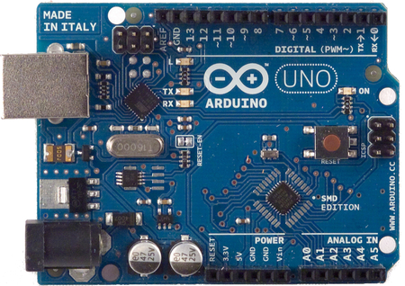
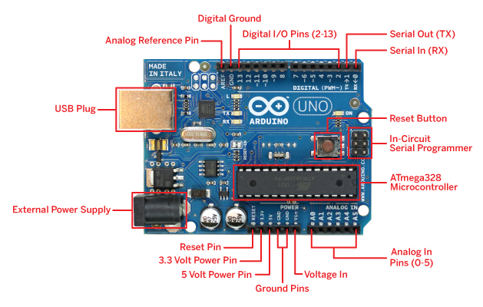
Arduino Uno Microprocessor
Based on ATmega328 processor
16 MHz, 32 KB flash memory
Stackable design
Simple programming construct (subset of C)
6 analog inputs
14 digital inputs/outputs
http://arduino.cc/en/uploads/Main/ArduinoUnoSmd450px.jpg
http://cdn.makezine.com/make/arduino/Arduino-callouts1.jpg

Slide 5
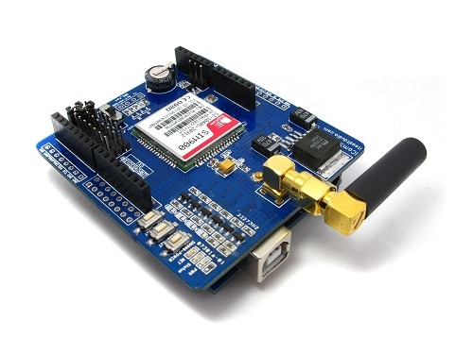
SIM900 GSM/GPRS Shield
Quad-Band 850/900/1800/1900MHz
Control via commands (GSM 07.07, 07.05 and SIMCOM enhanced AT Commands)
SMS texting features
3.5 inch standard sockets for MIC and speaker
http://blog.iteadstudio.com/wp-content/uploads/image/2011_05/sim900-gprs-shield-icomsat-preview_1.jpg

Slide 6
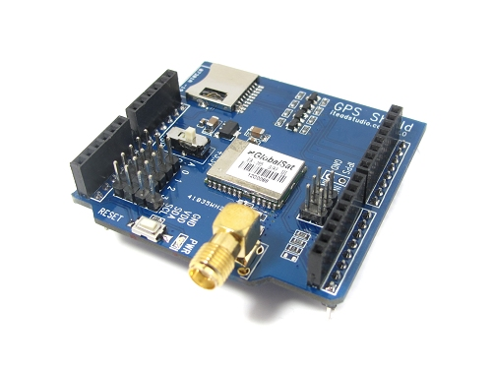
GPS Shield from ITEAD Studio
Acquires position and speed at 2 Hz
Micro SD interface
Active antenna design with high receive sensitivity
Extremely fast time to first fix at low signal level
UART interface
http://www.exp-tech.de/images/product_images/original_images/gpsshield4.jpg

Slide 7
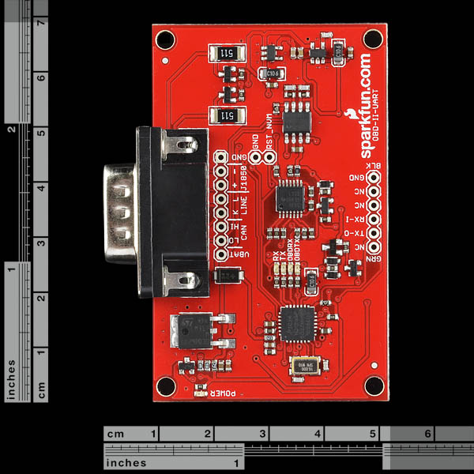
OBD-II UART (Sparkfun electronics)
UART interface (baud rates from 38 bps to 10 Mbps)
Secure boot-loader for easy firmware updates
Support for all legislated and some non-legislated OBD II protocols
Superior automatic protocol detection algorithm
Large memory buffer
Voltage input for battery monitoring
https://www.sparkfun.com/products/9555
images are CC BY-NC-SA 3.0

Slide 8
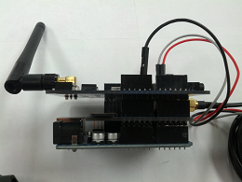
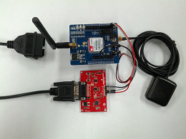
Assembled OBDII Logger
Requires no modification of vehicle
Shields stack vertically to Arduino
OBDII board must be connected externally
Images shown include cellular and GPS antennas as well as OBDII port connector
A standard baud rate of 9600 programmed from the Arduino can be used for communication between all boards
Operation temperature: -40℃ ~ +85℃

Slide 9
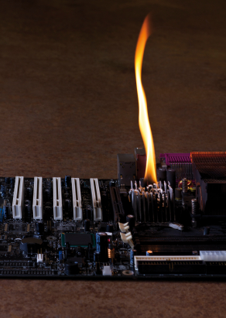
Implementation Woes
Donated SIMs were all deactivated
Senior Design Kill Wall:
2- Arduino Unos
2- OBDII UART Translator Shields
1- 12V-5V DC Voltage Step Down converter
Arduino may be plugged in to USB, but sometimes requires full system reboot to be recognized
Cellular connectivity in the Engineering Building

Slide 10
OBD II ACQUISITION TEST SPEEDS
Model Year | Make/Model | Data Points/Second
N/A | ECUSim 5100 | 38.0
1996 | Ford Bronco | 5.5
1998 | Oldsmobile Bravada | 19.6
1999 | Dodge Ram 1500 | 22.0
2000 | Ford F350 | 20.9
2001 | Chevrolet Tahoe | 26.4
2001 | Mazda B3000 | 25.7
2003 | Saturn L200 | 26.8
2004 | Chevrolet Avalanche | 26.2
2004 | Chevrolet 2500 HD | 24.5
2004 | Chevrolet Astro | 22.8
2005 | Jaguar X-Type | 4.2
2005 | Honda Accord | 4.5

Slide 11
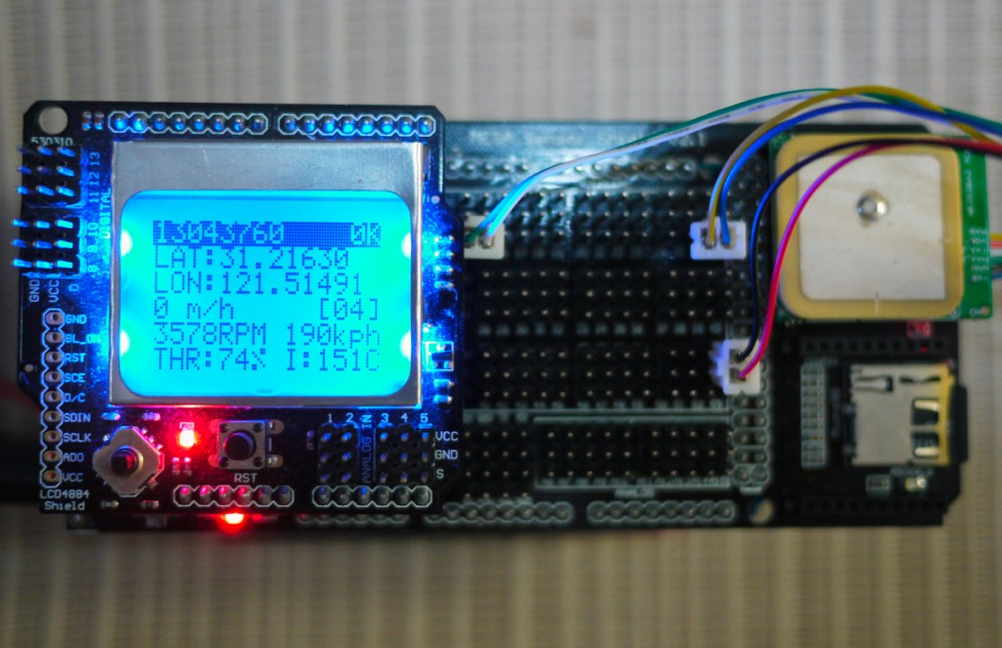
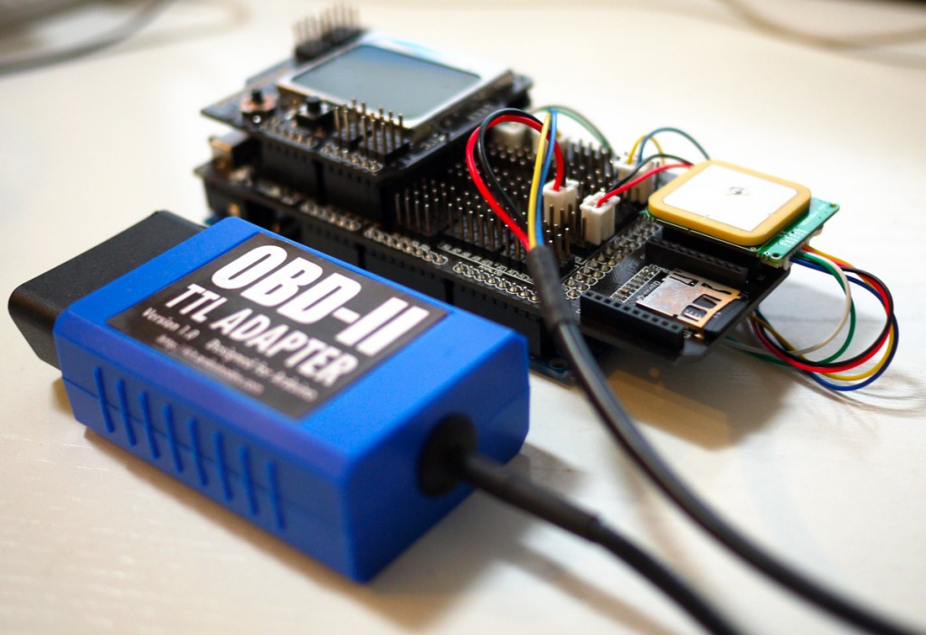
Related work
”The ultimate GPS and OBD-II data logger based on Arduino MEGA”
Designed for vehicle owner/operator to monitor OBDII parameters
No data transmission functionality, stores mined data locally on SD card
Arduino MEGA main board
Arduino MEGA IO extension board
LCD4884 shield for Arduino
MTK3389 GPS receiver (with 5Hz update speed)
OBD-II UART adapter
http://arduinodev.com/ultimate-gps-obd-data-logger-displayer/

Slide 12
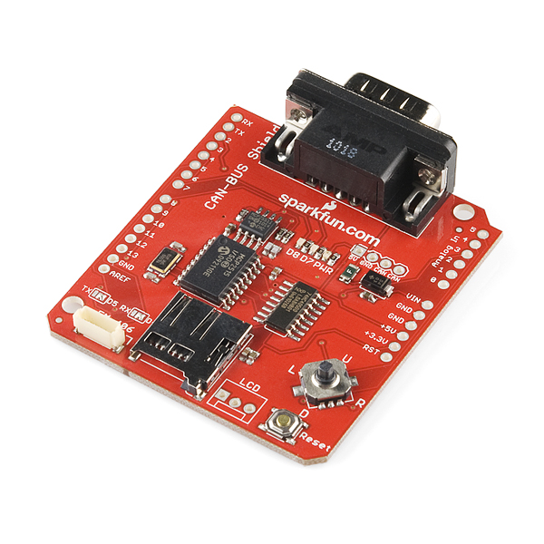
Related work
UAA “CANOPNR” project using Arduino framework
Utilized SIM900 cellular shield to send data to a remote server
GPS module connected directly to CAN board (seen in image below)
MySQL integrated web app was designed to view the data in real-time
Strictly CAN protocol, neglects most vehicles older than 2008
images are CC BY-NC-SA 3.0

Slide 13
OBD II Logger comparison
Device | Stand-Alone | GSM-Enabled | Programmable | GPS | Data Logger | CAN | Approx. Cost (USD)
Bluetooth OBD Scanners |  | √ | √ | √ | √ |  | $150-$500
PC Scan Tools | √ |  |  |  |  | √ | $30-$400
Hem Data Mini Logger | √ |  |  | √ | √ |  | $800-$1500
Car Chip Pro | √ |  |  | √ | √ |  | $305
Data Scout |  |  |  |  | √ | √ | $500
DashDyno SPD ProPack | √ |  |  |  | √ | √ | $320
IOSiX OBD-II Datalogger | √ | Opt. |  | Opt. | √ |  | $700
Arduino/GSM/GPS/OBDII Device | √ | √ | √ | √ | √ | √ | $160

Slide 14
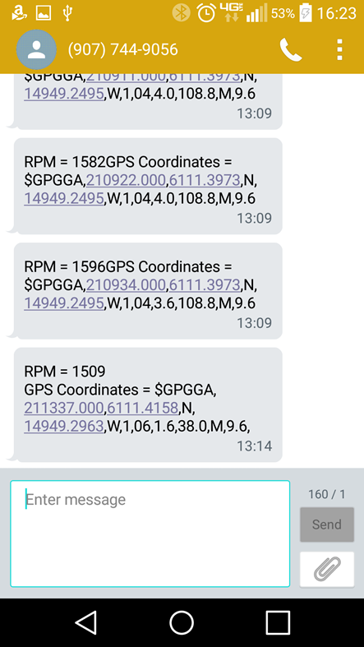
Current Functionality
Capability of relaying an SMS message containing:
Any desired OBDII Data
GPS Coordinates and GMT

Slide 15
Possible Functions
Cold weather oxygen sensor analysis
Closed vs. Open loop oxygen sensor analysis
Determine effect of colder climates on sensor warm-up time
Adaptive maintenance strategies
Conditions in which a failure occur can be collected and used for diagnosis
Vehicle monitoring
Fleet maintenance
Anti-theft device

Slide 16
Any questions?

